Slide 1


Head, Spinal and Pelvis Injuries
Notes:
TIME – 45 MINUTES

Slide 2
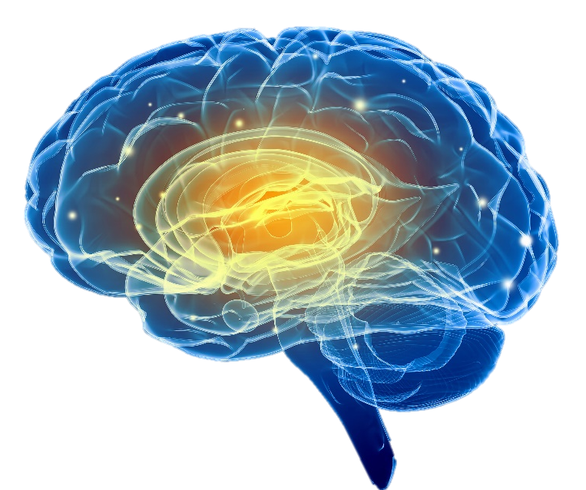
Head, Spinal and Pelvis Injuries
Head and Brain Injuries
Signs and symptoms:
Bleeding
Fluid from ears or nose
Bruising
Black eye(s)
Headache
Confusion
Unresponsive
Decreased LOC
Blank Stare
Vision problems
Signs of shock
Notes:
Always consider the MOI
HEAD INJURIES- Obvious injuries, black eyes, bleeding or fluid from nose or ears. Headache, confusion, decreased LOC, blank stare, vision problems, pain

Slide 3
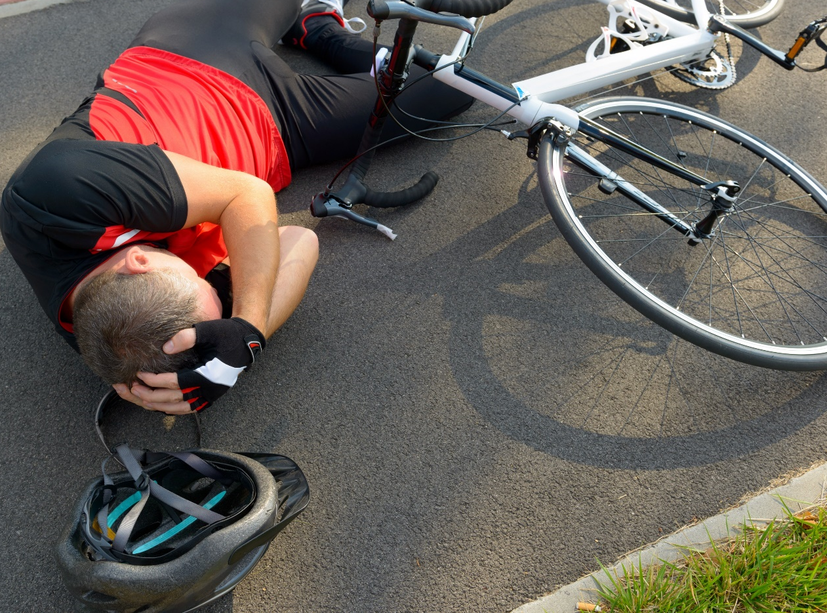
Head, Spinal and Pelvis Injuries
Always consider the MOI
All suspected head and brain injuries should seek medical attention
Notes:
.

Slide 4
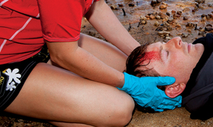
Head, Spinal and Pelvis Injuries
Treatment
Look, Talk, Call, ABC
Tell casualty “DON’T MOVE” and treat for shock
Support neck (if needed)
Notes:
Concussions are very difficult to determine by first aiders so all suspected head or brain injuries should seek medical attention

Slide 5
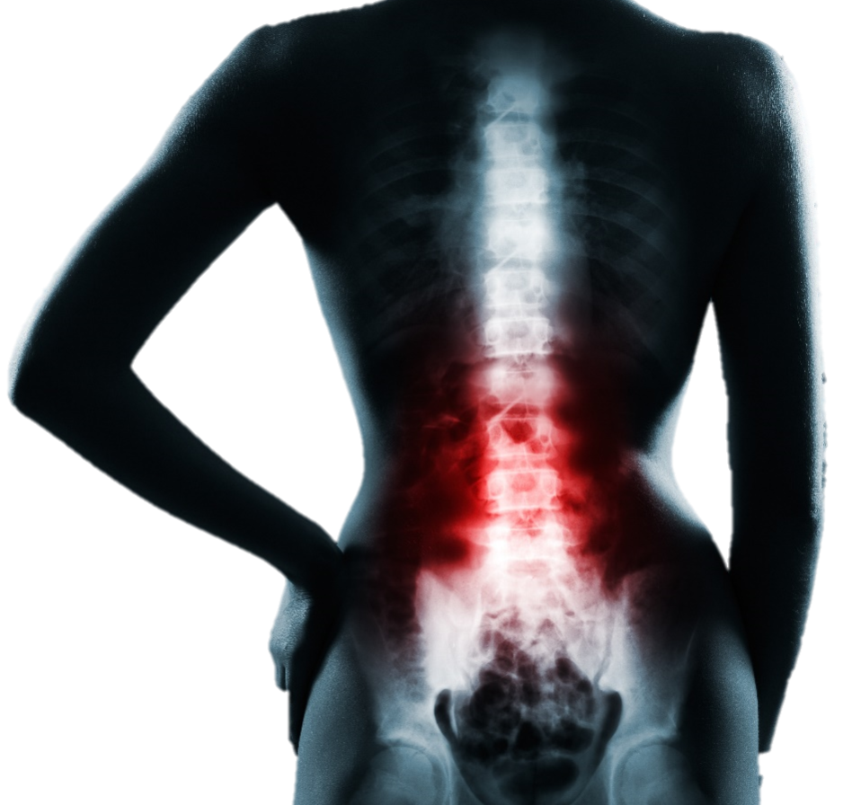
Head, Spinal and Pelvis Injuries
Spinal and Pelvis injuries
Signs and symptoms:
Bleeding
Back pain
Signs of shock
Tingling
Pain in upper thigh
Sound of grating bones
Unable to stand
Numbness
Pain
Unable to move
Notes:
SPINAL – Obvious injuries, pain, paralysis, numbness, tingling, signs of shock, inability to move, unable to stand
PELVIS- Pain and tenderness in pelvic bone area, groin, hip or lower back. Bruising, swelling, numbness or tingling in genital area or upper thighs. Instability of pelvis, sound of bone grating on bone.

Slide 6
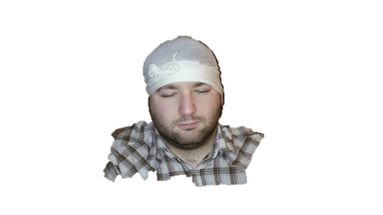
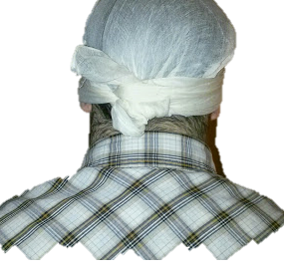
Head, Spinal and Pelvis Injuries
First aid treatment for a scalp or ear wound
Notes:
SCALP: Apply gauze to cover wound and use a triangular as a bandana. Tie a knot at the back of head. Do not tie under chin!
EAR: Apply gauze to wound and use triangular as a bandana or use roller gauze to apply pressure on wound. Ensure bandana or roller gauze is low enough (around eyebrow level and below bump) so bandaging will stay in place.

Slide 7
Spinal and Pelvis Injuries
Treatment
Look, Talk, Call, ABC
Tell casualty “DON’T MOVE” and treat for shock
Stabilize injuries (if needed)
Monitor until EMS takes over

Slide 8
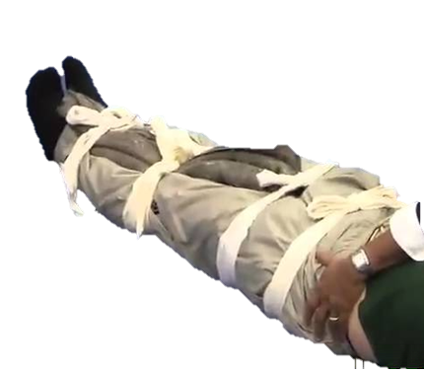
Head, Spinal and Pelvis Injuries
First Aid treatment of possible pelvis injury
Notes:
THINK OF MOI. Remember this may occur during crush injury, long fall over 10 ft, force, being thrown, vehicle, cyclist or pedestrian accidents. Look at positioning of body to help determine. Be a detective. May have back pain, hip pain, pelvic pain or tenderness, instability of pelvis. Organ most often injured is bladder.
TREATMENT- LOOK, TALK, CALL, ABCD. Tell casualty not to move. Place blanket or something bulky between legs to fill any gaps. Use 4 narrow bandages. Slip through under both legs through gap at knee areas. Place just below hip, above and below knees and at ankles. Check CSM before and after. . Tighten in this order. Knees, hips, ankles. Figure of 8.

