Slide 1
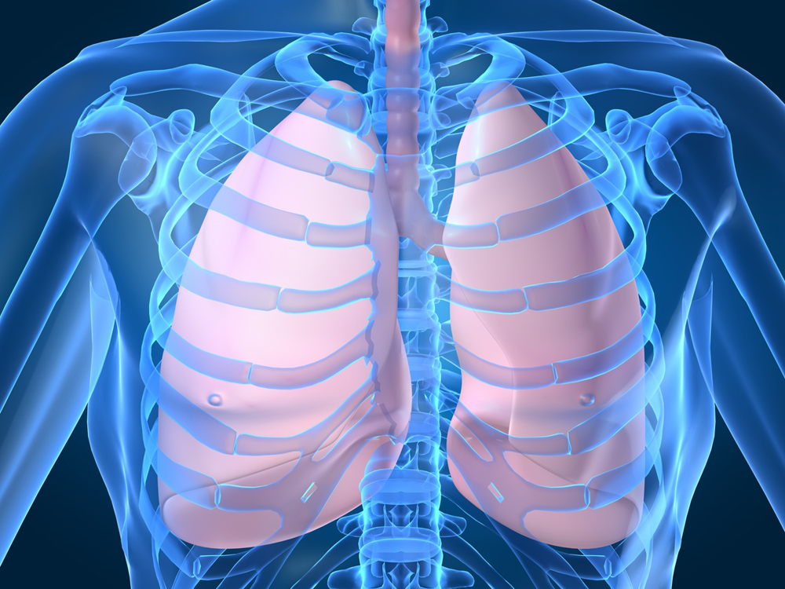
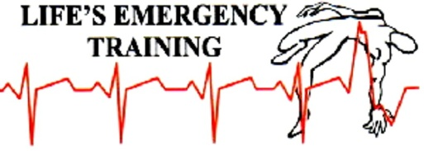
Chest Injuries
Notes:
TIME- 45 MINUTES
CHEST WALL- Ribs, sternum protect internal organs such as heart, lungs, esophagus, major vessels, aorta, superior vena cava.R VENA CAVA WE WILL DISCUSS THREE DIFFERENT TYPES OF CHEST INJURIES:
Penetrating chest injury, fractured ribs, blast injuries.

Slide 2
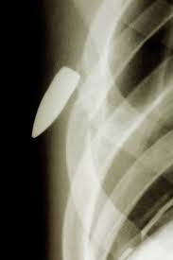
Chest Injuries
First aid treatment for penetrating chest injuries : Look, Talk, Call, ABCD, place in resting position.
Notes:
PENETRATING CHEST WOUND- Something penetrates chest wall. Can cause sucking chest wound. Open pneumothorax. May have chest pain, bleeding, air or bubbling noise at site, difficulty breathing, signs of shock
Air enters through chest wall opening during inhalation and fills up chest in the space between the lining of the lung and the chest wall. Causes increased pressure on lung. Can eventually build up enough to put pressure on major vessels and heart causing shock (tension pneumothorax)
2016 UPDATE TX OF SUCKING CHEST WOUND: Need to cover with a non occlusive material suchc as gauze. If material becomes soaked with blood or fluid change so it does not obstruct chest would
SIGNS AND SYMPTOMS OF TENSION PNEUMOTHORAX: Chest pain, SOB, decreasing LOA, shock, tracheal shift away from injured side. Serious medical emergency!
TX: LOOK, TALK, CALL, ABCD. Have casualty sit or lie with injured side down. Cover, reassure, monitor ABC’s often until EMS arrives.

Slide 3
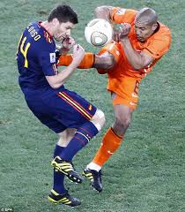
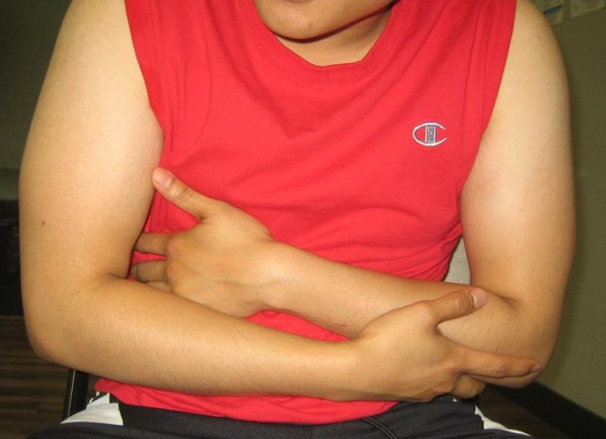
Chest Injuries
Dailymail.co.uk
First aid treatment for rib injuries:
Look, Talk, Call, ABCD, place in resting position.
Notes:
Usually trauma so remember to look for other injuries as well
DISCUSS SIGNS AND SYMPTOMS OF RIB INJURIES;
Pain, bruising, swelling, pain on breathing, guarding area, shallow breathing, MOI
TX- Self-splinting, have casualty apply gentle pressure with blanket or pillow to help limit movement and provide stability.
Use 2 broad bandage triangulars to hold in place. Ensure casualty can still breathe properly. If casualty wants to lie down, position injured side down.

Slide 4
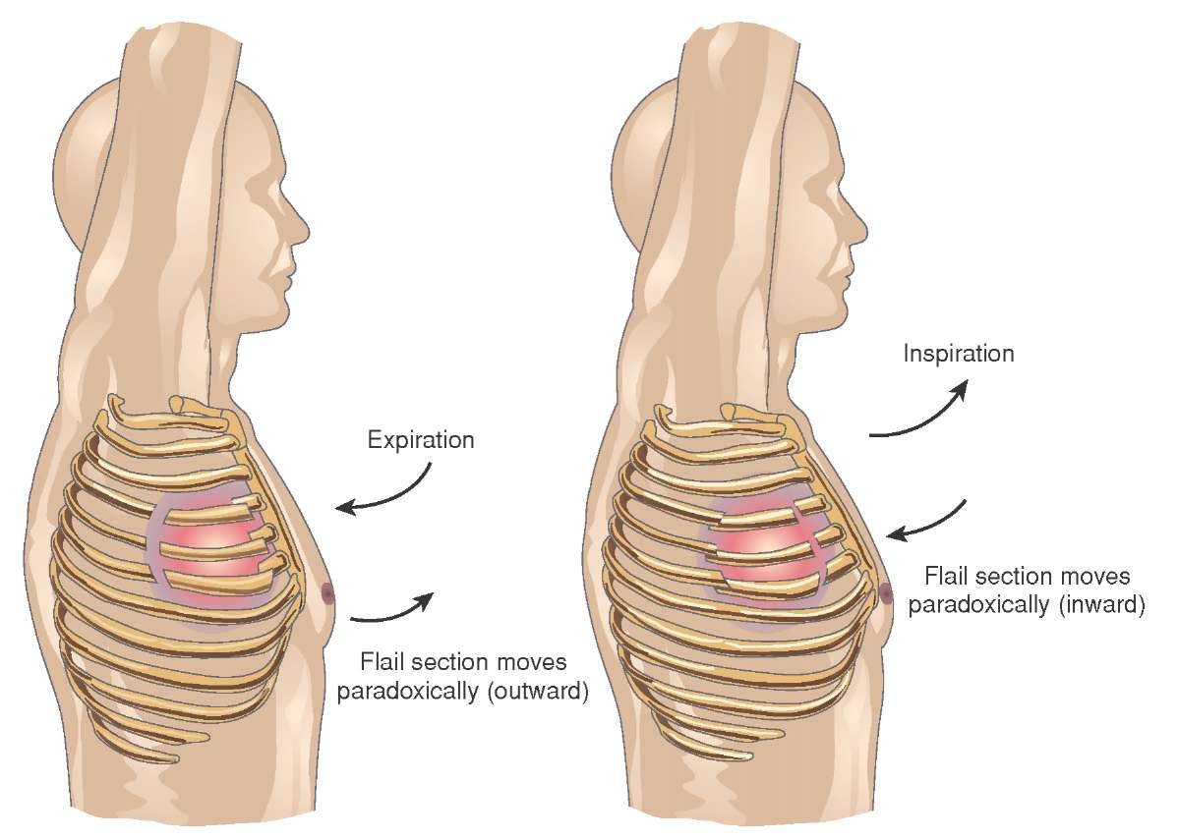
Chest Injuries
Imgkid.com
First aid treatment for flail chest injuries:
Look, Talk, Call, ABCD, place in resting position.
Notes:
FLAIL CHEST:
Two or more ribs broken in two or more places. Creates floating rib section. Causes chest wall instability and paradoxical chest wall movement. Interferes with normal breathing and causes extreme pain and possibility of damaging lung.
SIGNS AND SYMPTOMS: Painful breathing, grating noise when taking breath, shallow breaths
FIRST AID: Have casualty apply gentle pressure with a blanket or pillow to injured section to limit movement and provide stability. Can use triangulars to secure

Slide 5
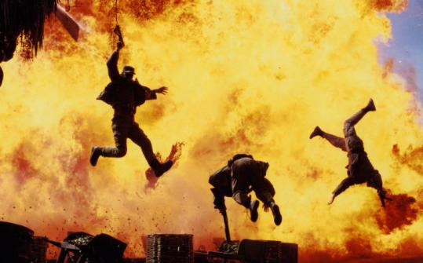
Chest Injuries
brooklynvisualeffects.wordpress.com
First aid treatment for blast injuries:
Look, Talk, Call, ABCD, place in resting position.
Notes:
PRIMARY INJURIES- Caused by blast’s pressure and extreme heat. Causes potential lung damage and damage to other parts of the body. Body parts and organs containing air highly susceptible to damage (GI tract, inner ear, sinuses)
SECONDARY INJURIES: Caused by flying debris injuring the casualty
TERTIARY INJURIES: Caused by force of blast throwing casualty
ORGANS THAT CAN BE AFFECTED: Brain, ears, lungs, heart, digestive tract. Be observant and safety conscious. Look for casualties.
SIGNS AND SYMPTOMS CAN BE NUMEROUS: Multi-trauma
TX: LOOK, TALK, CALL, ABCD. SAFETY! Only approach if it is safe. Tell casualty not to move. Get bystander to support head. Stop life-threatening bleeds. Treat serious injuries first. Reassure, cover, monitor ABC’s frequently until EMS takes over.

