Slide 1
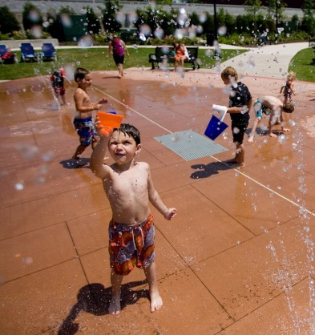
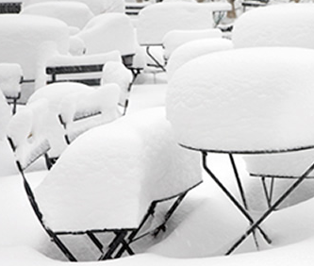

Heat and Cold Injuries
Notes:
TIME: 20 MINUTES

Slide 2
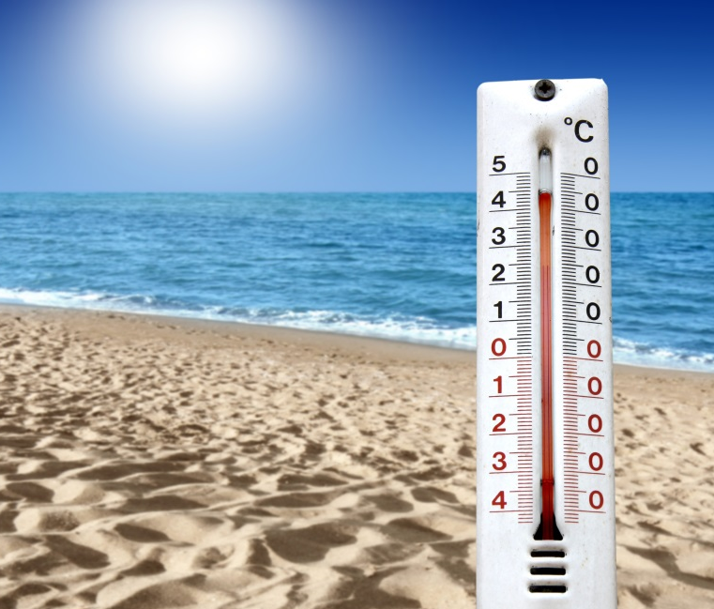
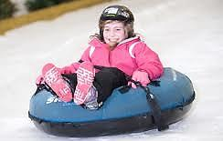
Heat and Cold Injuries
Prevention:
Stay hydrated
Stay dry
Avoid alcohol
Limit time in extreme temperatures
Notes:
Discuss how the body loses heat- Breathing, dehydration, sweating, skin exposure to cold, head, sitting or lying on cold surfaces, wind chill
WAYS TO PREVENT COLD INJURIES: Limit outdoor exposure in extreme weather. Ear appropriate clothing for the weather. Avoid alcohol. Stay hydrated. Wear clothing that wicks away moisture.

Slide 3
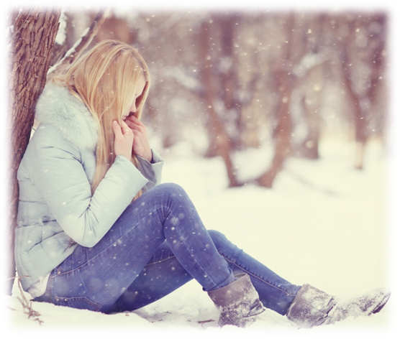
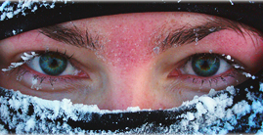
Heat and Cold Injuries
Frost Bite – White and waxy skin, numb, blisters, and becomes painful
Hypothermia – shivering, to no shivering and possible unresponsiveness
Notes:
SIGNS AND SYMPTOMS:
SUPERFICIAL FROSTBITE: Usually affects areas such as nose, chin, ears, fingers and toes. Skin freezes in below 0 celcius weather.
Painful, gray waxy, cold, stiff
DEEP FROSTBITE: Again usually nose, chin, ears, fingers and toes. Skin freezes in below 0 celcius.
Gray and waxy looking skin. Cold to touch. Not painful, no feeling. Blisters when rewarming. Gets painful on rewarming
HYPOTHERMIA: Body is unable to produce body heat as quickly as it loses it. Body’s circulation slows down
MILD HYPOTHERMIA: Shivering, confusion, problems speaking
MODERATE HYPOTHERMIA: Decreased LOC, shivering slows down or stops. This stage may not last long.
SEVERE HYPOTHERMIA: Shivering stops. Casualty becomes unresponsive. May be difficult to recognize if casualty is breathing. Breathing is very slow.
FROZEN STATE: Cold, whole body stiff, body moves as one, unresponsive, not breathing.

Slide 4

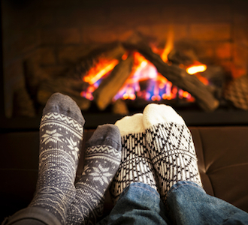
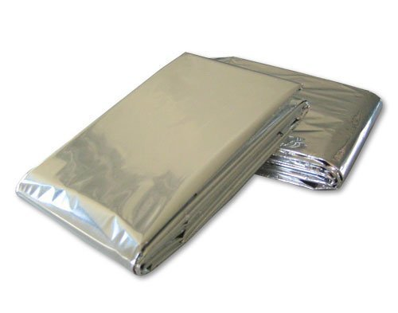
Heat and Cold Injuries
First Aid Treatment
Notes:
Superficial Frostbite TX: Get indoors or to a warm place. Re-warm exposed areas with your own body heat or warm water.
Deep Frostbite TX: Warm place. Do not rub frozen areas. Remove jewelry in affected areas. Rewarm slowly. Do not allow to refreeze. Place gauze between fingers or toes to absorb moisture and prevent skin sticking. Will become painful when blisters appear. Seek medical help
TX FOR MILD & MODERATE HYPOTHERMIA: Get into warm area. Remove and replace wet clothing. Warm with blankets and warm sugary drink. No alcohol
SEVERE HYPOTHERMIA: Get into warm area. Remove and replace wet clothing. Warm with blankets. If unresponsive, check for breathing for a longer time. Pulse check 30 seconds. Handle as gently as possible. Reassure, cover, monitor, CPR if needed.
Frozen State TX: Look, Talk, Call, ABC. Do not start any TX. Wait for EMS. Will be medically rewarmed over an extended period of time before life status decision is made.

Slide 5
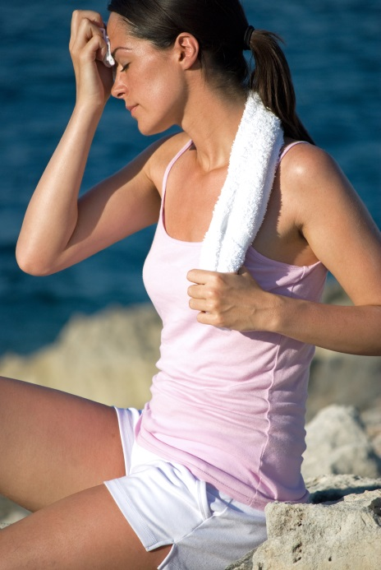
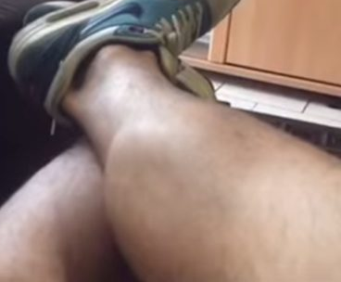
Heat and Cold Injuries
Heat cramps – painful muscle spasms
Exhaustion – headache, nausea and stomach cramps
Heatstroke – Flushed, hot with either dry or sweaty skin
Notes:
CAUSES OF HEAT INJURIES- High indoor or outdoor temp. High humidity. Inappropriate clothing. Types of activities.
PREVENTION OF HEAT INJURIES- Sunscreen, hat, hydration before & after activities. Cooler environment when extremely humid, hot or poor air quality outside.
HEAT CRAMPS : Due to activity and dehydration. Leg or abdominal cramps, heavy sweating, thirsty
HEAT EXHAUSTION: Due to dehydration & activity. Sweating, slightly warm to touch, headache, nausea, vomiting, diarrhea, weak or tired.
HEAT STROKE: Body’s inability to cool itself. Hot, dry, flushed, confused, staggering.
CLASSIC: Due to dehydration and staying in extremely hot environment.
EXERTIONAL: Typically outdoor workers or those exercising in heat. May be hydrating but unable to cool themselves due to outdoor temp. Usually occurs in a few hours or within a day.

Slide 6
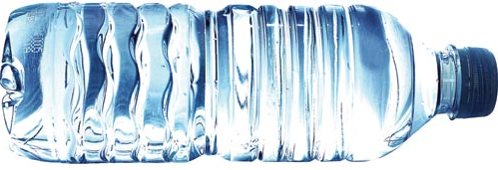
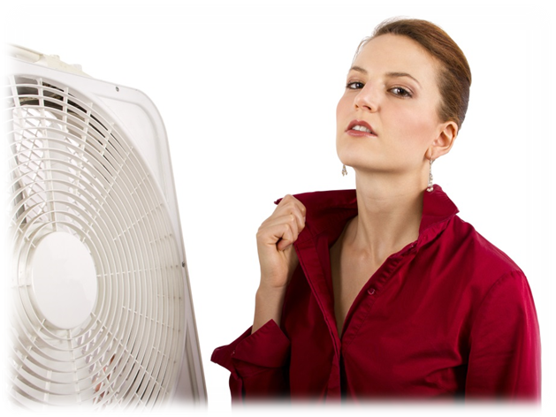
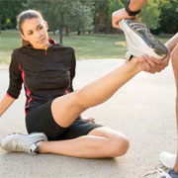
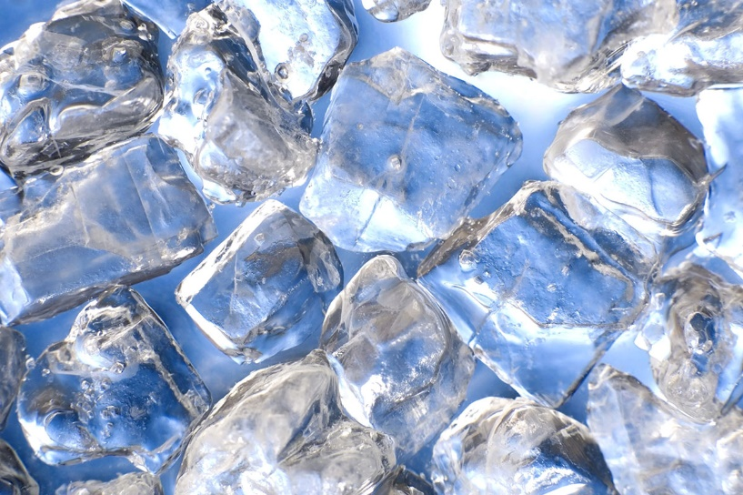
Heat and Cold Injuries
First Aid Treatment
Notes:
HEAT CRAMPS TX: Move to cool area. Have casualty stretch out cramp and rehydrate
HEAT EXHAUSTION TX: Move to cool area. Remove excessive clothing, lay casualty down, cool using cool cloths, misting and fanning. Offer sips of room temp water to rehydrate. No improvement in 30 minutes Seek medical help
HEAT STROKE TX: Cool casualty as quickly as possible using ice packs at neck, arm pits and groin where arteries come close to skin surface.
If large body of water is available, immerse the casualty if responsive and alert. Medical help.

