Slide 1
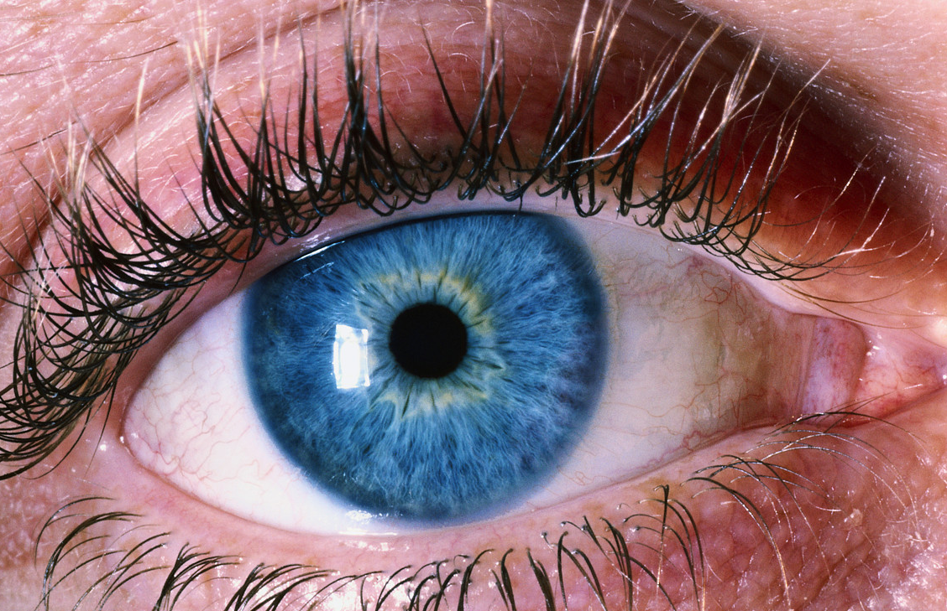

Eye Injuries
Notes:
TIME – 20 MINUTES
DISCUSS ANATOMY OF THE EYE
Pupil, iris, sclera, cornea, behind the eye- retina, optic nerve.

Slide 2
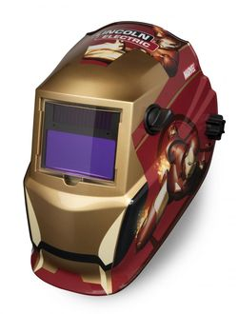
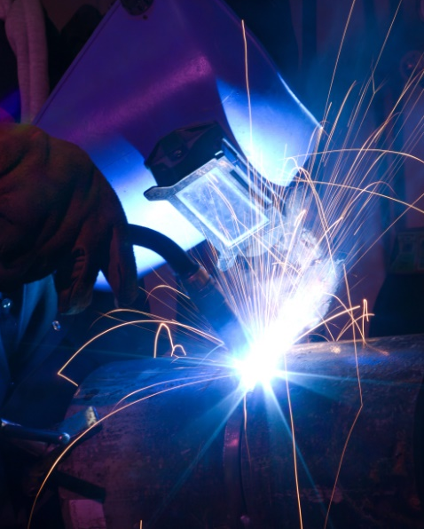

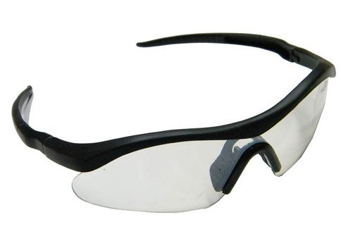
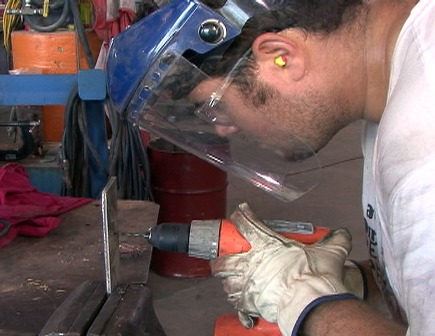
Eye Injuries
Notes:
PREVENTION: Use eye protection at work or home when there may be flying debris or when there is bright light (welding, sun)
Keep all safety guards on machinery. Be trained on using machinery before using it. Keep a clear area around your working area to minimize accidents.
Use Safety glasses!
If injury is minor, attempt to examine eye. Always wash hands or wear gloves. Support casualty’s head. Lying down if possible.
INJURY COULD BE CAUSED BY:
LOOSE PARTICLES/DEBRIS
S&S: Red, tearing, pain, poor vision
FIRST AID: Have casualty attempt to remove particle only if can be seen. Have casualty pull upper lid down over lower eyelid. Wipe lower eyelid with clean cloth. Rinse for 5-10 mins or until vision clears. Do not attempt to remove an embedded object, anything on the centre (cornea) or stuck to the eyball.YEBALL
INTERNAL BLEEDING: BRUISING AROUND EYE-If vision clear, apply cold to bruised area
EXTERNAL BLEEDING: Use gauze pads and direct pressure. If minor wound, ensure vision clear. More serious go to hospital.
STUCK TO EYEBALL OR EMBEDDED IN EYEBALL: Place bulky material around object (roller gauze) to limit movement. Cover both eyes to limit movement and further damage to eye.
EMBEDDED OBJECT AROUND EYE AREA: SAME
EXTRUDED EYEBALL: A lot of force required. Suspect head/spinal. Do not attempt to place it back in. Cover with empty paper cup. Tape cup in place on face. Have them close their eyes and cover uninjured eye to minimize movement and prevent further injury.

Slide 3
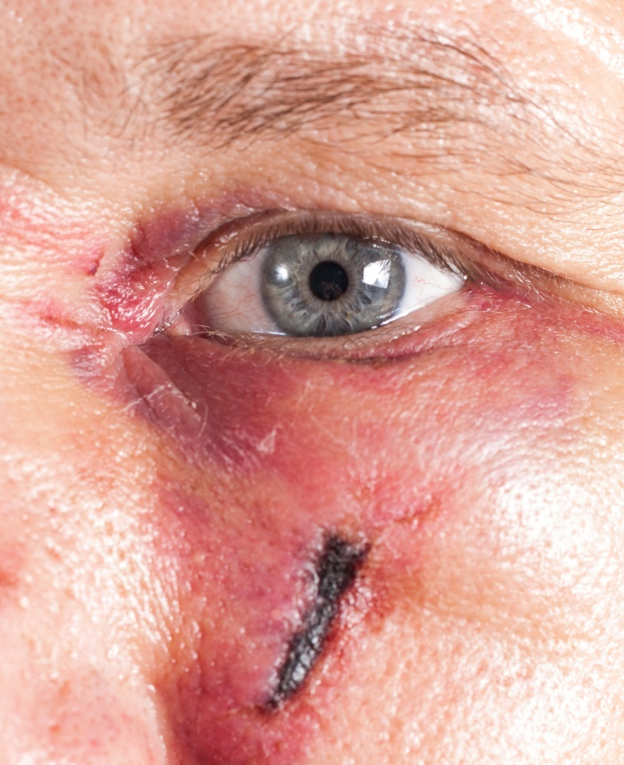
Eye Injuries
First Aid Treatment
Apply ice to face area
Never apply pressure to eyeball
Never replace dislodged eyeball
Notes:
INJURY COULD BE CAUSED BY:
LOOSE PARTICLES/DEBRIS
S&S: Red, tearing, pain, poor vision
FIRST AID: Have casualty attempt to remove particle only if can be seen. Have casualty pull upper lid down over lower eyelid. Wipe lower eyelid with clean cloth. Rinse for 5-10 mins or until vision clears. Do not attempt to remove an embedded object, anything on the centre (cornea) or stuck to the eyball.
INTERNAL BLEEDING: BRUISING AROUND EYE-If vision clear, apply cold to bruised area
EXTERNAL BLEEDING: Use gauze pads and direct pressure. If minor wound, ensure vision clear. More serious go to hospital.
STUCK TO EYEBALL OR EMBEDDED IN EYEBALL: Place bulky material around object (roller gauze) to limit movement. Cover both eyes to limit movement and further damage to eye.
EMBEDDED OBJECT AROUND EYE AREA: SAME
EXTRUDED EYEBALL: A lot of force required. Suspect head/spinal. Do not attempt to place it back in. Cover with empty paper cup. Tape cup in place on face.

Slide 4
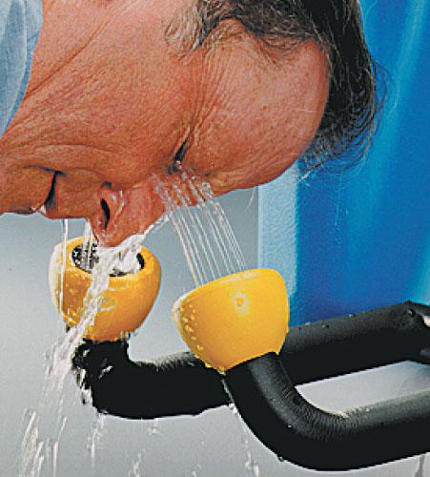
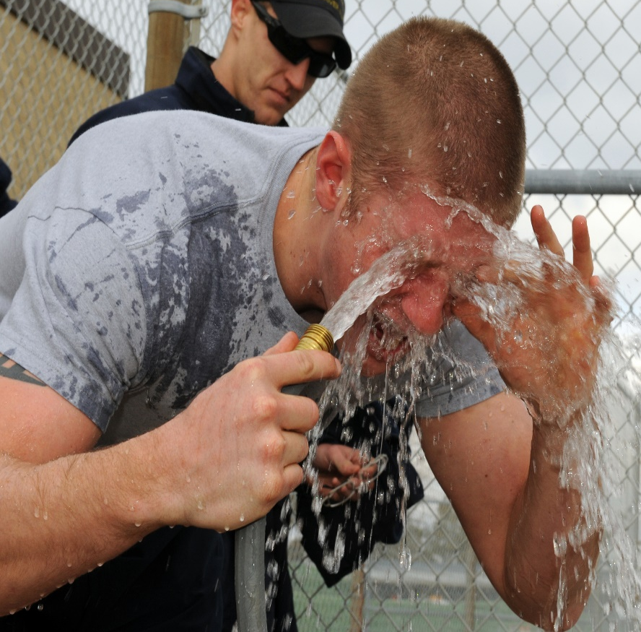
Eye Injuries
First Aid Treatment
Notes:
BURNS: From Chemicals and Welding torches
CHEMICAL:
S&S: Painful, tearing, unable to open eye
CHEMICALS: Remove excess chemical with gloved hand. For dry or liquid, rinse affected eyes in room temp water for 15-20 mins. Assist casualty to keep eyelid open for this. Cover both eyes gently with moist gauze. Take MSDS to hospital
WELDING: Welder’s flash can damage eyes. Wear proper eye protection. Have casualty sit down. Cover both eyes with cool, moist cloths. Change the cloths often to maintain cool temp for best pain relief. Get medical help.

Slide 5
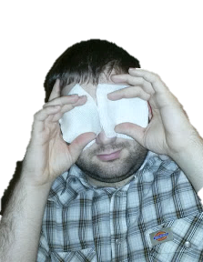
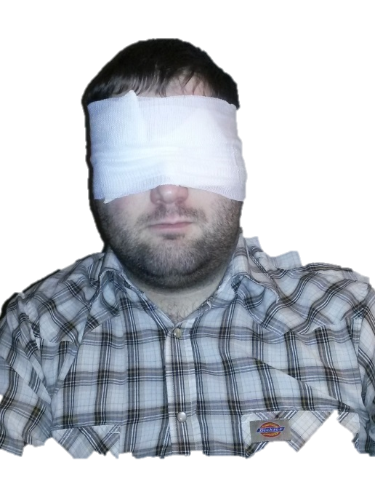
Eye Injuries
First Aid Treatment
Always use moist gauze if directly on eye
Attempt to cover both casualty’s injured and uninjured eyes
Notes:
Have caualtyclose their eyes and cover uninjured eye to minimize movement and prevent further injury.

Slide 6


Eye Injuries
Notes:
WHMIS training from 1988 until February 2015. The transitional information is known as WHMIS 2105 until June 2017 to ensure WHMIS 2015 is taught a combination of WHMIS and GHS. Starting in June 2018 until Dec 1 2018 the final phase is brought in when call Canadian employees must be trained in WHMIS 2015 that includes GHS

