Slide 1
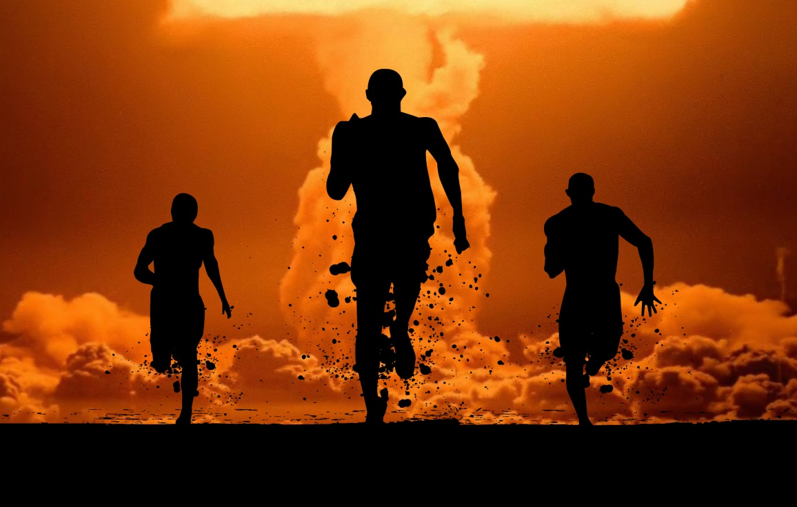

Multiple Casualty Management
Notes:
TIME – 60 MINUTES

Slide 2
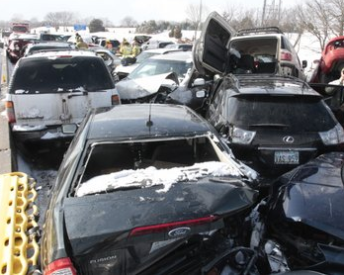
Multiple Casualty Management
Triage is used when there are more casualties than first aiders.
First aiders must triage casualties (to sort by priority).
Notes:
Discuss situations where you may have more casualties than first aiders.
TRIAGE- “To Sort” To ensure all casualties are treated in a timely manner based on the severity of their injuries.
Sorts into 4 categories treating most serious to least serious.
Spends no more than 5-15 seconds assessing for priorities.
No tx at this time. Count # of casualties. Keep a list if you can of # of casualties and number in each category
Can be overwhelming. Use systematic approach.

Slide 3
Multiple Casualty Management
Triage priorities:
1st Priority – casualty’s with A, B, C difficulties and lightning strikes
2nd Priority – casualty’s with major fractures (back, femurs)
3rd Priority – casualty’s with minor cuts, bruising or minor fractures
4th Priority – casualties that require CPR or trapped
Notes:
PRIORITY 1- Need medical tx immediately.
PRIORITY 2- Can wait up to one hour for tx and delay will not worsen injury
PRIORITY 3- Can wait approximately 3 hrs for tx and delay will not worsen injury
PRIORITY 4- Not injured, slightly injured or unlikely to survive due to their injuries. Unresponsive and not breathing casualties.
Examples: casualties who are trapped, crushed or impaled. Unresponsive, not breathing
Exception: Unresponsive, not breathing due to lightning strike (priority1). Usually in VF, high survival rate with defibrillation

Slide 4
Multiple Casualty Management
Look, for hazards, MOI and determine the number of casualties
Talk, calling out to walking wounded and gather in safe location then go to the remaining casualties spending no more than 10-15 seconds to find out what injuries they have
DO NOT perform any first aid at this time
Call, 911 and answer all the 911 dispatchers questions
Notes:
Information to report to 911 or EMS/Fire on their arrival:
Dangers, safety issues
Special circumstances: people trapped or impaled
# of injured
Is everyone accounted for?
Who are the immediate priorities.
Follow direction by paramedics on scene

Slide 5
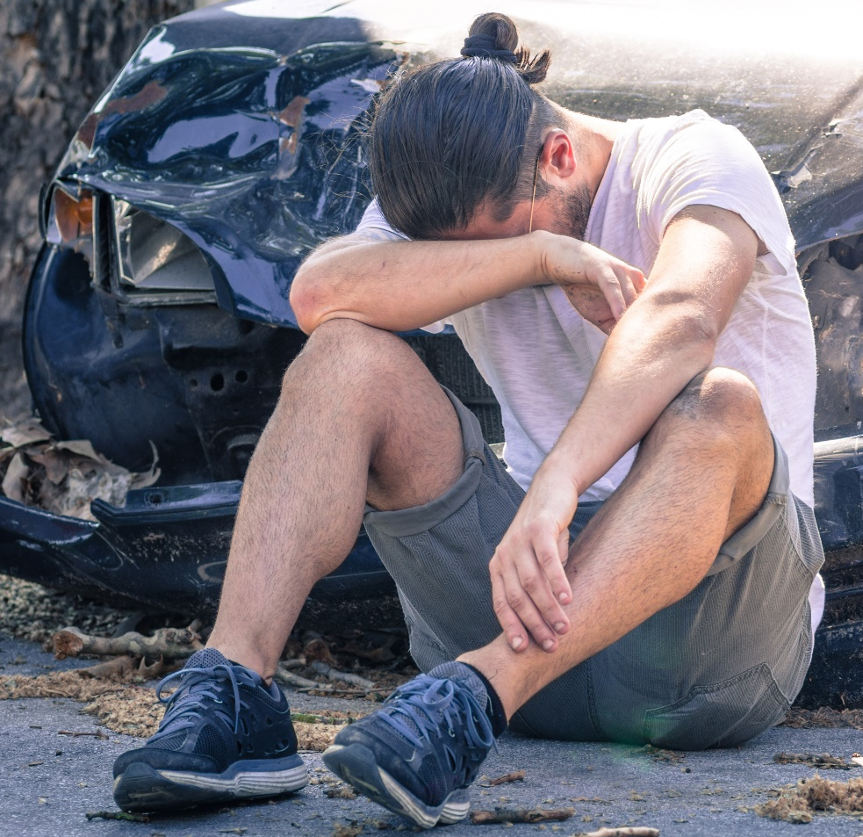
Multiple Casualty Management
Ensure you keep in constant contact with walking wounded
Start first aid treatment on remaining casualties
Reassess casualties injuries often and adjust priority first aid treatment as needed
Delegate any other first aiders or bystanders to assist you

Slide 6
Multiple Casualty Management
Scenario
Notes:
SCENARIO:
A small school bus and a mid-sized car collide. There are 4 casualties in total inside both vehicles. You are by yourself and there are no homes in sight.

Slide 7
Multiple Casualty Management
Bus driver – trapped, unresponsive and not breathing
Car driver – lying in field, unresponsive and not breathing
Small child – crying in car seat
Passenger – walking in field
Notes:
IN A GROUP DISCUSS AND REPORT THE STEPS YOU WOULD TAKE.
Safely park your own vehicle. Gather cell phone and first aid kit.
Continually check for hazards as you approach the vehicles. (None found)
In the bus you only find the driver who is unresponsive and not breathing. He is also trapped because of steering wheel. No one else on bus.
As you approach the car that is halfway down a culver, you hear a small child screaming. You now see that the car’s driver was thrown from the car into the field. She is unresponsive and not breathing.
You hear something and see the car’s passenger wandering in the field and they don’t respond when you call to them.
DISCUSS AND PRIORITIZE

Slide 8
Multiple Casualty Management
Scenario Answers

Slide 9
Multiple Casualty Management
Answers
1. Walking wounded
2. Crying baby
3. Cardiac arrest in field
4. Cardiac arrest trapped in bus
Notes:
Discuss if the car passenger had been in the car with the baby and initially appeared okay….how would this change your prioritization?
Answer: No priority one is cardiac arrest in field.
Why? Because alert and seemingly “ok” passenger can monitor baby and self, while you provide CPR on casualty in field.
You start CPR on the casualty in the field. Call out to check on the car’s passenger and baby. He/she does not respond verbally anymore. What should you do?
Answer: Stop CPR and check the passenger who is now not responding verbally.

