Slide 1


Poisons
Notes:
TIME: 30 MINUTES
Poisoning occurs when any substance enters the body in greater amounts than the body can handle or are extremely toxic
DISCUSS EXAMPLES- Meds, alcohol, gases, cleaning products, plants. Products may have labels as in meds, cleaning products, workplace products etc. Or may not have labels….plants, gases
PREVENTION: Keep poisons in a high level, locked cabinet. Child safety locks. Keep all chemicals in original containers, properly marked.
Do not use common containers to store poisons in. Ex: windshield washer fluid in old pop bottle. Learn and teach others poison symbols on labels. Read MSDS. Take WHMIS Training.

Slide 2

Poisons
Notes:
WHMIS 2015 training need to be updated by June 1 2018 to include GHS information Read MSDS. Take WHMIS Training.

Slide 3
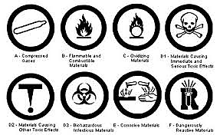
Poisons
Absorbed – Inhaled – Ingested – Injected
Notes:
DISCUSS HOW POISONS CAN ENTER BODY.
Absorbed: Through skin (poison ivy)
Inhaled: Into lungs (gases)
Ingested: Into stomach (eaten)
Injected: Into body (drugs, bee stings, snake bites)
DETERMINE SEVERITY CONSIDER SEVERAL FACTORS:
Type, amount, strength, how long ago, age & weight of casualty, what route, toxicity.

Slide 4
Poisons
Look, Talk, ABCs. Call 911 if any difficulties with:
Safety
Airway
Breathing
Circulation

Slide 5
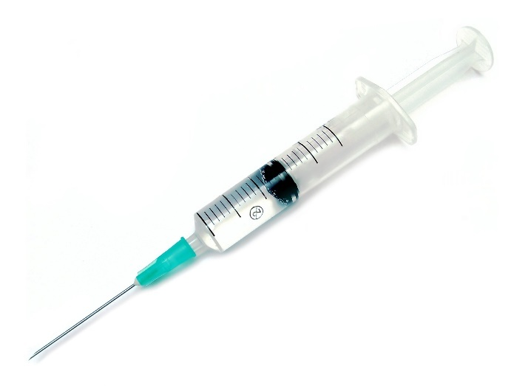

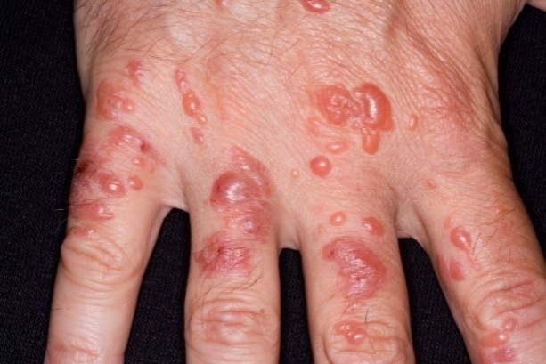
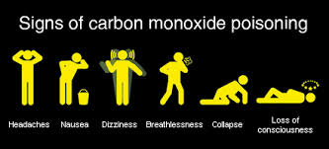
Poisons
Look, Talk, Call, ABCs.
Call 911 or seek medical attention if needed.
Notes:
Hand blistered from poison ivy, poison berries CO warning signs

Slide 6
Poisons
Treatment
Absorbed Poisons
Call 911 if any problems with casualty’s ABC’s
Flush contaminated area with water.
Inhaled Poisons
Do not enter area if unsafe or problems with casualty's ABC’s call 911. If safe open windows and doors and get casualty out of area.
Notes:
ABSORBED: IE Poison Ivy
S&S: Redness, hives, swelling, blisters, painful and itchy TX: Flush area for 10-15 mins, seek medical attention if needed
INJESTED: Something eaten or drank S&S: Pain, burning, coughing, stomach pain, vomiting
TX: If responsive- Call Poison Control. If unresponsive, place in recovery position on left side (slows rate of absorption). Monitor until EMS arrival.
Never induce vomiting or dilute with milk or water unless directed to do so by Poison Control
INHALED: Gases like ammonia, carbon monoxide S&S: Difficulty breathing, nausea, vomiting, decreased LOA
TX: If safe, open window, ventilate area, remove casualty from area, monitor ABCs until EMS arrival

Slide 7
Poisons
Treatment
Ingested Poisons
Do not induce vomiting or dilute with fluid.
Call 911 if any problems with casualty’s ABCs
s unless directed by Poison Control.
Injected Poisons
Call 911 if any problems with casualty’s ABCs
If no obvious signs or symptoms call Poison Control
Notes:
INJESTED: Something eaten or drank S&S: Pain, burning, coughing, stomach pain, vomiting
TX: If responsive- Call Poison Control. If unresponsive, place in recovery position on left side (slows rate of absorption). Monitor until EMS arrival.
INJECTED: Insect sting, drugs, snake bite
S&S: Redness, swelling, itchy, painful at site. May go into shock, have difficulty breathing. BREATHING
TX: Recovery position, reassure, cover, monitor ABCs until EMS arrival.
Only call Poison Control if no problems with ABCs.

Slide 8

Poisons
Call Poison Control
Notes:
Only call Poison Control if no problems with ABCs.

Slide 9
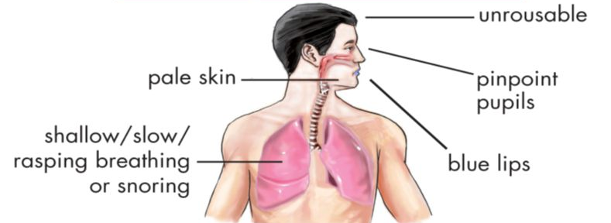
Poisons
Opioid Overdose
Signs and symptoms
Notes:
Opioids made from poppy aka heroine, morphine, codeine, oxy, fentanyl and many street names

Slide 10
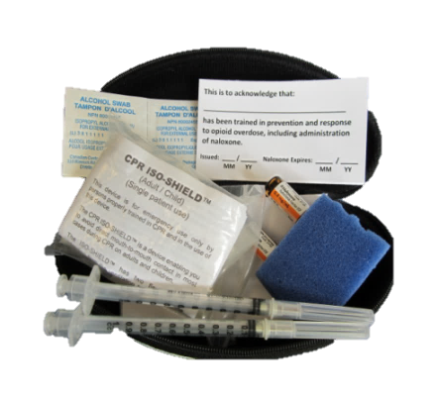
Poisons
Opioid
Prevention
Kit
Notes:
This is for information only. First Aiders that are not trained do not need to get involved with drug administration only first aid treatment.
Naloxone is man made drug found in opioid prevention kits. Can be syringe or as of July 2106 a nasal spray.

Slide 11
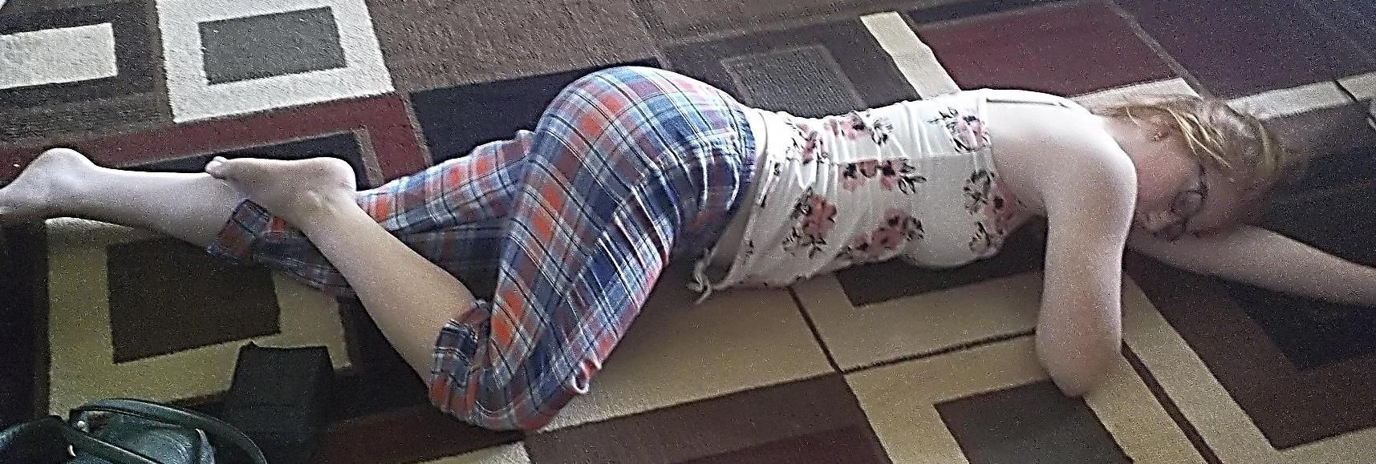
Poisons
First Aid Treatment
Look Talk, Call, ABC’s
Recovery position and monitor breathing
Notes:
People can wake violent from naloxone treatment
place on left side if possible
monitor breathing start CPR if needed

