Slide 1
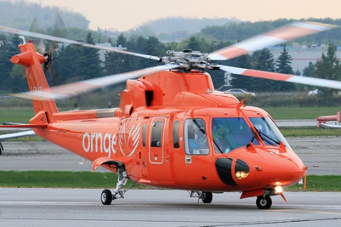

Rescue Moves
Notes:
TIME- 30 MINUTES

Slide 2
Rescue Moves
Leave casualty rescues moves to the professionals unless:
The casualty is in danger
You are in an extremely remote location
First aiders safety is the first priority
Be honest in how much you can lift
Use a firm footing, wide stance, lift with your legs and keep your back straight

Slide 3
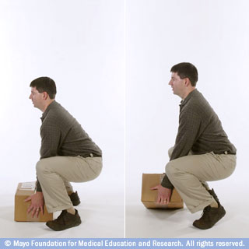
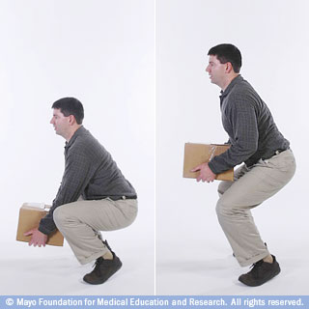
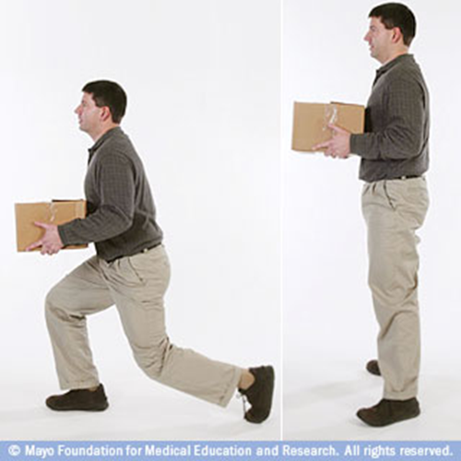
Rescue Moves
Notes:
DEMONSTRATION OF PROPER LIFTING TECHNIQUES
In a situation where the casualty’s life would be at risk if left in position found and must be moved.
Blanket Roll – Roll casualty onto a strong blanket and use the shoulders or foot end to drag the casualty away from danger. Good for short distances.
Discuss how you could move a casualty when it is safe to do so at work- rolling office chair

Slide 4
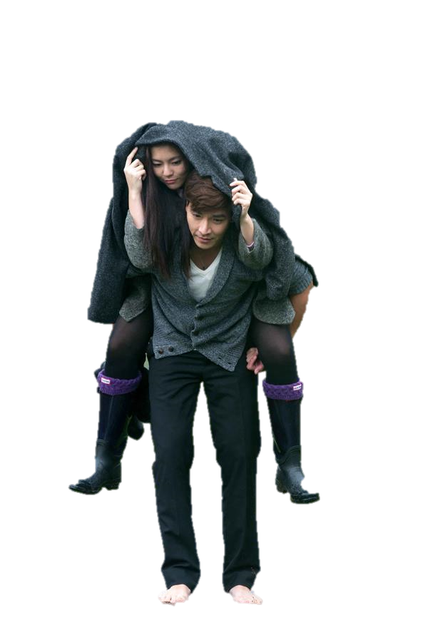
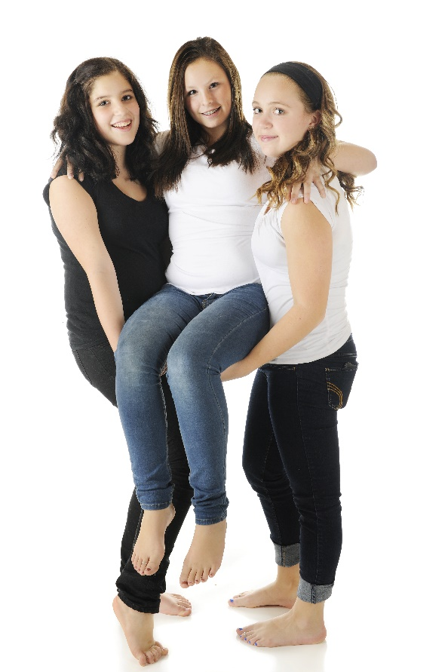
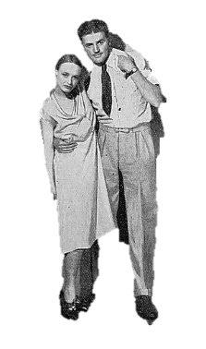
Rescue Moves
Notes:
BACKPACK CARRY> CASUALTY OVER YOUR SHOULD IF INJURIES ALLOW
2 PERSON ASSIST: ONE FIRST AIDER ON EITHER SIDE OF CASUALTY. CASUALTY’S ARMS OVER FIRST AIDER’S SHOULDER
HUMAN CRUTCH: TAKE ONE OF CASUALTY’S ARMS AND PUT IT AROUND YOUR SHOULDER, PLACE YOUR OTHER ARM AROUND THE CASUALTY’S WAIST
2 PERSON CHAIR LIFT- GOOD IF GROUND IS FLAT. ONE FIRST AIDER ON EITHER SIDE. CASUALTY PLACES ONE ARM OVER EACH SHOULDER. EACH FIRST AIDER PLACES OTHER HAND UNDER CASUALTY CREATING A SEAT

Slide 5
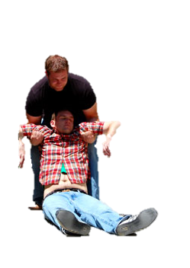
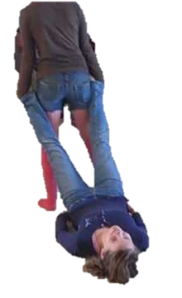
Rescue Moves
Blanket Drag
Notes:
Drag Carry Shoulders- Lift casualty under armpits and use lower arms to support head. Walk backwards to pull to safety.
Feet- Grab both ankles of casualty and pull while walking backwards. Hopefully on smooth and even ground.

Slide 6
Student Performance
1. Have the students pair up and assist a simulated casualty by using a human crutch rescue move.
Notes:
Casualty sitting on ground with an injured knee.
Have first aider assist casualty from injured side. Ensure first aider bends knees firmly, keeps both feet on ground and assists casualty to stand using their legs, not their back. Have them assist for approx 10 meters

