Slide 1
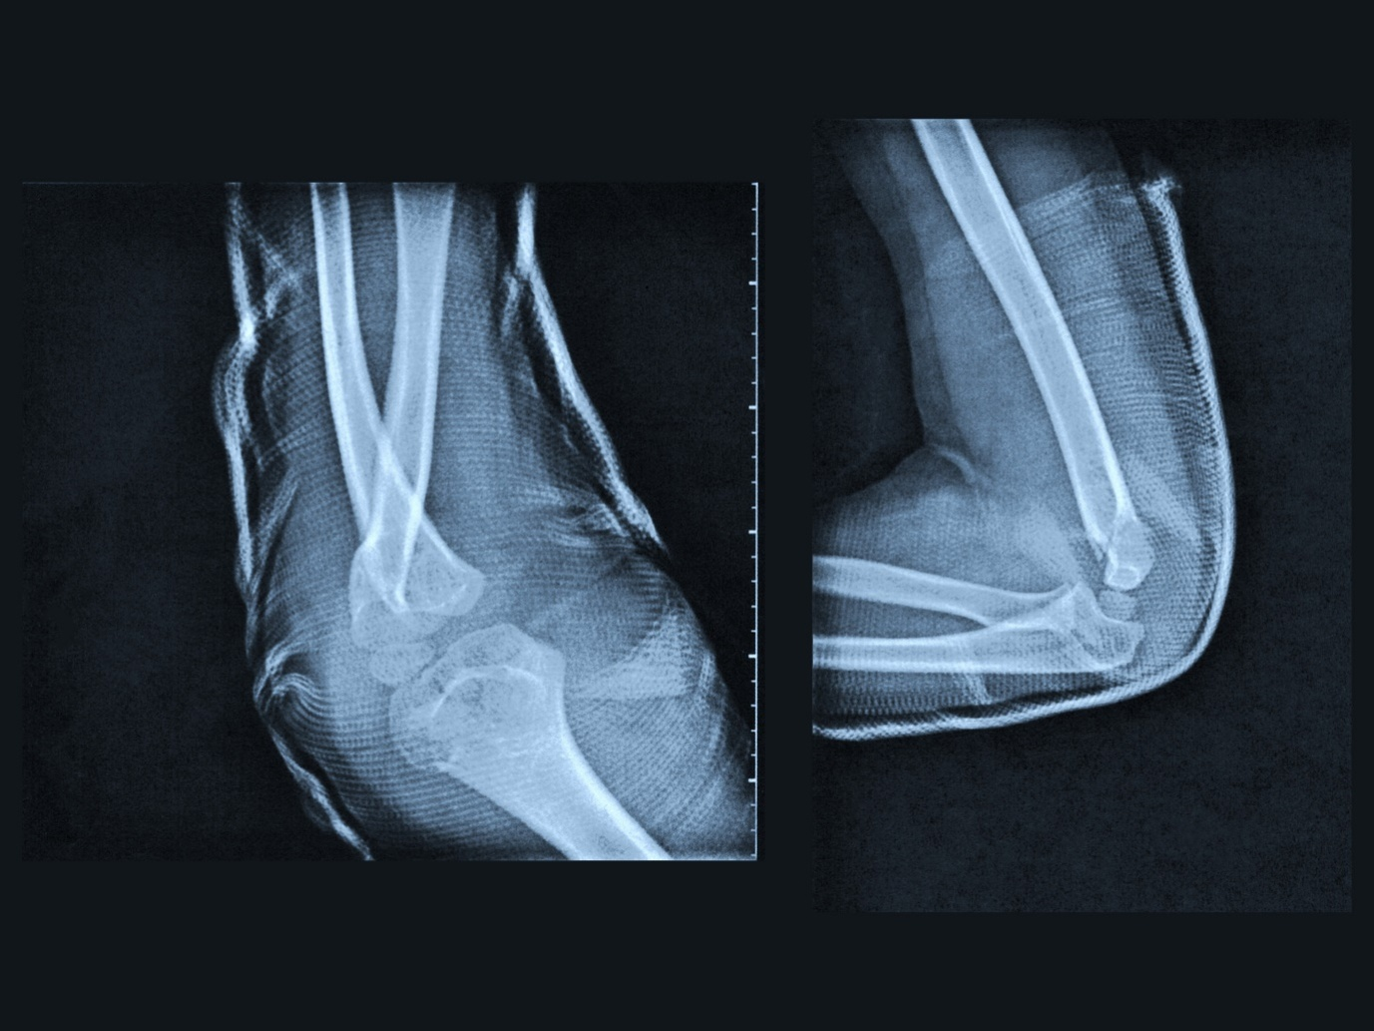
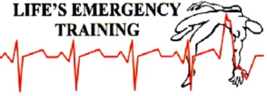
Bone and Joint Injuries
Notes:
OBJECTIVES: TIME: 60 minutes
First Aider to recognize signs and symptoms of bone, joint and muscle injuries and apply the first aid treatment for all of them,
THE HUMAN SKELETON Is composed of both fused and individual bones, supported by ligaments, tendons, muscles and cartilage.

Slide 2
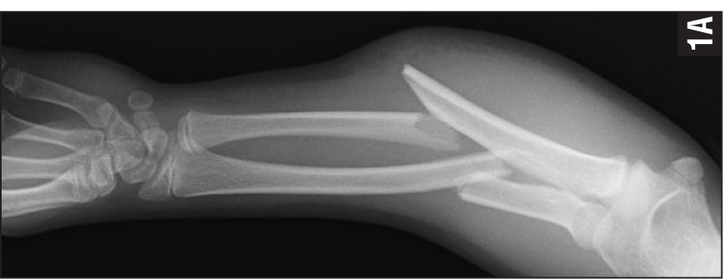
Bone and Joint Injuries
Open or Closed Fracture - a break or crack
Joint - two bones meet
Dislocation – separated joint
Sprain – over stretch or tear of ligament
www.healio.com
Notes:
JOINTS: Bones can move because of the way they are joined together. Where two bones come together is a JOINT. Held together by strong bands of tissues called ligaments.
TENDONS: Tough, flexible bands of fibrous connective tissues that connects muscles to bones
LIGAMENTS: Connect bone to bone
STRAIN -A stretched or torn muscle or tendon. Tendons connect muscle to bone.
SPRAIN- A stretched or torn ligament. Ligaments connect bones at a joint.

Slide 3
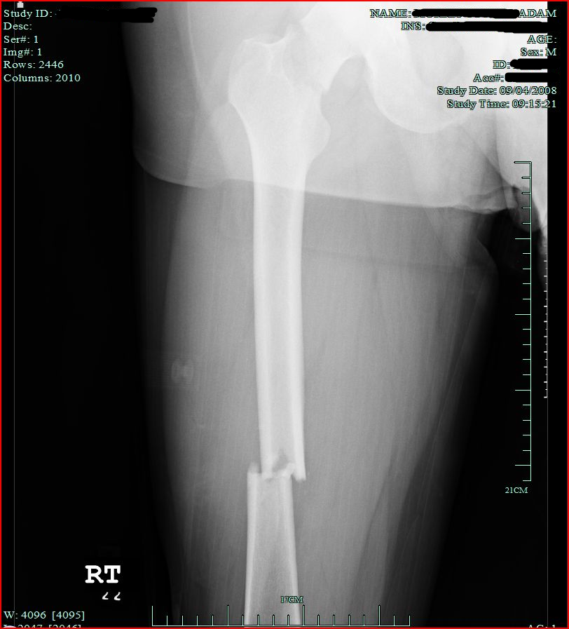
Bone and Joint Injuries
Open (compound) fracture – fracture that broke skin
Closed fracture – fracture that didn’t break the skin
Femur fracture – extremely painful and lots of blood loss
Notes:
FEMUR # - Serious. Amount of force required must lead you to suspect multiple injuries as well. Blood loss within thigh can be up to 1 – 1 .5 litres. Casualty can go into shock.
SIGNS AND SYMPTOMS OF FEMUR FRACTURE:
DOTS,
D – deformity
O – open wounds
T – tenderness
S - swelling
extreme pain, bruising, shortening of affected leg length and external rotation of foot

Slide 4
Joint and Bone Injuries
Remember to always consider the M.O.I. and:
Signs and symptoms
Unable to stand
Guarding
Outward turned foot (femur)
Leg shorter than other (femur)
Bruising
Extreme pain
Unable to weight bear (pelvis)
D. O. T. S.
Notes:
May have swelling, unable to use limb, stiffness, numbness, sound/feel of bone grating on bone
Deformity due to fracture or dislocation

Slide 5
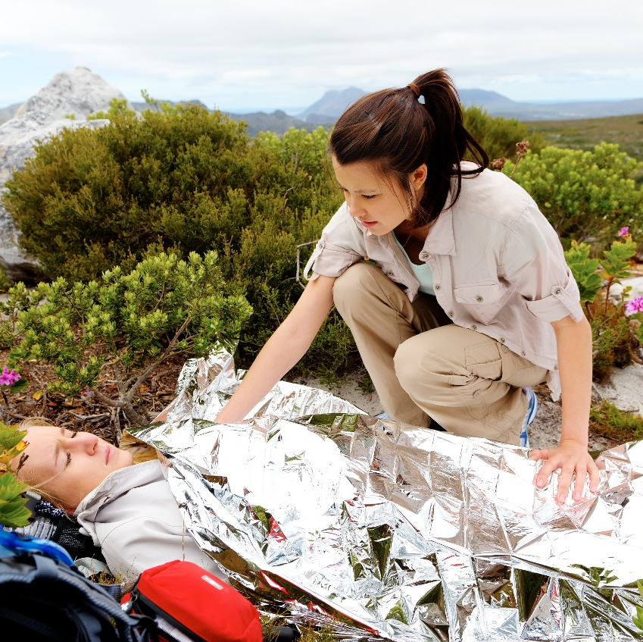
Bone and Joint Injuries
Treatment
Look, Talk, Call, ABC
Do not move casualty
Keep warm
Nothing to eat or drink
Monitor and record ABCs until EMS arrive and take over
Notes:
Always leave possible fractures or dislocations in position found. You may want to support injured limbs (example put a pillow under a bent knee for support)
Do not push bones back into wound. Gently place a gauze over open wound.
Do not splint unless EMS is delayed

Slide 6
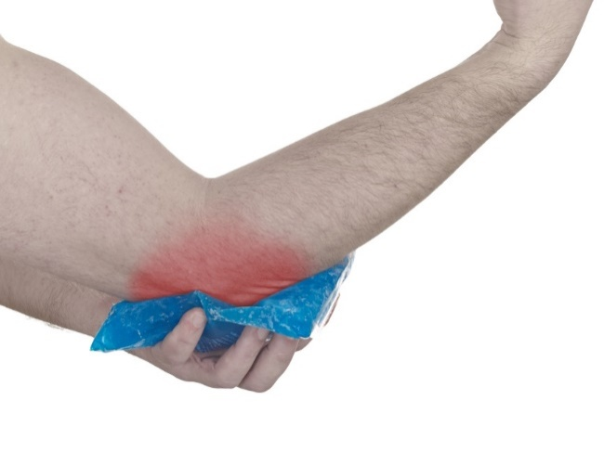
Bone and Joint Injuries
R – rest
I – immobilize C – cold E – elevate
Notes:
Never straighten a # or put a dislocation back in place. Leave in position found!
REST - Stop using limb immediately
IMMOBILIZE- Using casualty or a splint, support the limb
COLD- Ice packs to help reduce swelling for 20 minutes max
ELEVATE – Elevate the injured area, will also help reduce swelling

Slide 7
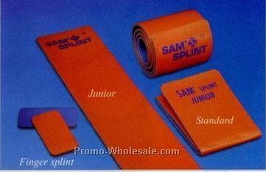
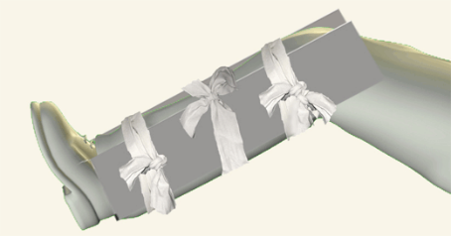
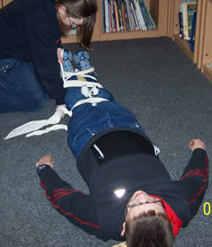
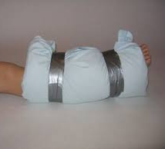
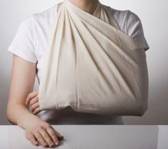
Bone and Joint Injuries
Splinting – to help reduce pain and help stabilize injuries
Notes:
Splinting effort to prevent injury from worsening and reducing pain.
Splints purchased - rigid
Household items - pillows
Other body parts – finger to finger
Always check CSM before and after splinting.

Slide 8
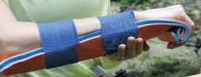
Bone and Joint Injuries
Always secure the splint above and below the injured area
Notes:
Always check CSM before and after splinting.
Splint to go from joint to joint, above and below fracture. Bandage above and below fracture site.
Discuss use of Slings
Discuss different types of splints. How can we improvise?

Slide 9
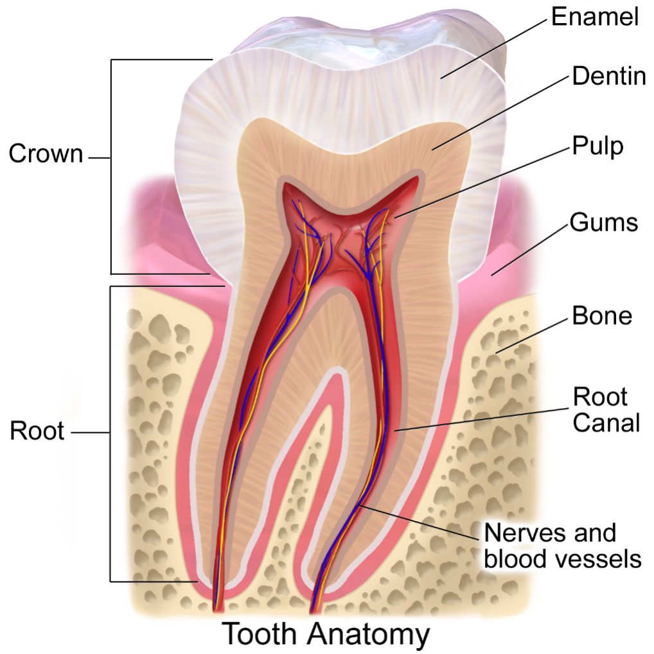
Bone and Joint Injuries
Tooth Injuries
Treat bleeds inside the mouth with damp gauze
Pick up form exposed end (not root) and place in whole milk or the persons saliva
Seek dentist immediately
Notes:
With all mouth injuries ensure casualty has no head or spinal injuries. If head or spinal injuries call 911. Dentist are found in ER’s if needed.
Use damp gauze to avoid sticking ice may help with swelling and pain
DO NOT rinse toot to clean
Often dentist can replace and stabilize tooth allowing tooth to survive

Slide 10
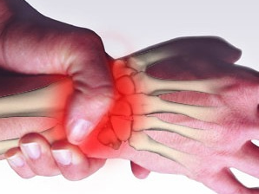
Bone and Joint Injuries
Repetitive Strain Injuries (RSI) – hands, arms, shoulders, backs or legs.
Usually caused by:
poor posture
extended length of standing
stationary in any position for too long
Treat by use of modified duties and RICE
Notes:
For great information go to
WSIB www.WSIB.on workers pages
Ministry of Health www.labour.gov.on.ca health and safety pages

Slide 11
Student Performance
Have students team up and perform the following first aid treatment on simulated injured casualty's with:
Fractured collarbone
Dislocated shoulder
Open fracture upper arm
Closed fracture forearm
Closed fractured wrist
Notes:
STUDENT TO PERFORM FIRST AID FOR:
Collarbone
Dislocated Shoulder
Open # of upper arm
Closed # of forearm
Closed # of wrist

Slide 12

Student Performance
Have students team up and perform the following first aid treatment on simulated injured casualty's with:
Closed fractured upper leg
Closed fracture knee
Open fracture lower leg
Sprained ankle
Notes:
Closed # of upper leg
Fracture of knee
Open fracture of lower leg
Sprained ankle

