Slide 1

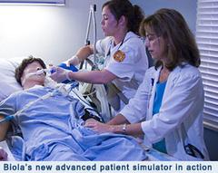

Basic Life Support-BLS

Slide 2
BLS and AED Agenda
Information and Terms
Emergency Scene Management
CPR
AED
Choking
Quiz
Course evaluations and certificates

Slide 3
Terms
Health care – Maintaining and restoration of health by the treatment and prevention of disease especially by trained and licensed professionals
Health care Providers - A trained person licenced in Ontario or Canada to provide medical treatment such as doctors, nurses and paramedics
Patient – A sick or injured person requiring medical treatment

Slide 4
Terms
Ages
Adult – puberty and older
Child – 1 year to puberty
Infant – under 1 year old
Signs – Things you can see example pale colour
Symptoms – Thing the patient has to tell you example pain
Notes:
Puberty – Male facial hair or armpit hair Female development of breasts

Slide 5
Terms
BVM/Ambu Bag – Bag valve mask (Ambu bag is a brand name)
SCA – Sudden Cardiac Arrest
MI – Myocardial Infarction
CVA – Cerebral Vascular Accident
TIA – Transient Ischemic Accident
AED – Automated External Defibrillator
PAD – Public Access Defibrillation
Notes:
Puberty defined as :
Female breast development
Make facial or armpit hair

Slide 6
Terms – Legalities
Good Samaritan Law - 2001
Bill 20 (Ontario)
Volunteer and no compensation
Acts in good faith
Gets Consent
Implied
Verbal/Expressed
Only in time of an emergency
Exempt from civil liability
Unless caused gross negligence
Chase McEachern Act - 2007
AED users and owners
Volunteer and no compensation
Acts in good faith
Only in time of an emergency
Exempt from civil Liability
Unless caused gross negligence
Notes:
This legislation would cover a BLS when off duty. When working you have a duty to respond

Slide 7
Terms
History – What happened to cause the injury or illness
Mechanism of Injury (MOI) – What caused the injury
Abandonment – Stay with the patient until hospital team or EMS arrives
Notes:
BLS must wait until a higher level of care takes over in a hospital setting

Slide 8
Terms – Communicable Diseases
Airborne – Tuberculosis, Measles, SARS/MERS
Body Fluids or blood – HIV, AIDs, Hepatitis A, B, C, D and E, Meningitis, MRSA and VRE
Immunizations and frequent hand washing
Personal Protective Equipment (PPE)
Latex free gloves and barrier devices
Notes:
SARS – Severe Acute Respiratory Syndrome
MERS – Middle Eastern Respiratory Syndrome

Slide 9
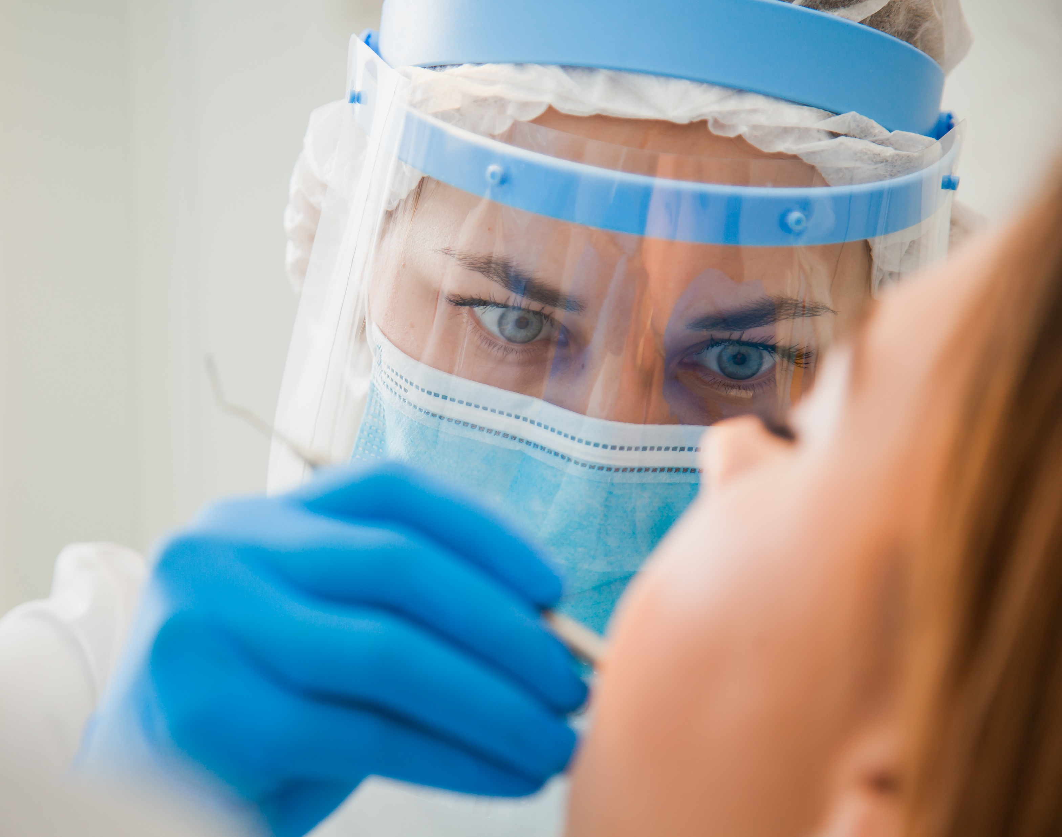


Terms – Personal Protective Equipment (PPE)
Notes:
Have participants name some other types of PPE
Double gloving
BVM
Face shields
Goggles
N95
Gowns
Boots
Caps

Slide 10
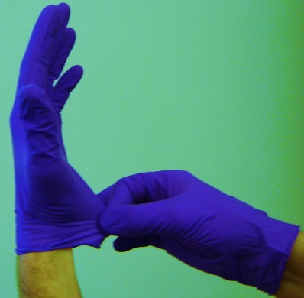
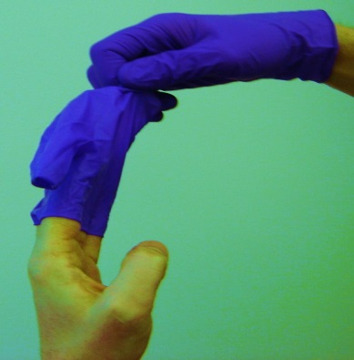
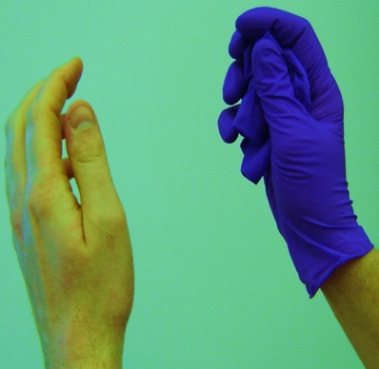
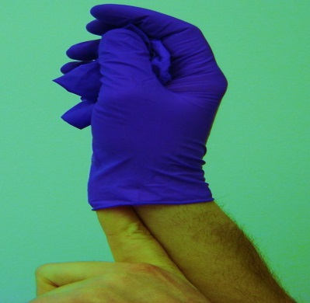
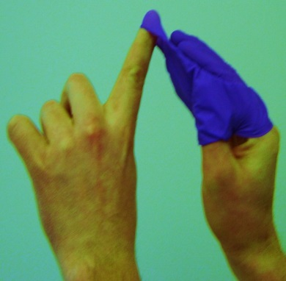
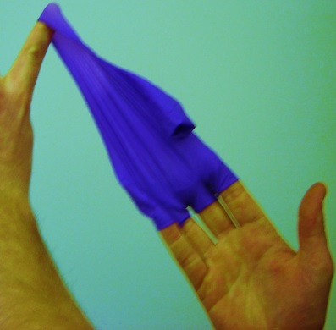
Terms – Gloves
Manual Page 12
Notes:
In BLS environment Bio Hazard disposal only

Slide 11
Student Performance
1. Have students perform glove removal and proper disposal

Slide 12
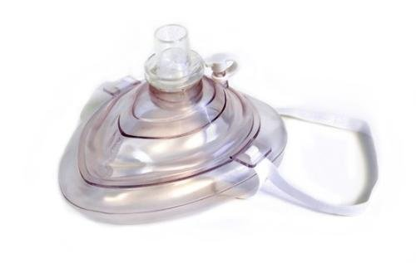
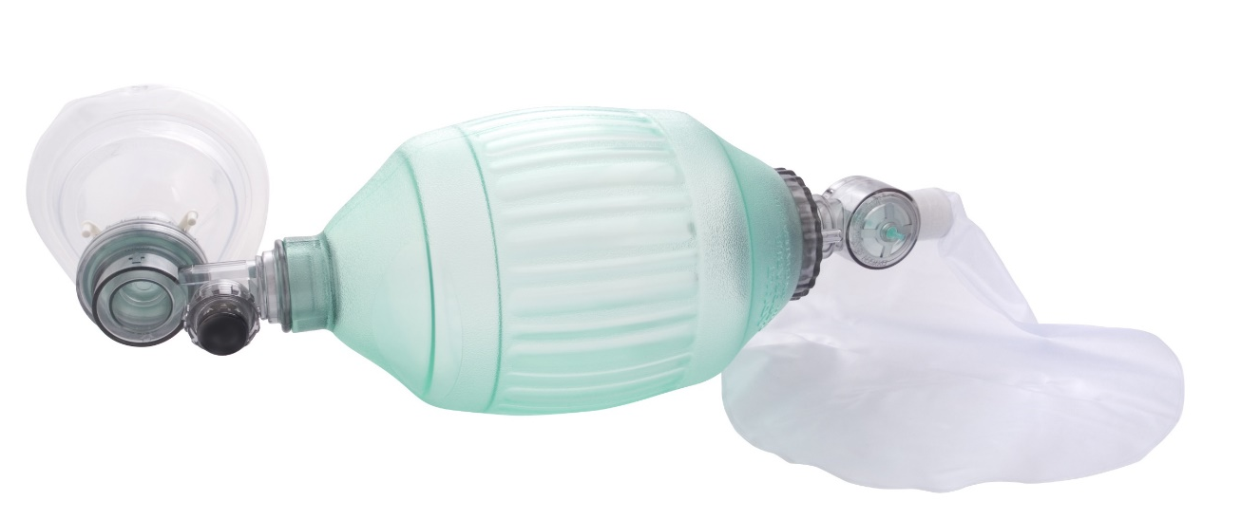
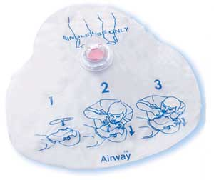
Terms –Resuscitation devices
Pocket Mask
Bag Valve Mask Adult
Face Shield
Notes:
Pass out all 3 for participants to see
DO NOT show how to use them at this time

Slide 13
Critical Incident Stress and Post Traumatic Stress Disorder

Slide 14
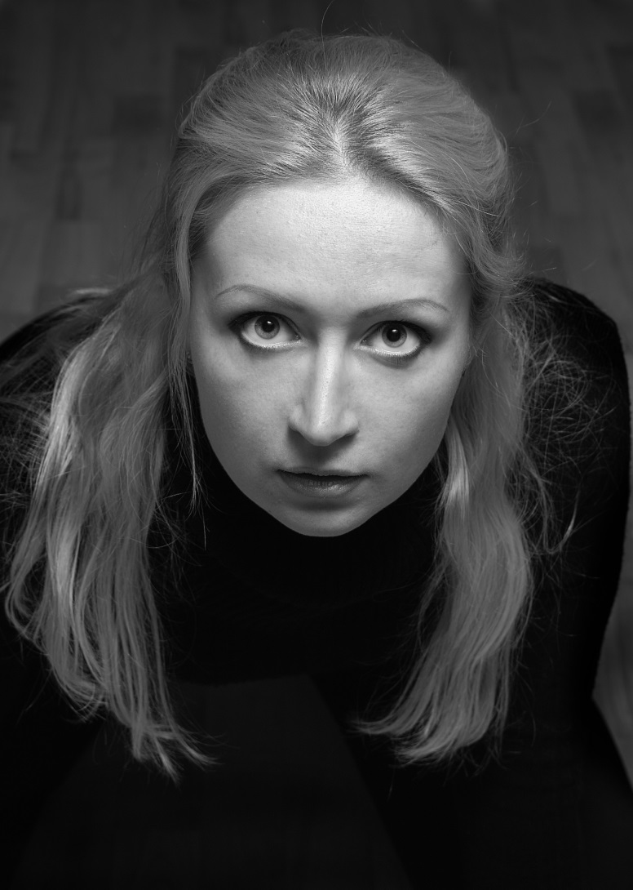
Terms – Medical Professional’s Reaction
Critical Incident Stress immediately after:
Anxiety
Upset stomach
Difficulty sleeping
Drink too much
Unable to eat or eat too much
Panic attacks
Teary
Post Traumatic Stress after 72 hours:
Personality changes
Poor hygiene
Always late or no show
Always tired
Excessive alcohol or drug use

Slide 15
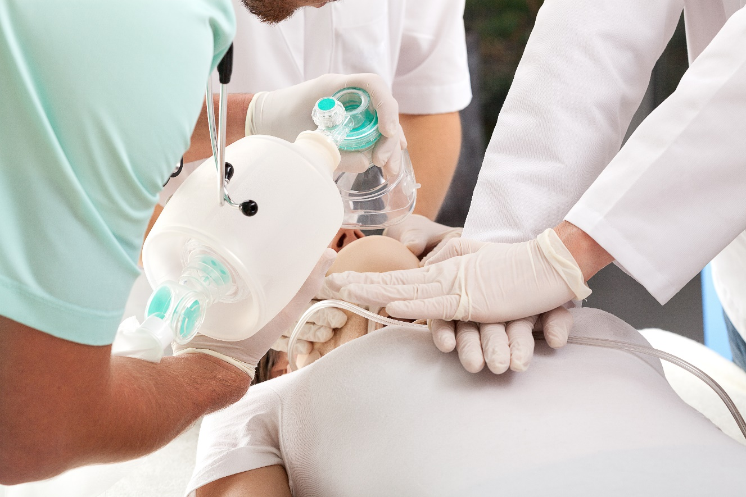
Basic Life Support CPR

Slide 16
BLS CPR
In all emergencies use this sequence:
Look, Talk, Call,
Circulation, Airway, Breathing
Notes:
Because BLS do many skills at the same time or there is a team providing care the scene survey talk is to check for responsiveness and normal breathing. The primary survey is now CAB (HSF 2010 Guidelines)

Slide 17
BLS CPR
Look – hazards, MOI and how many injured
Talk – check for responsiveness and get consent , look for normal breathing for 5-10 seconds (not agonal), carotid pulse (adult and child) or brachial (infant) for 5-10 seconds
Call – get someone to call 911 and another person to get an AED
(internal response plan)
Circulation – start CPR with 30 compressions
Airway – open airway with head – tilt, chin – lift or jaw thrust
Breathing – give 2 normal breaths
Defibrillation – for patient’s that are unconscious with no breathing or pulse

Slide 18
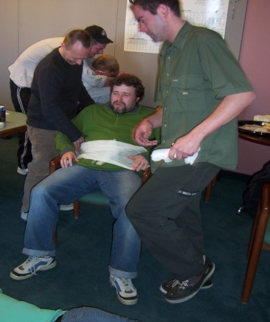
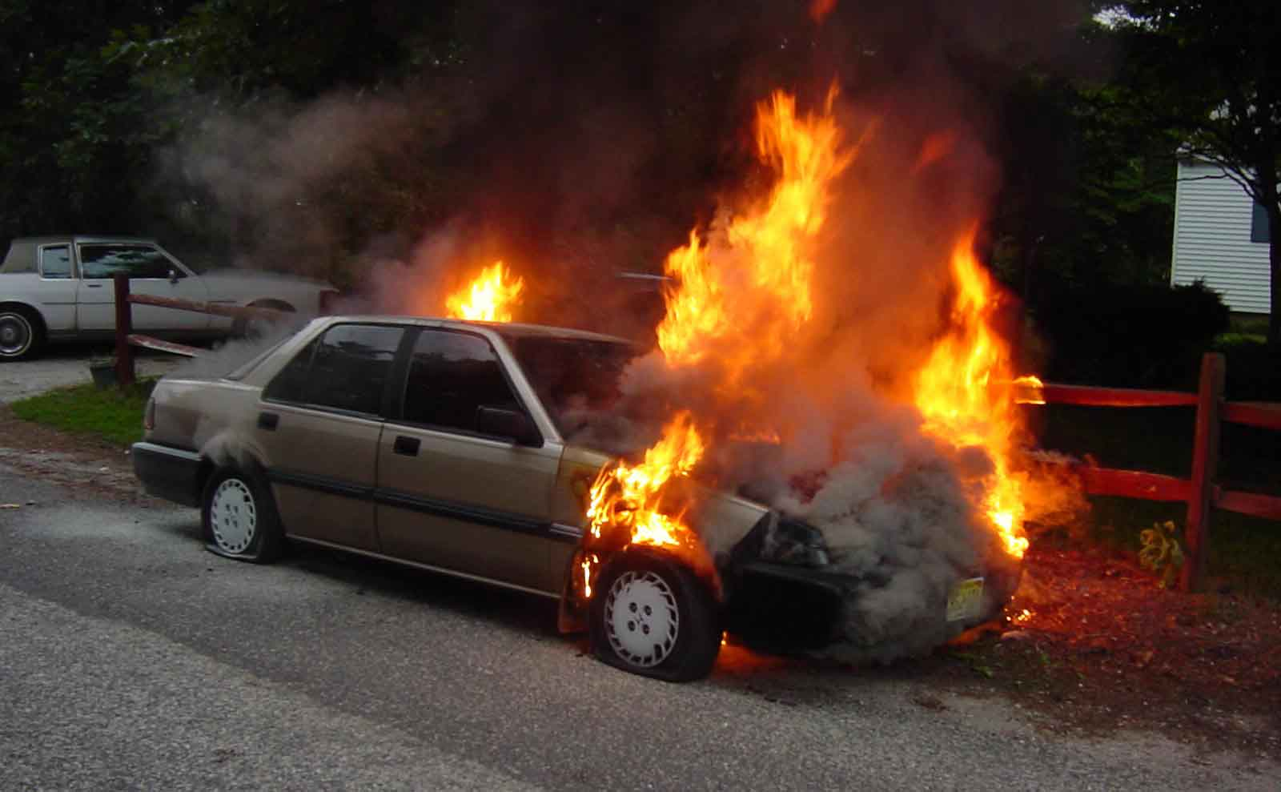
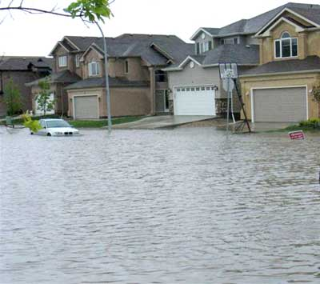
BLS CPR
Look – MOI, hazards and how many injured

Slide 19
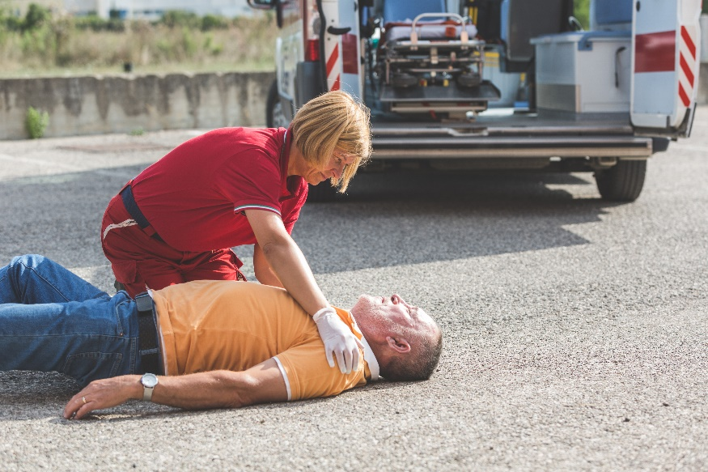
BLS CPR
Talk to the patient: if unconscious tap n’ shout for up to 5–10 seconds, look for normal breathing (not agonal) and check for a pulse.

Slide 20
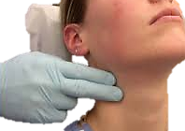
BLS CPR – Pulse Check
Adult and children ‘s pulse is obtained from their carotid pulse.
This is located on the side of the neck about half way down the neck and in the valley between the trachea and ligaments.
A resting heart rate for an adult is 60-100 per minute.
Notes:
Pulse check 5-10 seconds Maximum

Slide 21
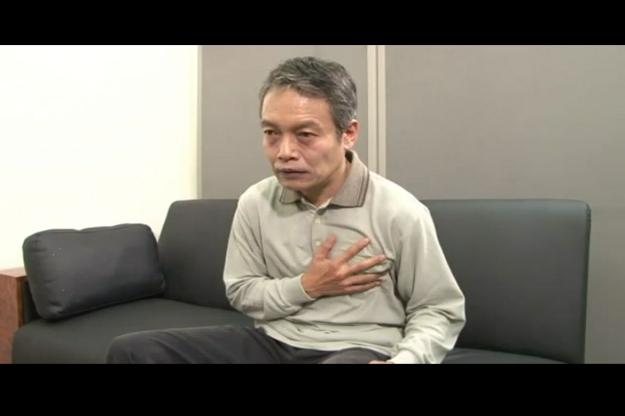
BLS CPR Agonal Breathing
Notes:
Body knows the mechanics of breathing but this is not effective

Slide 22
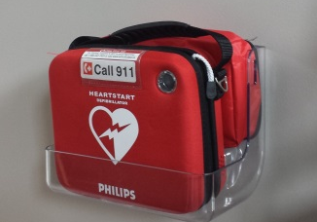
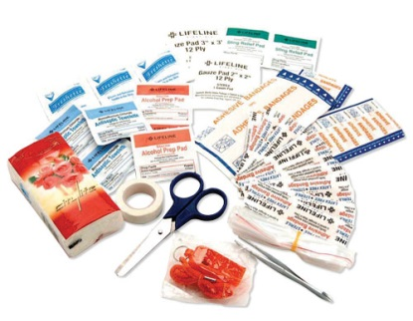
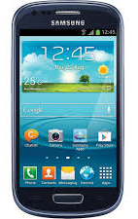
BLS CPR
Call 911, if possible get someone else to call and get an AED (internal response plan)
When you are not at work use bystanders for:
911 phone call (cell vs. landline)
AED, First aid kit and blankets
Traffic and people control
Watch for fire and EMS
Take Charge and Delegate!
Notes:
If you were in the hospital parking lot what would you ask bystanders to do?
If you were at the playground with your kids what would you ask for?

Slide 23
Student Performance
Have students perform Look, Talk, Call

Slide 24
BLS CPR – CAB
Circulation – Start CPR with 30 compressions pushing at least 2” (5-6 cm)
Airway – open airway with a head – tilt, chin – lift or a jaw thrust
Breathing – using a pocket mask give 2 normal breaths
Defibrillation – for patients that are in cardiac arrest
Notes:
DO NOT show jaw thrust at this time

Slide 25
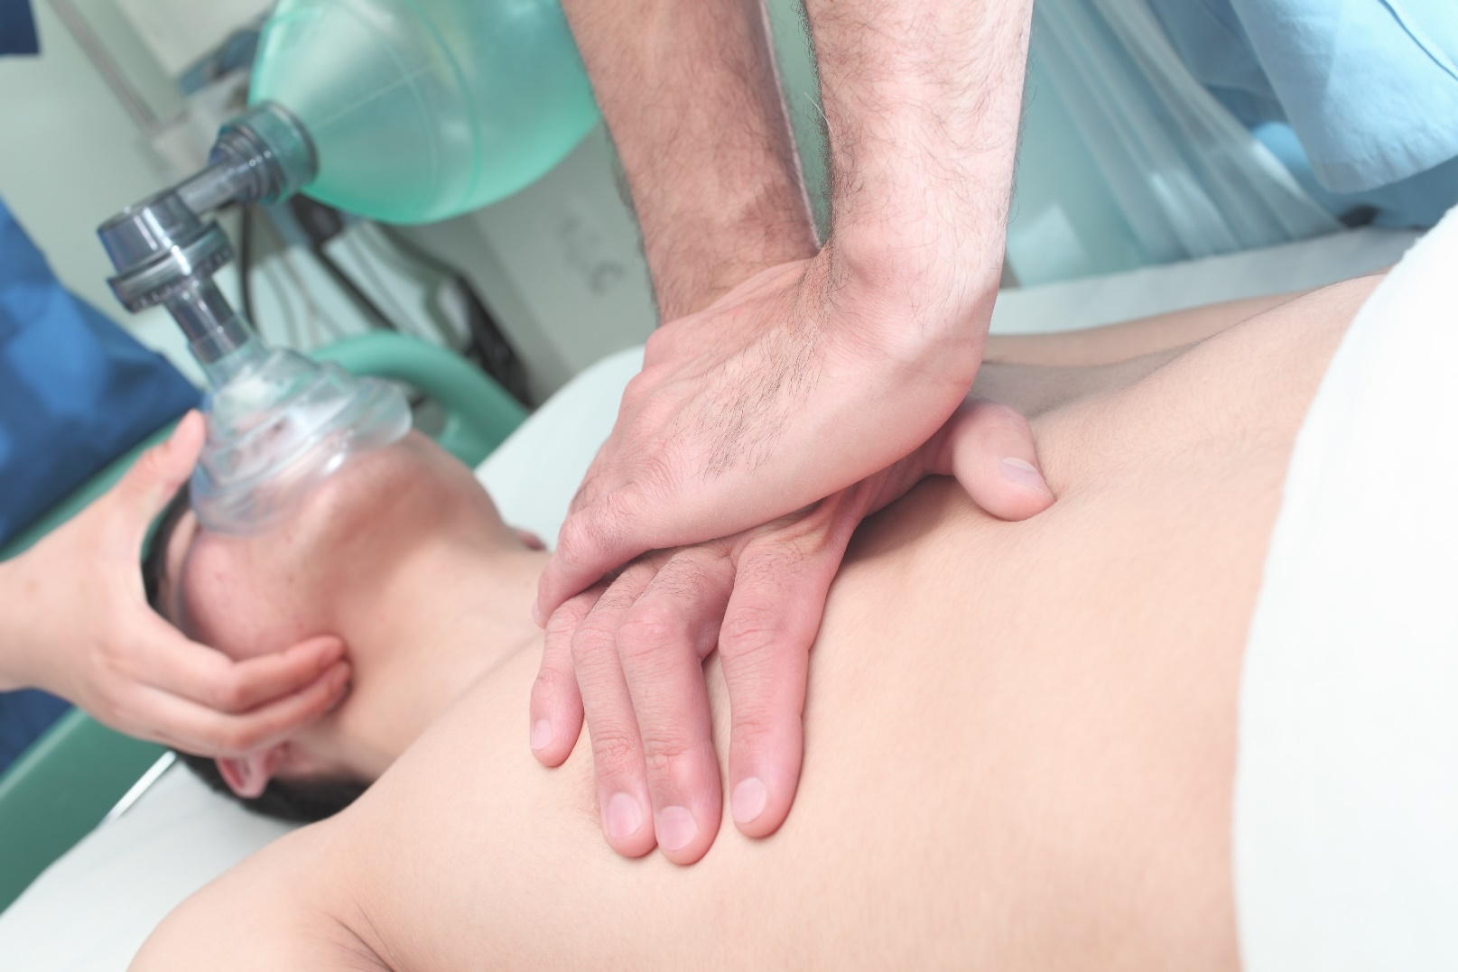
BLS CPR
C – 30 Compressions at least 2” or 5-6 cm
Notes:
When no trauma always use head tilt chin lift (HTCL)

Slide 26
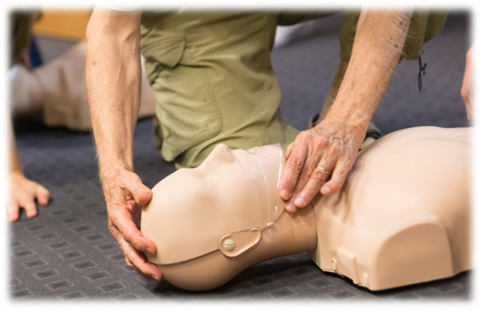

BLS CPR
A – open the unconscious patient’s airway with a head tilt, chin lift or a jaw thrust
B – give 2 normal
breaths
Notes:
When no trauma always use head tilt chin lift (HTCL)

Slide 27
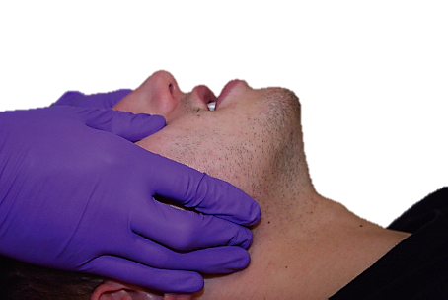
BLS CPR – Jaw Thrust
The jaw thrust is used to open a patient’s airway when you suspect head and spinal injuries typically due to trauma. You can perform the jaw thrust:
Kneeling by the person’s head
and placing one hand on
either side of the persons face
Place your fingers under the
patient’s ear on the jaw line and
lift the jaw with both hands
Notes:
If trauma is suspected use the jaw thrust. Try this one time only, if you are unsuccessful do a HTCL carefully

Slide 28

BLS CPR – Bag Valve Mask (BVM)
E
A
B
C
D
A. Face mask B. Bag C. Oxygen Reservoir D. Blow Off Valve E. Oxygen tubing connector
Notes:
Have at least 2 sizes of BVM’s available Ideally all 3 sizes
Review parts with participants

Slide 29
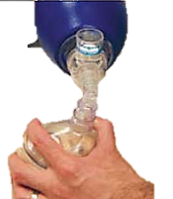
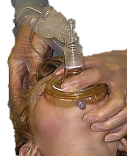
BLS CPR – BVM
When applying a seal with a mask, use the “C” grip (Figure 1) on the patient’s face and an “E” grip (Figure 2) at the patients chin.
Figure 1
Figure 2
Notes:
Using a BVM is a 2 person technique to perform effective ventilations

Slide 30
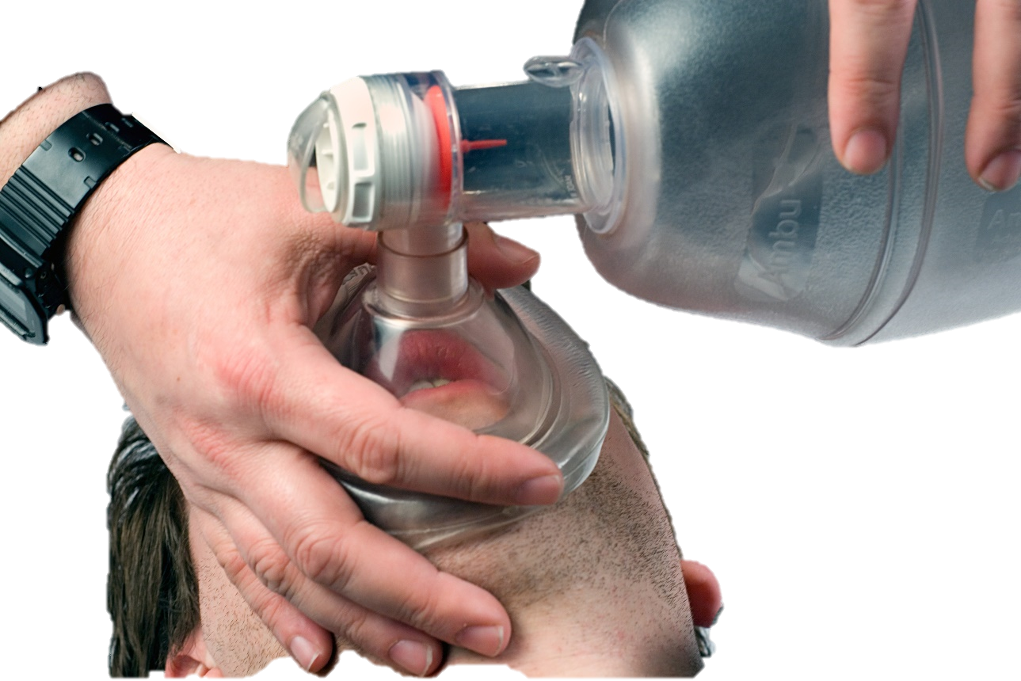
BLS CPR – Artificial Respirations (AR)
Breathing rates per minute
Adult
12–20 per minute
1 breath every 5-6 seconds
Child
12–30 per minute
1 breath every 4-5 seconds
Infant
20 – 30 per minute
1 breath every 3-4 seconds
*Remember when patient has an ETT, AR is asynchronous*
Notes:
When patient is in respiratory arrest or in cardiac arrest, give 1 normal breath every 6-8 seconds. When CPR is being performed you do not time breaths with compression. CPR and respirations are asynchronous.
Discuss interposed breaths and importance of timing with the patients breaths.

Slide 31
Student Performance
Have students perform proper BVM technique for all age groups.

Slide 32

Adult CPR

Slide 33
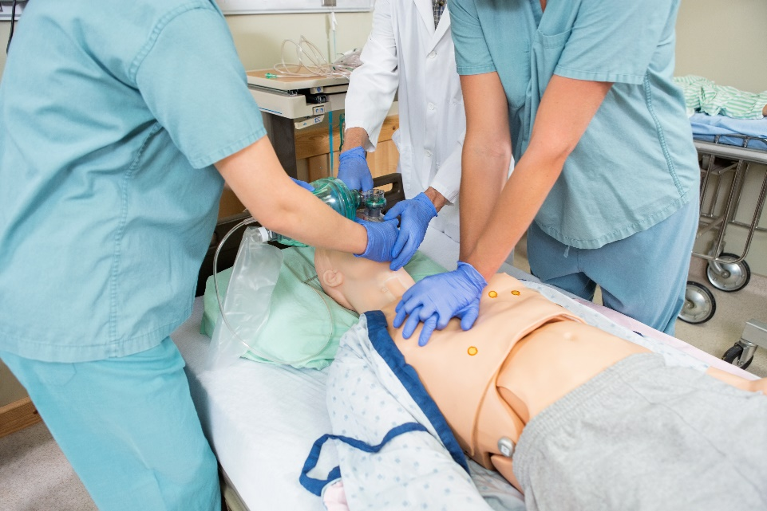
Adult CPR
Cardiac arrest is when the heart stops pumping blood because of muscle (mechanical) or electrical problems
Causes:
Drowning
Electrocution
Heart Attack
Trauma

Slide 34
BLS CPR Skills Chart
 | Adult | Child | Infant
Ages | Puberty and up | 1 year old to puberty | Under 1 year
Pulse Point | Carotid | Carotid | Brachial
Rescue Breathing | Every 5 sec. 12 – 20 /min. | Every 4 sec. 15 - 22/ min. | Every 3 sec. 20 -28/min.
CPR Starting Point | No pulse | No pulse or 60 bpm or less with poor perfusion
Ratio 1 person | 30:2 | 30:2 | 30:2
Ratio 2 person | 30:2 | 15:2 | 15:2
Depth | At least 2” | About 2” or 1/3 depth | 1/3 depth
Technique | 2 hands | 1 or 2 hands | Two fingers Or 2 person encircling
Use AED | Yes | Yes | Yes
Lone Rescuer | Immediately | Witnessed after 2 mins. Not witnessed immediately | Witnessed after 2 mins. Not witnessed immediately
Advanced Airway | Ventilate 1 breath every 5 seconds Asynchronized breaths
Notes:
REVIEW ONLY do not start a lengthy discussion on all new skills.
In depth conversation is during that skill

Slide 35
BLS CPR– Adult 1 rescuer
Look – All hazards, how many people injured, and MOI
Talk – Talk to person, if no response, tap and shout then, check for normal breathing for no more than 5 -10 seconds
Check carotid pulse for no more than 10 sec. If no pulse start CPR
Call – direct another person to call 911, someone else to get a first aid kit and AED (start internal response)
Notes:
Remind BLS that if not sure if there is a pulse present do not take more than 10 seconds. If no pulse or unsure if there is a pulse start CPR.

Slide 36
BLS CPR– Adult 1 rescuer
Circulation – Start 30 compressions
Airway – Open their airway head tilt, chin lift or jaw thrust
Breath – Give 2 normal breaths with pocket mask
Notes:
Remind BLS that if not sure if there is a pulse present do not take more than 10 seconds. If no pulse or unsure if there is a pulse start CPR.

Slide 37
BLS CPR – Child and infant CPR 1 rescuer
Look – All hazards, how many people injured, and MOI
Talk – Talk to person, if no response, tap and shout then, check for normal breathing for no more than 5 -10 seconds. Check carotid pulse for no more than 10 sec.
**If no pulse or below 60 bpm with poor perfusion start CPR**
Call – direct another person to call 911, someone else to get a first aid kit and AED (start internal response)

Slide 38
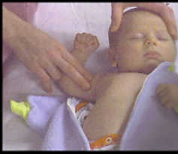
BLS CPR – Infant pulse check
An infant’s pulse is obtained at their brachial pulse.
This is found between the biceps and triceps muscles.
A resting heart rate for an infant is at least 100 per minute.
Notes:
Pulse check 5-10 seconds Maximum

Slide 39
BLS CPR – Child and infant CPR 1 rescuer
Circulation – Start 30 compressions
Airway – Open their airway head tilt, chin lift or jaw thrust
Breath – Give 2 regular breaths with pocket mask

Slide 40
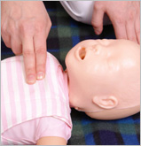
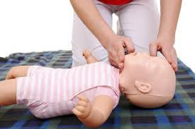
BLS CPR – Infant CPR
C – Two fingers just below the nipple line in the centre of the chest
A – Head tilt chin lift into sniffing position
B – Using a pocket mask ventilate twice
Pushing down 1^{1/2”} (4cm) or 1/3 of chest depth
Notes:
Remind BLS that if no pulse or below 60 bpm with poor perfusion start CPR

Slide 41
Student Performance

Slide 42
BLS CPR – Lone Responder
Adult
Leave adult in recovery position as soon as you have determined that the patient is unconscious, activate 911 (internal response plan) and return to provide treatment
Child and Infant
For all patients under puberty found unconscious
perform two (2) minutes of CPR prior to activating 911(internal response plan)
If witnessed unconscious collapse immediately leave patient to activate 911 (internal response)

Slide 43

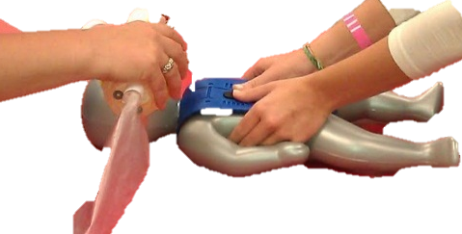
BLS CPR – 2 Person CPR
CPR is extremely tiring
Switch with another co-worker
after 2 mins or 5 cycles of CPR
Adult 2 person CPR 30:2
Child 2 person CPR 15:2
Infant 2 person CPR 15:2
encircling technique
Notes:
*NB* Minimize interruption's in CPR when switching positions

Slide 44
BLS CPR – Stopping or Delayed CPR
Stop doing CPR
You may stop CPR when:
An adult regains a breathing or a pulse (signs
of circulation)
Child and infant with pulse over 60 bpm
Higher level of trained help takes over
Your health or safety is in danger
Interrupt CPR
You may briefly stop CPR when;
patient vomits –turn to recovery position
AED is on patient and advises DO NOT TOUCH patient – listen closely to all instructions

Slide 45
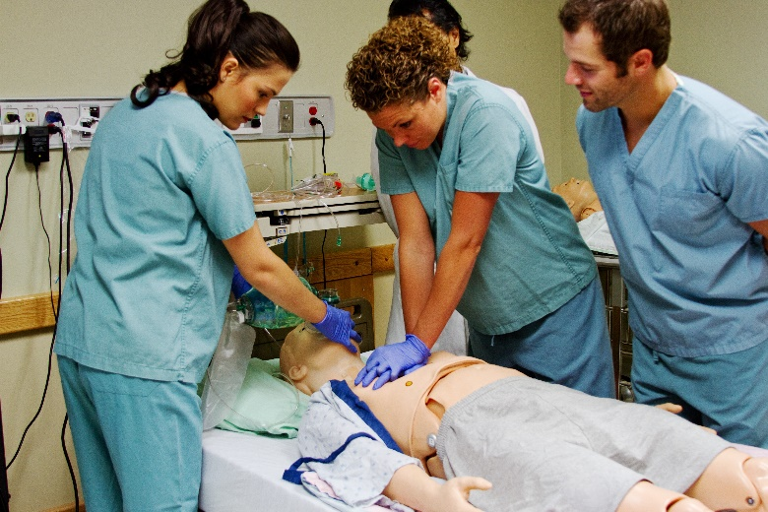
BLS CPR – Review
Minimize interruptions
Push hard and fast, rate of at
least 100/min.
Allow chest to rise fully (recoil)
Remember high quality compressions
Switch rescuers after 2 minutes (if possible)

Slide 46
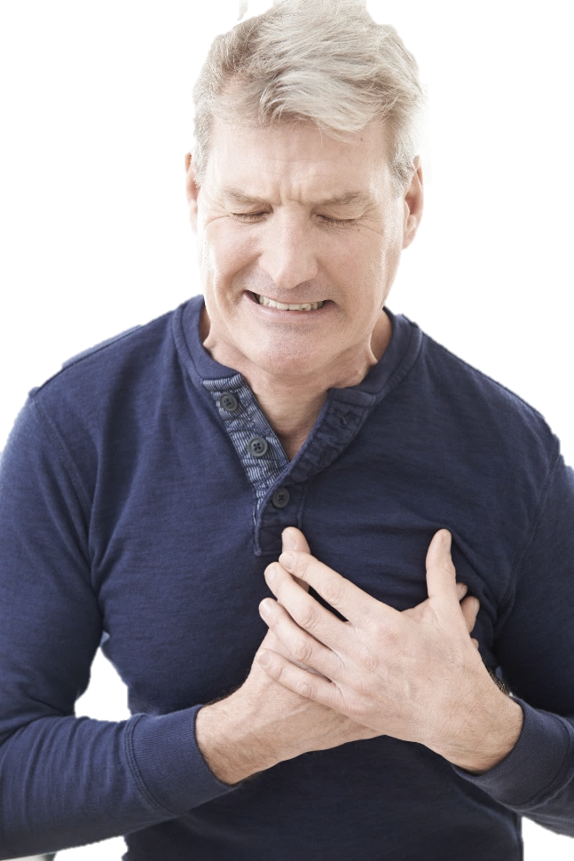
Cardiovascular Emergencies

Slide 47
Cardiovascular Emergencies
The leading cause of cardiac arrest in Canada is:
Myocardial Infarctions (MI) and Angina
Cerebral Vascular Accident (CVA) and Transient Ischemic Accident (TIA)
These are usually due to cardiovascular disease.
Always remember:
Look, Talk, Call, CAB
Notes:
MI-heart attacks
CVA- Stroke

Slide 48

Cardiovascular Emergencies
®HSFC
Early access to 911
Early CPR
Early AED
Early Advanced Care

Slide 49
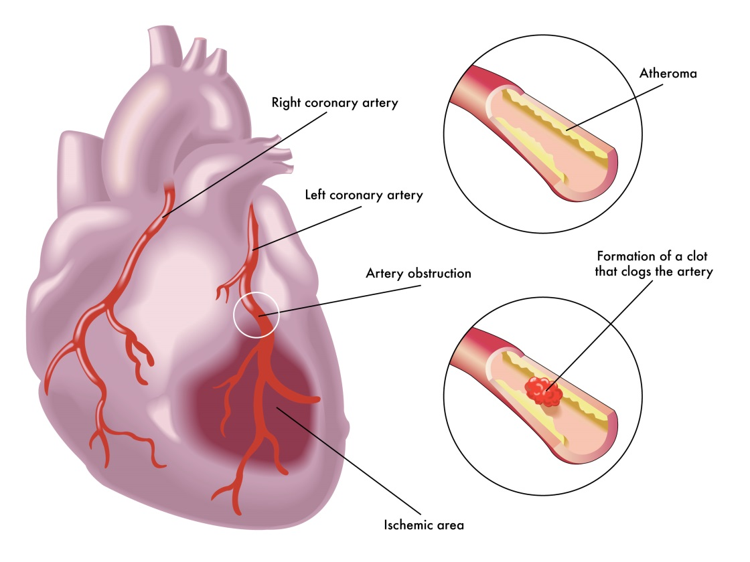
Cardiovascular Emergencies
MI “The interrupted blood flow that occurs during a heart attack can damage or destroy a part of the heart muscle.” (www.mayoclinic.org)
Angina “… is a type of chest pain caused by reduced blood flow to the heart muscle. Angina is a symptom of coronary artery disease. ” (www.mayoclinic.org)
Notes:
Remember these are Diagnosis

Slide 50
Cardiovascular Emergencies
Signs and symptoms
PASS IT ON
Pale
Anxiety
Sweating
Short of breath
Angina: Only lasts 10 minutes with rest and medication. If discomfort persist longer call 911
Indigestion
Tightness in chest
Over all weakness
Nausea and vomiting
Notes:
Reminder* Women may get neck, jaw, or shoulder blade pain
Elderly diabetics may deny any pain or discomfort

Slide 51
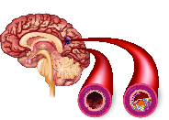
Cardiovascular Emergencies
Ischemic CVA “Occurs when the blood supply to part of your brain is interrupted or severely reduced, depriving brain tissue of oxygen and food” (www.mayoclinic.org)
Hemorrhagic CVA “A brain aneurysm can leak or rupture, causing bleeding into the brain.” (www.mayoclinic.org)

Slide 52
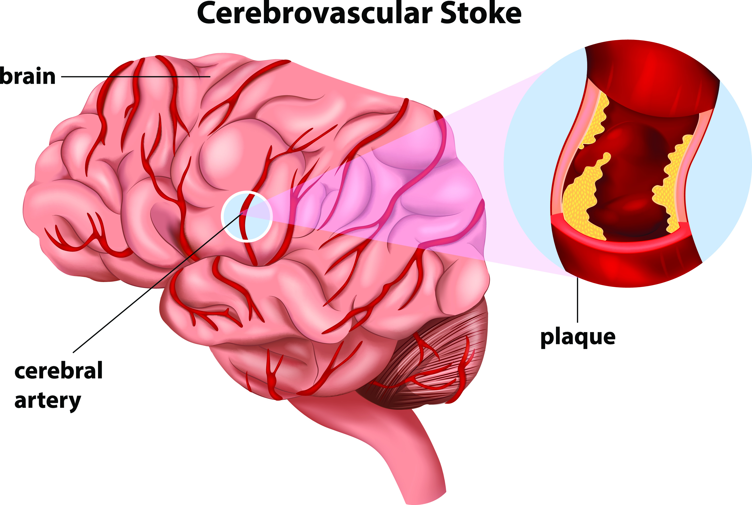
Cardiovascular Emergencies
Transient Ischemic Attack (TIA) - “Is like a stroke, producing similar symptoms, but usually lasting only a few minutes and causing no permanent damage.” (www.mayoclinic.org)

Slide 53
Cardiovascular Emergencies
Signs and symptoms
F
Facial droop, headache, vision problems
Arm drift, numbness, paralyzed
Speech problems
Time of onset quick onset
A
S
T

Slide 54
Cardiovascular Emergencies
First Aid Treatment
Look, Talk, Call CAB
Resting position
Cover and reassure
Nothing to eat or drink
Assist with medications if needed

Slide 55
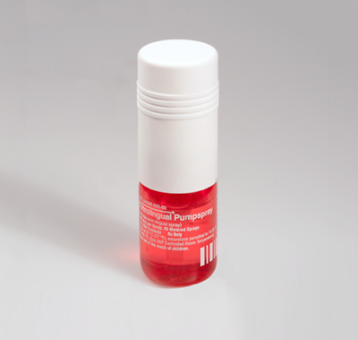
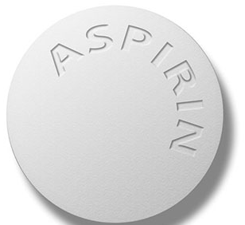
Cardiovascular Emergencies
5 rights of medications
Before assisting with medications ensure the patient is conscious and alert.
Right :
Person
Medication
Dose
Time between doses
Route
Notes:
As of 2015 HSF recommends 2 x 81 mg or 1x 325 mg ASA to be crushed or chewed

Slide 56
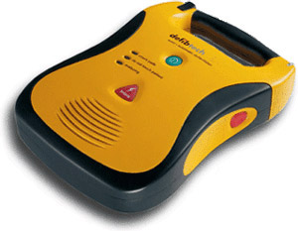
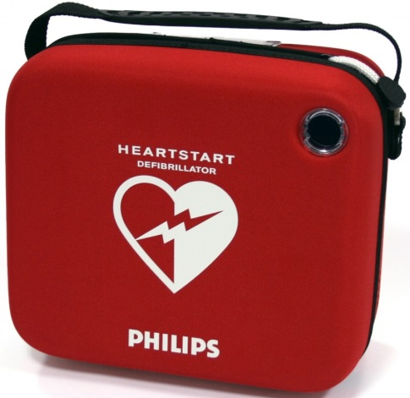
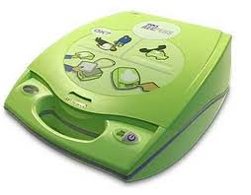
Automated External Defibrillators (AED)

Slide 57
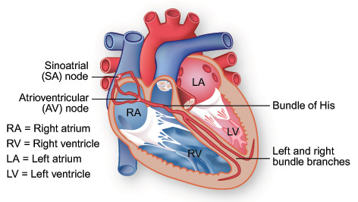
AED
Can be used by anyone on any age
AED – Computer programed ECG
Hearts electrical system gets irritated with decreased oxygenation
Notes:
As of 2015 HSF recommends 2 x 81 mg or 1x 325 mg ASA to be crushed or chewed

Slide 58
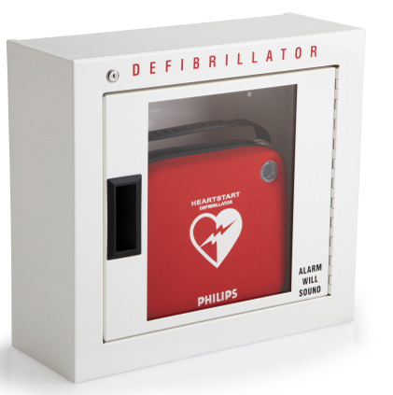
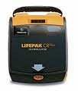
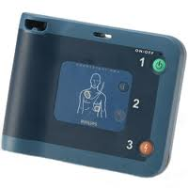
AED
Look For AEDs in public areas
All the basics of AEDs the same
Easy to turn on/off
All talk
All have electrodes
Shock ability
Data Recording

Slide 59
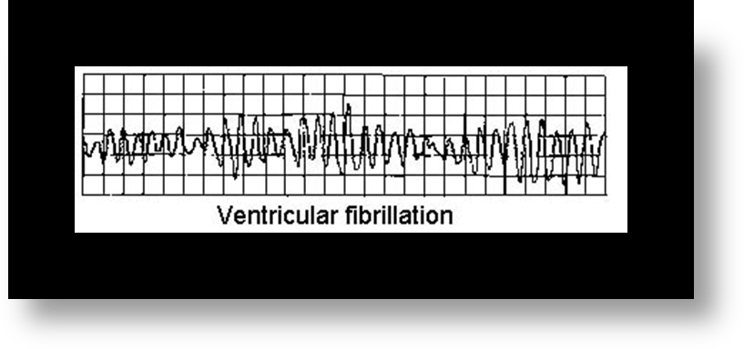
AED
Most common wrong rhythm associated with 80% of SCA
AED will only allow a shock if finds VFib or VTach
Shockable Rhythm
Notes:
Will not see these rhythms on AED These units do not monitor only defibrillate.

Slide 60
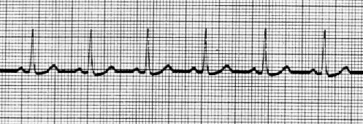
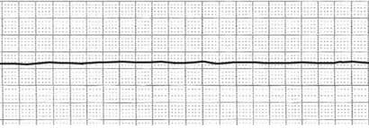
AED
No Shock
Normal Sinus Rhythm
Asystole
Notes:
Will not see these rhythms on AED

Slide 61

AED
Place AED by patient’s head
Turn AED on
Listen to instructions
Place pads on bare dry chest
Clear the patient
Push shock button if required
Start CPR for 2 minutes
Cycle repeats every 2 minutes
Notes:
Stress Turn it on!!!!!!!!!

Slide 62







AED – Special Considerations

Slide 63
AED
Always leave pads (electrodes)on casualty
Always leave AED turned on
Even when patient regains breathing or pulse
Place patient in the recovery
position, monitor ABCs,
reassure and keep warm until EMS takes over

Slide 64


AED – Own an AED?
Daily and monthly checks
Electrodes expiry dates
Responder kit contents (pocket mask, gloves, scissors, razor)
Installed lithium battery
Cabinet alarm
Yearly training
Internal response plan
Site Coordinator
After the Medics leave…
Get AED ready to use again (if possible), fill out work related and post call reports, ensure training company has been notified

Slide 65
Student Performance
Student is to perform look, talk, call, CAB. Perform CPR until the AED arrives.
Continue to follow AED instructions for 2 analyzes, ensuring at least 2 position switches between rescuers performing CPR.

Slide 66

Choking

Slide 67

Choking – Prevention
Do not talk and eat at the same time
Small bites of food
Chew well and slowly
Sit while eating
Age appropriate toys

Slide 68
Choking – Adult and Child
Mild Choking
Can still cough, talk , breath, flushed (red) skin
Tell them to continue they are doing the right thing and stay with them
Severe Choking
Unable to cough, talk or breath. May be grasping neck, panicked look on face and may become pale
We must act to assist patient

Slide 69

Choking – Severe choking
Signs and Symptoms
Patient is unable to cough, talk or breath
May have high pitched wheezing
Arms around neck or flailing arms
Look of fear or panic on face
Poor colour (pale, gray, ashen or blue)

Slide 70


Choking – Severe choking
Give Abdominal thrusts

Slide 71
Student Performance
Student to simulate treatment for a mild choking.
Student to simulate treatment on a severe choking by performing abdominal thrusts.

Slide 72

Choking – Special Circumstances
Pregnant, large or a wheelchair patient
Use chest thrusts when standings or in the sitting position
Flat fist on breastbone using armpits to locate middle of chest
Pull straight in on the breastbone
Notes:
Remember wheel chair patients

Slide 73

Choking – Unconscious
Assist to the ground, ensure 911 has been called and ask for an AED
Start 30 compressions
Before giving 2 breaths check mouth every time for obstruction
Only do finger sweep if you see something
Continue 30:2 until the patient:
Return of breathing or pulse
AED arrives
EMS takeover

Slide 74

Choking – Alone
What can you do if you are severely choking and alone?
https://www.dailymail.co.uk/health/article-4405338/Give-Heimlich-manoeuvre-stay-alive.html

Slide 75



Choking – Infant
Prevention:
Adult supervision
Age appropriate toys
Check nipples and pacifiers for wear
Safety locks on doors
Gates at stairwells
www.overstock.com

Slide 76


Choking – Infant
5 back blows
5 chest thrusts
(www.ufhealth.org)

Slide 77
Student Performance
Student to perform treatment for a simulated mild choking infant.
Student to simulate first aid treatment on a severe choking, performing 3 sets of 5 back blows and 5 chest thrusts.

Slide 78
Choking – Unconscious
If infant becomes unconscious ensure 911 (internal response) has been activated.
Then start CPR, after 30 compressions check the infants mouth for any obstructions. If something is found remove it. If nothing found attempt two breaths using BVM. Continue 30:2 cycles until the infant regains breathing, pulse, the AED arrives or EMS takes over.

Slide 79
BLS and AED
Quiz
Evaluations
Certificates

Slide 80

Thank you for taking the time to care!

