Slide 1

AED and CPR

Slide 2
CPR and AED Agenda
Information and Terms
Emergency Scene Management
CPR
AED
Choking
Quiz
Course evaluations and certificates

Slide 3
Information
First Aid – Temporary aid prior to medical aid
First Aider – A person who provides first aid
Medical Aid – A person medically trained such as a doctor nurse or paramedic
Casualty – A person wanting first aid treatment
Notes:
INFORMATION AND TERMS: 45 MINUTES.
FIRST AID: Medical Aid may not always be needed
FIRST AIDER: Not always required to possess a first aid certificate but training helps build knowledge and
CASUALTY- An injured or ill person needing first aid

Slide 4
Terms
    Ages
    Adult 8 years and older
Child 1-8 years
Infant under 1 year old
Signs – Things you can see example pale colour
Symptoms – Thing the casualty has to tell you example pain
Notes:
Ask the class to define the following words as a sign or a symptom:
Sweaty, dizzy, nausea, vomiting

Slide 5
Terms
History – What happened to cause the injury or illness
Mechanism of Injury(MOI) – What caused the injury
Abandonment – Stay with the casualty until EMS arrives
Notes:
DISCUSS HISTORY: Is this an illness or injury? Did the casualty get dizzy on the ladder and then fall? What were they doing prior to feeling the chest pain?
MOI: IE: If they fell, how far did they fall? What part of their body did they injure? By what means? MOI can help determine the potential of any injuries
DISCUSS How to determine the MOI. Look at scene and determine if any force involved. If ladder overturned, how is casualty’s body lying on ground? If there was force, take head and spinal
ABANDONMENT: Once care is started, stay with the casualty until medical aid arrives.

Slide 6
Good Samaritan Law
Bill 20
Not paid to perform first aid or CPR
Need to get expressed consent – verbal, nod or gesture
Implied consent – when a casualty is unresponsive you have consent to perform first aid treatment.
Notes:
Not liable for damages that result from the person’s negligence in acting or failing to act while providing the service
Practice within the scope of your training
Briefly discuss Chase McEachern Act for Defibrillator use by the public (2007)
VOLUNTEER: Not paid to provide service
SCOPE OF TRAINING: Stay within scope of training

Slide 7
Student Performance
1. Have students gain consent to perform first aid.

Slide 8
Communicable Diseases
Airborne – Tuberculosis
Body Fluids or blood – HIV, Aids,
Hepatitis B, Hepatitis C and Meningitis
Immunizations and frequent hand washing
Personal Protective Equipment (PPE)
Latex free gloves and barrier devices
Notes:
DEFINITION: Disease transmitted from one person or animal to
AIRBORNE TRANSMISSION: Suspended in the air. Direct contact not needed. (Chickenpox,
DROPLET TRANSMISSION: (RESPIRATORY)- Breathing in or contact of droplets expelled from someone during sneezing, coughing, spitting or
(Acute bronchiolitis, pneumonia, influenza,
BLOOD OR BODY FLUID TRANSMISSION: Blood transfusion, needle-stick injury, tattoing, ear piercing, sexual intercourse, open (HEP B, AIDS. HEP C, Meningitis)

Slide 9
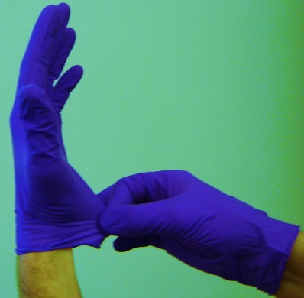
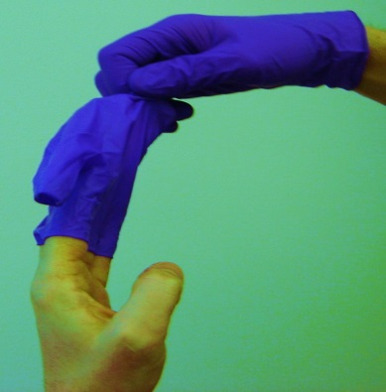
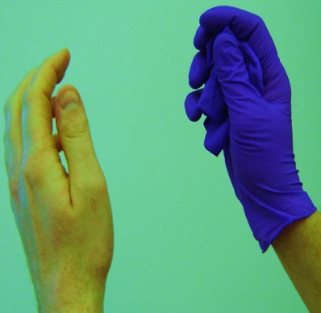
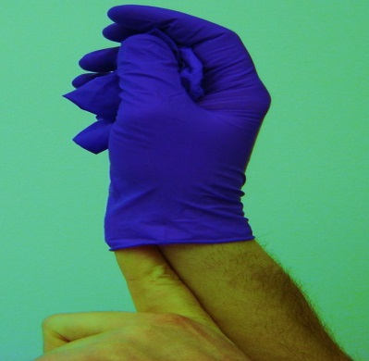
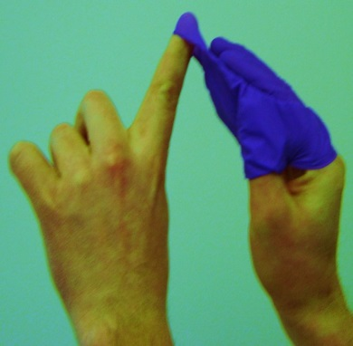
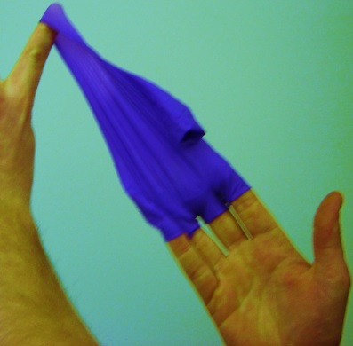
Personal Protective Equipment
Notes:
REMOVAL OF GLOVES: FOLLOW 6 STEPS IN PHOTOS
Use one gloved hand to grab the palm of the second glove.
Slowly pull the second glove inside out into the palm of the first glove.
Slip a crooked finger of the first hand into the cuff of the gloved hand and slowly pull the glove down until both gloves are contained.
Dispose of in biohazard bag or double bagged garbage

Slide 10
Student Performance
1. Have students perform glove removal and proper disposal

Slide 11
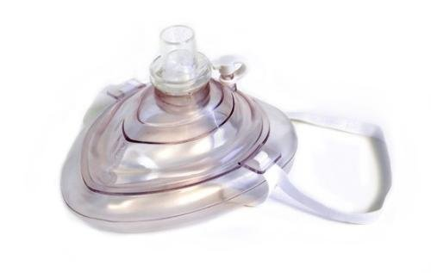
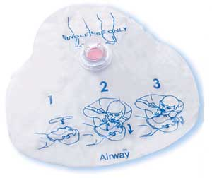
Personal Protective Equipment
Pocket Mask
Face Shield
Notes:
A POCKET MASK – has a one-way valve and filter. Usually is popped open.
Place at the bridge of casualty’s nose. Creates a seal against casualty’s face. Air blown in goes through filter. Expelled air goes through one way valve away from first
Can be disinfected for re-use (10 parts water, 1 part bleach). Valve and filter must be replaced
FACE SHIELD- May have filter or filter and one-way-valve and possibly with bite block
Place over mouth to deliver air. Remember to pinch casualty’s nose.
Must seal their mouth over casualty’s mouth to deliver air
Must release the seal to allow air to be released
Disposable. One use only.

Slide 12
Critical Incident Stress and
Post Traumatic Stress Disorder

Slide 13

First Aider’s Reaction
Critical Incident Stress immediately after:
Anxiety
Upset stomach
Difficulty sleeping
Drink too much
Unable to eat or eat too much
Panic attacks
Teary
Post Traumatic Stress after 72 hours:
Personality changes
Poor hygiene
Always late or no show
Always tired
Excessive alcohol or drug use
Notes:
CIS: Normal sensation after the emergency caused by unused adrenaline
Talk to someone, ie: peer, co-worker, counselor, family member
PTS: If feeling not decreasing after 72 hours, seek professional

Slide 14
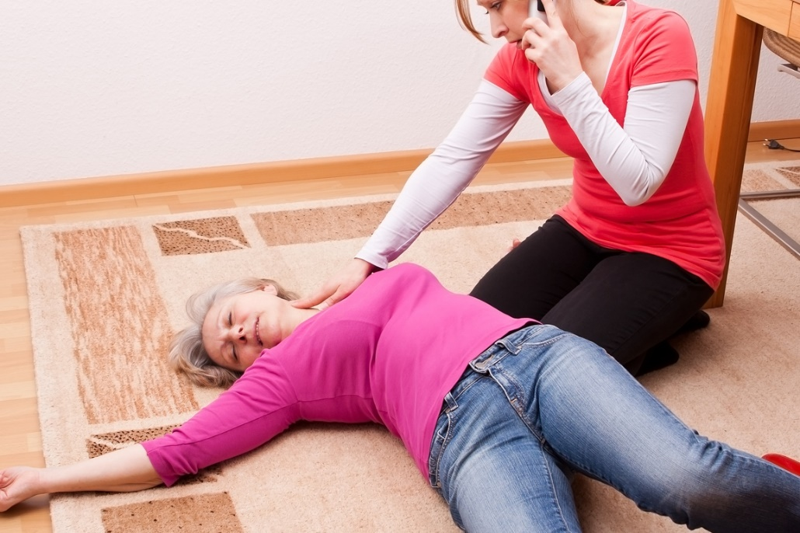
Emergency Scene
Management

Slide 15
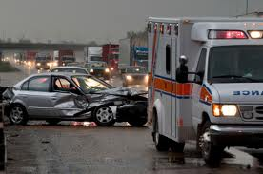
Emergency Scene Management
Scene Survey
Primary Survey
Secondary Survey
Ongoing Care

Slide 16
Emergency Scene Management
In all emergencies use this sequence:
Look, Talk, Call,
Airway, Breathing, Circulation

Slide 17
Emergency Approach
Look – hazards, MOI and how many injured
Talk – check for responsiveness and get consent
Call – get someone to call 911 and another person to get an AED
(internal response plan)
Airway – open airway with head – tilt, chin – lift
Breathing – check for normal breathing for 5-10 seconds
Circulation – ensure no severe bleeds or start CPR if needed
Defibrillation – if casualty is unresponsive with no breathing

Slide 18
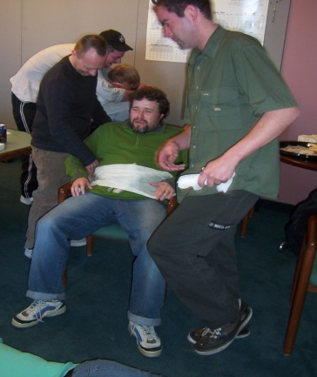
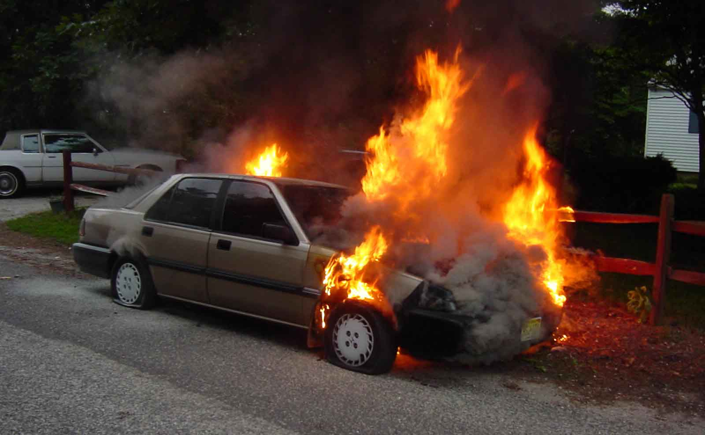
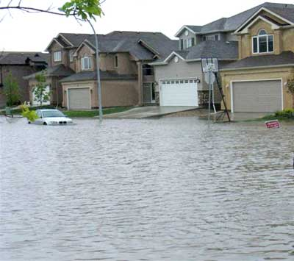
Scene Survey
Look – MOI, hazards and how many injured
Notes:
LOOK for hazards: Fire, wire, glass, gas, traffic, crowds, animals.
Try to determine the MOI by looking and asking
Take charge of the scene. Call out for assistance from bystanders
Are there clues? Ie overturned ladder
Ask how many people injured for proper triage.
If hazard cannot be safely removed, get to safe location and let 911 know
***Have students discuss potential hazards at their workplace. Different ones at home? Other sites? Highway, ballpark?

Slide 19
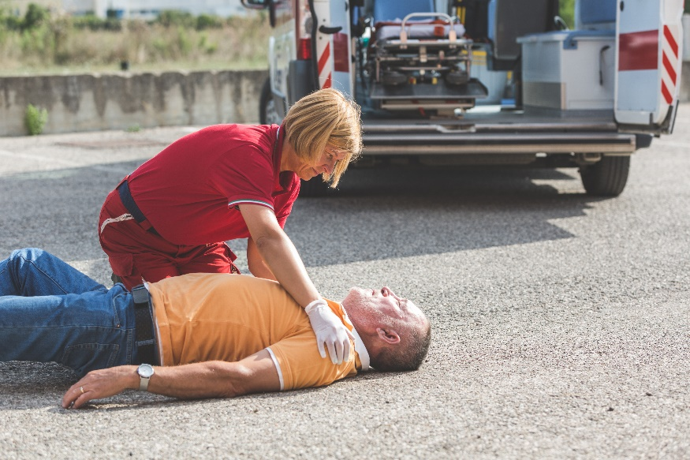
Scene Survey
Talk to the casualty: if unresponsive tap n’ shout for up to 5-10 seconds
Call 911, if possible get someone else to call and get an AED (internal response plan)
Take Charge and Delegate!
Notes:
Introduce yourself as a first aider to obtain consent and to ask what is wrong
Casualty not responding? Tap on both shoulders calling into both ears for 5 – 10 seconds
Suspect head or spinal due to MOI? Tell casualty “Don’t Move”. Get bystander to provide spinal motion restriction by holding head in place. Direct.
Take charge, delegate and treat casualty. Have someone call 911 and have someone bring AED , if available, to the site. All to return when done

Slide 20
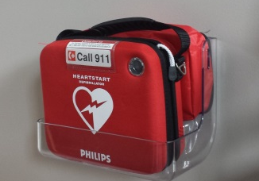
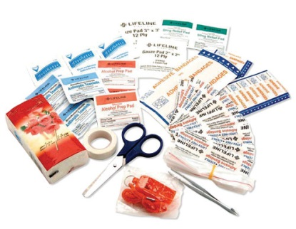
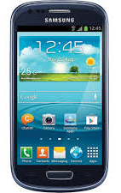
Scene Survey
Use bystanders for help with:
911 phone call (cell vs. landline)
AED
First aid kit and blankets
Traffic and people control
Watch for fire and EMS
What else can they help with?
Notes:
DISCUSS: What things can bystanders help you with?
DISCUSS: Benefits and pitfalls of landline vs. cell phone, VOIP
DISCUSS: 911 Questions
Exact location, best entrance, phone # calling from, what happened, how many injured, is casualty responsive, breathing or do they have severe bleeding?
Do not hang up until instructed. Follow dispatch instructions.
Language lines available.

Slide 21
Student Performance
1. Have students perform a scene survey.
Notes:
Look, Talk, Call and AED
Look for hazards, # of injured, MOI
Talk- Introduce, get consent, ask what happened. No verbal response? Tap and shout for 5 – 10 seconds
Call - Students should instruct bystander to call 911 and get AED or have another person get AED

Slide 22
Emergency Scene Management
Primary Survey
Airway – open airway with head tilt, chin lift
Breathing – check for normal breathing
Circulation – ensure no severe bleeds or start CPR if needed
Defibrillation – for casualty’s unresponsive and not breathing
Notes:
Unresponsive casualty lying on back.
Tongue muscles relax and can block airway.
Head-tilt-chin-lift required to pull the tongue muscle back and to open the airway
Demo on next

Slide 23
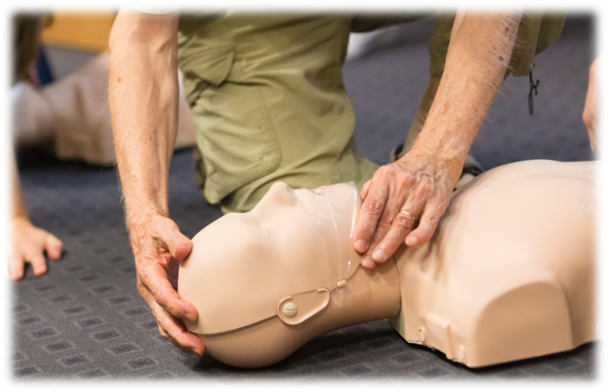
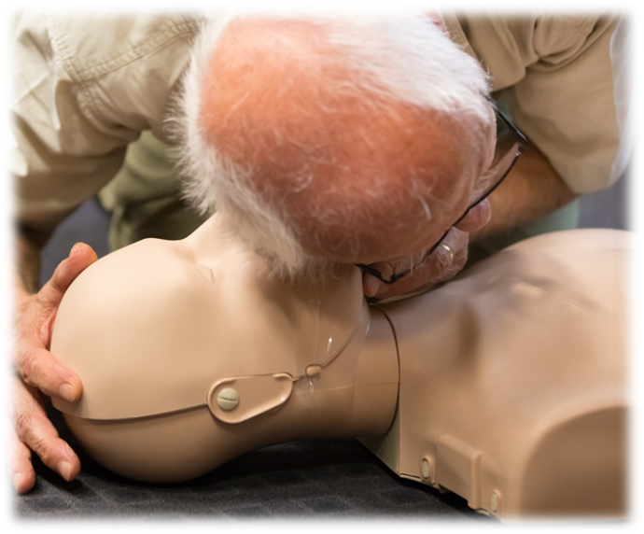
Primary Survey
A – open the unresponsive casualty’s airway with a head – tilt, chin – lift
B – check for normal
breathing for 5-10 seconds
(not agonal breathing)
Notes:
AIRWAY –Place one hand on the casualty’s forehead and push down. With two fingers of the other hand, lift up under the casualty’s chin. Maintain this while casualty is unresponsive
BREATHING- Normal breathing described as at least one breath in and out every 5 – 10 seconds.
How to assess breathing- bring your cheek close to the casualty’s face looking towards the casualty’s chest.
DISCUSS AGONAL BREATHING – Appearance of breathing or gasping but no air movement VIDEO

Slide 24
Primary Survey
Agonal Breathing
Agonal Breathing

Slide 25
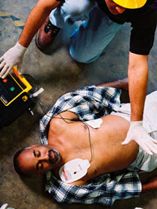
Primary Survey
C – circulation if patient is not breathing or not breathing normally they have no circulation start CPR 30:2 for all age groups
D – defibrillator is used on all age groups when they are unresponsive and not breathing
Notes:
If unresponsive and not breathing, begin CPR with 30 compressions followed by 2 breaths, continue until AED arrives
If breathing normally, perform rapid body check looking for any severe bleeds, abnormalities, wet spots, medic alert
Look for DOTS- Deformities, Open Wounds, Tenderness or Swelling
Used gloved hands, gently squeeze the casualty’s body from head to toe.
If severe bleeding found, attempt to control before moving on
DEFIBRILLATION: only used for casualties in cardiac arrest

Slide 26
Student Performance
1. Have students perform a primary survey.
Notes:
Students Pair up -
ABCD
Kneeling beside a casualty, perform head-tilt-chin-lift
Check for normal breathing for 5-10 seconds
Advise student that casualty is breathing normally
Students should be wearing gloves and perform a rapid body check looking for severe bleeds, fractures, medical bracelets.
If bleeding found, controls bleeding before moving on.

Slide 27
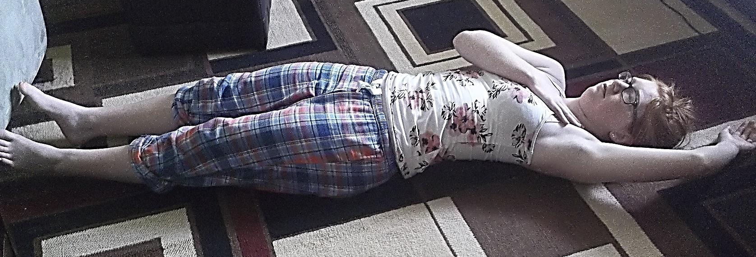
Recovery Position
Step 1
Notes:
A shock position that is used for casualties that are breathing and have no suspected head or spinal injuries. Beneficial for casualty who is or may be vomiting.
Kneel beside casualty’s waist area
2. Take casualty’s closest arm and move it gently above their head
3. Take casualty’s opposite arm and bring it across their chest, placing the hand on their shoulder. Hold in place for unresponsive casualty.

Slide 28
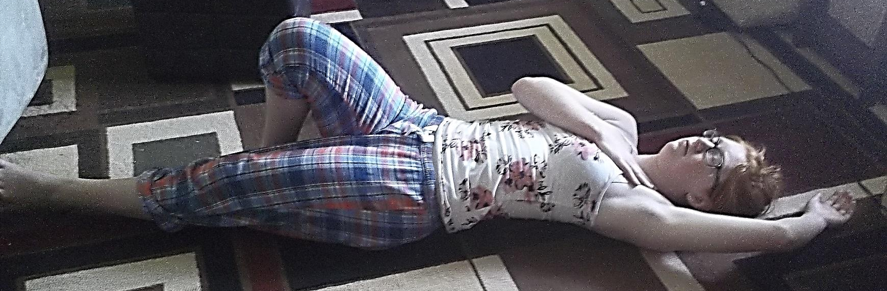
Recovery Position
Step 2
Notes:
Step 2:
Use free hand to take the casualty’s opposite knee and pull on the knee to drag the casualty’s heel towards their buttocks. Hold knee in place
Now push the knee down towards the ground and guide the upper body over while holding the casualty’s arm. Do not pull on the arm.
Continue until the casualty’s knee is touching the ground in front of the first aider, with the casualty on their side.

Slide 29
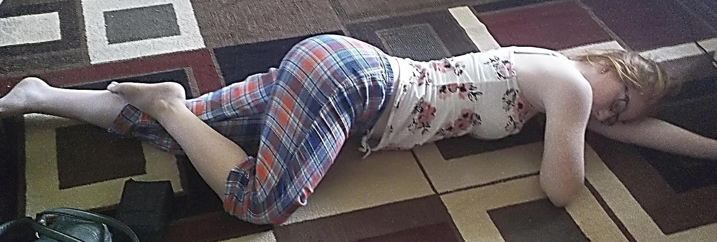
Recovery Position
Step 3
Notes:
Step 3:
Ensure the casualty’s elbow is drawn up so the casualty’s face is tilted toward the ground.

Slide 30
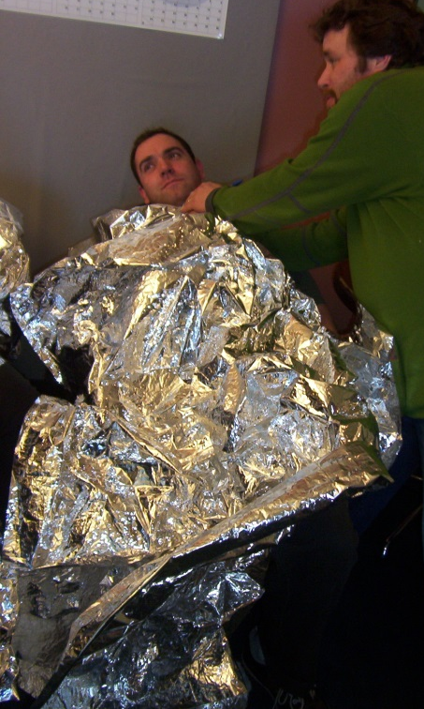
Secondary Survey and Ongoing Care
Secondary Survey - If casualty’s ABCs are stable or there is a delay in EMS response proceed with a head to toe exam
Ongoing Care
  Monitor ABCs
  place casualty in resting position
  keep warm
  nothing to eat or drink
Notes:
Secondary Survey
Briefly discuss the head to toe exam. Will be covered in more detail on Day 2
Monitor scene, ABC’s
Resting or in shock position. Keep warm. Nothing to eat or drink.
Talk to casualty and get more info if there is time
Record info to give to EMS
Talk to unresponsive casualty.

Slide 31
Student Performance
1. Have students place a student into the recovery position and perform on going care.
Notes:
Place casualty in recovery position.
Cover with blanket and monitor ABC’s
If unresponsive, place one hand on back and the other in front of their face feeling for breathing.
Reassure casualty.
Reassess ABC’s monitor, record and report.

Slide 32
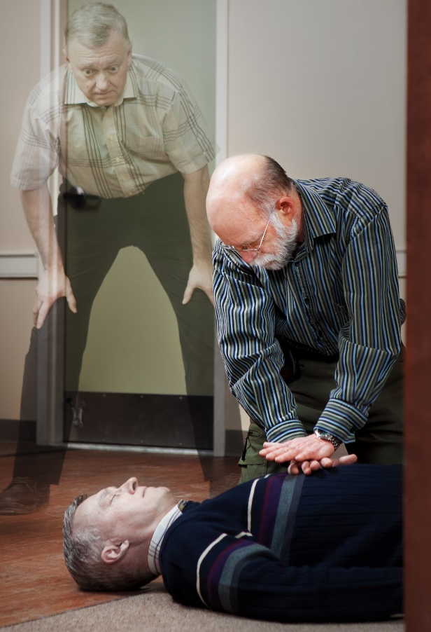
Cardiovascular Emergencies

Slide 33
Cardiovascular Emergencies
The leading cause of cardiac arrest in Canada is:
  Heart Attack and Angina
  Stroke and TIA
These are usually due to cardiovascular disease.
Always remember:
Look, Talk, Call, ABCDs
Notes:
STATS Canada 2008- Cardiovascular Deaths
54% Ischemic Heart Disease, 20% Stroke. 23% Heart Attack
DISCUSS RISK FACTORS FOR CARDIOVASCULAR DISEASE: Obesity, smoking, heredity, stress, genetics,
DISCUSS PREVENTION: Exercise, not smoking, good diet, stress free life

Slide 34

Cardiovascular Emergencies
®HSFC
Early access to 911
Early CPR
Early AED
Early Advance Care
Notes:
1. Immediate recognition and activation of 911MMEDIATE RECOGNITION AND ACTIVATION OF 911
2. Early CPR should be started ASAP on unresponsive casualty not breathing with no visible signs of circulation in order to provide oxygen to the vital organs until trained professionals arrive.
3. Rapid Defibrillation shocks the heart that is beating ineffectively and allows the heart to reset to a normal rhythm
4. Effective Advanced Life Support by trained healthcare providers on scene, enroute or at hospital
FIRST AID TREATMENT INCLUDES:
LOOK, TALK, CALL, ABCD. Get medical help immediately. Casualty in resting position. Treat for shock. Provide CPR and AED if needed

Slide 35
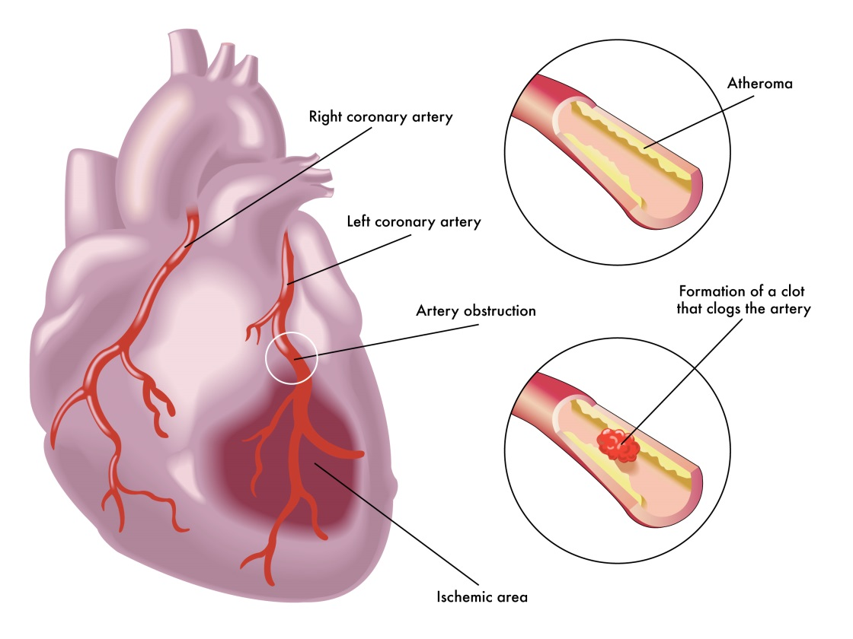
Cardiovascular Emergencies
Heart Attack “The interrupted blood flow that occurs during a heart attack can damage or destroy a part of the heart muscle.” (www.mayoclinic.org)
Angina “… is a type of chest pain caused by reduced blood flow to the heart muscle. Angina is a symptom of coronary artery disease. ” (www.mayoclinic.org)

Slide 36
Cardiovascular Emergencies
Signs and symptoms
PASS IT ON
Pale
Anxiety
Sweating
Short of breath
Angina: Only lasts 10 minutes with rest and medication. If discomfort persist longer call 911
Indigestion
Tightness in chest
Over all weakness
Nausea and vomiting
Notes:
Chest pain often described as:
Tightness, heaviness, constricting, may refer to one or both arms.
Females typically complain but can be male pain into neck, jaw between shoulder blades
Remember not everyone gets pain but will have signs of shock

Slide 37
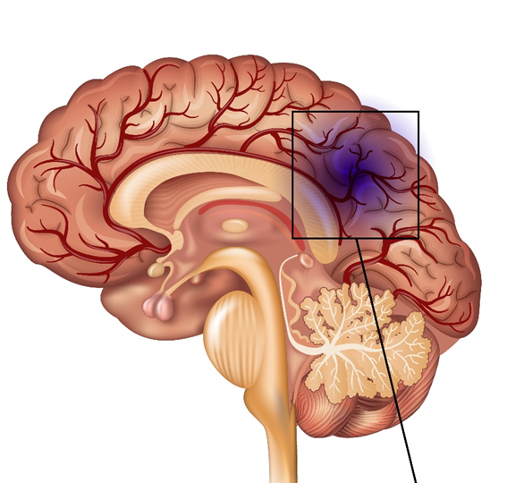
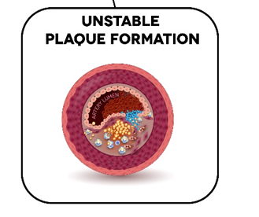
Cardiovascular Emergencies
Ischemic Stroke “Occurs when the blood supply to part of your brain is interrupted or severely reduced, depriving brain tissue of oxygen and food” (www.mayoclinic.org)
Hemorrhagic Stroke “A brain aneurysm can leak or rupture, causing bleeding into the brain.” (www.mayoclinic.org)
Notes:
Ischemic Stroke: Caused by a clot or other blockage within an artery leading to the brain (embolic and thrombotic)
Embolic – clot formed elsewhere and travels to brain arteries
Thrombotic- diseased or damaged brain artery become blocked by formation of blood clot – 80% of all strokes
Hemorrhagic Stroke:: Occurs when a diseased blood vessel within the brain bursts, allowing blood to leak inside the brain

Slide 38
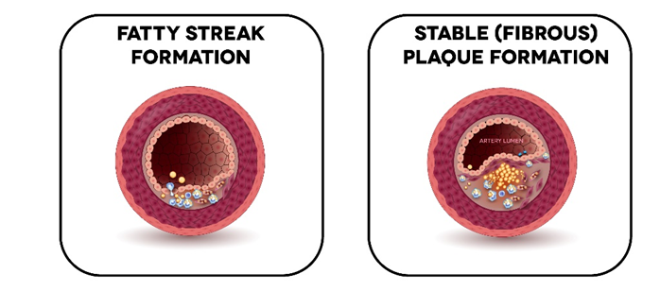
Cardiovascular Emergencies
Transient Ischemic Attack (TIA) - “Is like a stroke, producing similar symptoms, but usually lasting only a few minutes and causing no permanent damage.” (www.mayoclinic.org)

Slide 39
Cardiovascular Emergencies
Signs and symptoms
F
Facial droop, headache vision problems
Arm drift, numbness, paralyzed
Speech problems
Time of onset quick onset
A
S
T
Notes:
F - Have casualty try to smile (one side of mouth does not move when casualty smiles)
A - Have casualty extend both arms out in front of them and close their eyes. One arm will drift down or sideways. May notice weakness, numbness or paralysis of arms/legs on one side of body
S - Speech problems – slurred speech, proper words that make no sense or unable to speak at all
T - Time of Onset - Signs and symptoms occur suddenly and rapidly. May also have headache, vision problems, memory problems, confusion.
Time to Hospital - must be diagnosed and treatment begun with 3 hours of onset to give medication which can almost completely reverse stroke damage. Paramedics can take casualty directly to Regional Stroke Hospitals . Casualty must fit certain parameters and be diagnosed and treated within 3 hours of first sign or symptom

Slide 40
Cardiovascular Emergencies
First Aid Treatment
Look, Talk, Call ABCDs
Resting position
Cover and reassure
Nothing to eat or drink
Assist with medications if needed

Slide 41
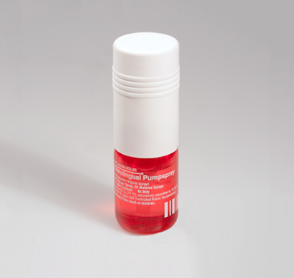
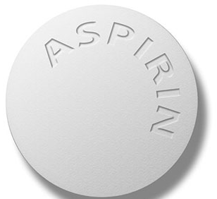
Cardiovascular Emergencies
5 rights of medications
Before assisting with medications ensure the patient is conscious and alert.
Right :
  Person
  Medication
  Dose
  Time between doses
  Route
Notes:
Right Person – No sharing of prescription meds. Must be their medication
Right Medication - for this illness
Right Route - by injection, inhalation or swallowing
Right Dose - Is it the right dosage for the casualty. How many times can they take their meds.
Right time – between doses
Assist with any of their own meds: ie ASA 2 x 81 mg chewable or one 325 mg ASA crushed. Anti clotting medication
Nitro dilates coronary arties for 5 mins lowering pressure and work of the heart

Slide 42
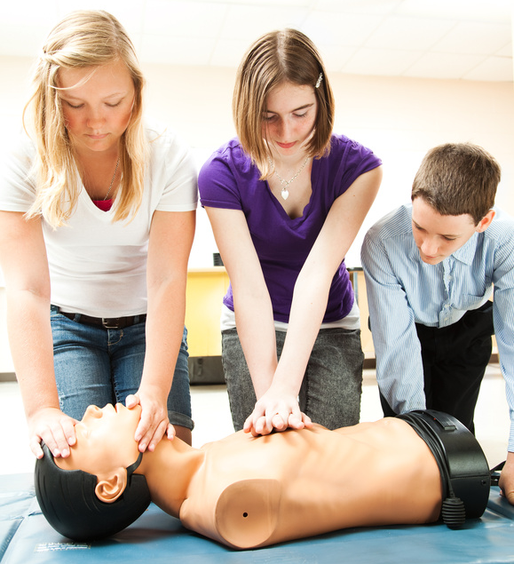
Adult CPR

Slide 43
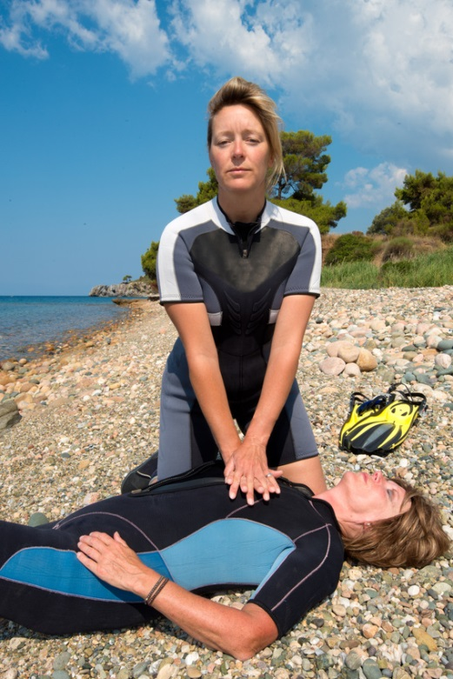
Adult CPR
Cardiac arrest is when the heart stops pumping blood because of muscle (mechanical) or electrical problems
Causes:
Drowning
Electrocution
Heart Attack
Trauma
Notes:
CPR has been used in pre-hospital setting since early 1970’s. Still little increase in survival rate over last 40 years or so
Less than 5-10% of adults who get CPR alone will ever walk out of hospital.
CPR important because it delivers oxygen to the brain.
Without oxygen in 4-6 minutes brain damage starts to occur. In 6-8 mins brain damage, 10 mins plus, brain damage usually permanent
CPR is started immediately so brain and heart will stay oxygenated until AED or paramedics arrive with more advanced TX.
Urban EMS usually take 8-10 mins to arrive on scene. Community CPR is the only way to increase chance of survival/
Learn CPR!!!

Slide 44
Adult CPR
Cardiac Arrest
Signs and Symptoms
Unresponsive
Not breathing
Cool to touch
Not moving
Gray or ashen coloured
No signs of life or circulation
First Aid Treatment
Look, Talk, Call, ABCDs
Start CPR
Attach AED
Continue until EMS takes over

Slide 45
Adult CPR
 | Adult | Child | Infant
Ages | Over 8 | 1 -8 years | Under 1 year
Call 911 | Unresponsive | Unresponsive | Unresponsive
Lone Rescuer | Immediately | After 2 mins. | After 2 mins.
Ratio | 30:2 | 30:2 | 30:2
Depth | Min. 2”(5 cm) | 2” (5 cm) | 1/3 diameter or 1.5”(4 cm)
Technique | 2 hands | 1 or 2 hands | Two fingers
Use AED | Yes | Yes | Yes
Notes:
treatment for Cardiac Arrest:
LOOK, TALK, CALL, ABCD
Start CPR 30:2 (100-120 compressions per min)
Attach AED as soon as it arrives and continue until EMS takes over
Lone Rescuer: In the adult, we call 911 immediately and then begin CPR, even if you have to leave the casualty to do this. If you do, place the casualty in the recovery position until you return.

Slide 46
Adult CPR
Always:
Look, Talk, Call, ABCDs
Place patient on hard flat surface
Start with 30 compression
Open airway and give 2 normal and rhythmic breaths 1 second each, until the chest rises
Breathing too hard encourages vomiting
Rate of at least 100 compressions/minute
Notes:
Look Talk, Call, ABCD. Start CPR if casualty is unresponsive and not breathing normally
Kneel beside casualty’s torso, placing heel of hand in centre of casualty’s chest between the nipples.
Place the other hand on top of the first hand ensuring only the heel of hand is on the chest.
Lock elbows in the straight position and ensure shoulders are over top of their hands.
Push down at least 2 inches and do 30 compressions (30 should only take 18 seconds)
Allow chest to rise between compressions. If first breath doesn’t go in, reposition and try again. If second doesn’t go in start compressions.
Perform 30 compressions pushing hard and fast.
After 30 compressions, give 2 rescue breaths with a barrier device. Blow enough air to see casualty’s chest rise and then stop.
Should only take 1 second. When air has escaped, deliver 2nd breath.
Reminder: overinflating the lungs can cause air to enter stomach and increases chance of vomiting

Slide 47
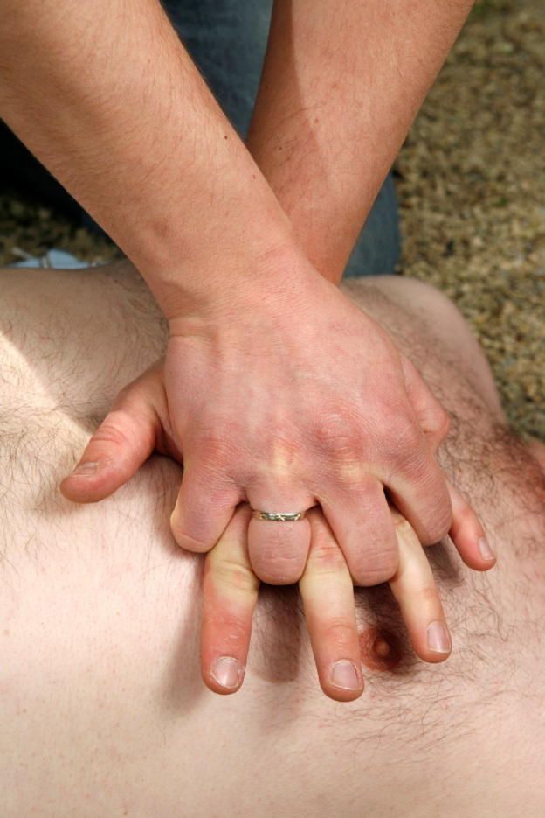
Adult CPR
Use 2 hands pushing down at least 2 inches
(5cm)
Notes:
REMEMBER:
Pushing hard and fast at a rate of at least 100 compressions/min and allowing the chest to completely rise between compressions and minimizing interruptions of compressions gives casualty best chance of survival.
CPR is very tiring, so it is recommended that a second rescuer assist with CPR and switch positions every 2 minutes of 5 cycles of CPR
Assistant does not need to be trained in CPR, rather just willing to help and listen to your directions

Slide 48
Adult, child and infant CPR
Hands Only CPR
If you are unwilling to give rescue breaths do compressions only non stop until EMS takes over
If a barrier becomes available switch to 30:2
Switch off with another first aider every 2 minutes
Remember push hard and fast, minimize interruptions and let the chest fully rise every time
Notes:
Common method used by EMS dispatch for most cardiac arrests

Slide 49
Adult CPR
Stopping CPR
Another person takes over CPR (first aider, fire or EMS)
Your environment or health is endangered
The patient shows signs of life
An AED tells you to clear the patient
patient vomits (recovery position) and start CPR again
Notes:
OTHER NOTES
1. Not unusual to cause rib dislocation or fractures during normal CPR. May feel like crunching or like someone cracking knuckles. Ensure correct placement and continue. Better to have fractured ribs than to be dead with ribs intact.
2. Casualty may vomit without warning. Turn them to their side to let vomit drain, then place on back again and continue CPR.

Slide 50
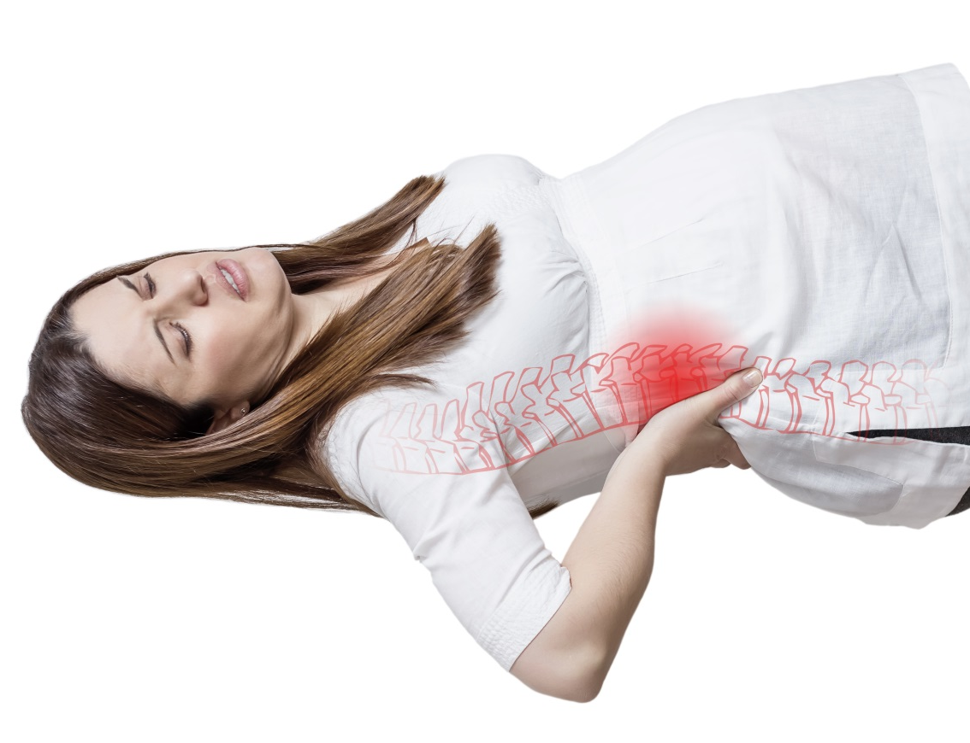
Adult CPR
Wedge 1” (2.5 cm) under right hip
Notes:
This takes pressure of the baby weight off the inferior vena cava allowing free flow of blood back to heart.

Slide 51
Student Performance
1. Have students perform look, talk, call, ABCDs. patient is not breathing. Student to perform CPR 30:2 for minimum 5 cycles.
Notes:
SCENARIO 1. Each student must perform this skill
1. LOOK, TALK, CALL, ABCD – Delegate someone to call 911 and someone to get AED. Indicate that casualty is not breathing.
2. Immediately start chest compressions (30:2) pushing down at least 2”. Push hard, push fast.
3. Put barrier device in place, then perform head-tilt-chin-lift.
4. Give 2 rescue breaths lasting 1 second each Watch for chest rise. Reposition if first breath does not go in and attempt 2nd breath.
5. Continue CPR
Each student to perform a minimum of 5 cycles or 2 minutes of CPR

Slide 52
Child C.P.R. – 1 and 2 rescuer
Look – All hazards, how many people injured, and MOI
Talk – Talk to person, if no response, tap and shout then, check for normal breathing for no more than 5 -10 seconds
Call – direct another person to call 911, someone else to get a first aid kit and AED (start internal response)
Airway – open airway with head tilt, chin lift
Breathing – check for normal breathing
Circulation – ensure no severe bleeds or start CPR if needed
Defibrillation – for casualty’s unresponsive and not breathing

Slide 53
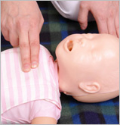
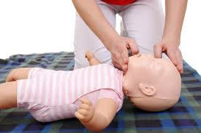
Infant CPR
Two fingers just below the nipple line in the centre of the chest
Head tilt chin lift into sniffing position and ventilate twice
Pushing down 1^{1/2} inches (4cm)

Slide 54
CPR
Lone Rescuer
Adult
Leave adult in recover position as soon as you have determined that the casualty is unresponsive, call 911 and return to provide first aid treatment
Child and Infant
For all casualties under the age of 8 perform two (2) minutes of CPR prior to calling 911

Slide 55
CPR
Push Hard and fast
At least 100 compressions/min
Minimize interruptions
Allow chest to completely rise
Don’t stop CPR until
  AED arrives
  EMS takes over
  Signs of circulation

Slide 56
CPR
CPR is very tiring switch every 2 minutes for high quality CPR
1 or 2 person CPR still 30:2
Push hard, Push fast
Allow the chest to rise after every compression
Limit interruptions
Notes:
Teamwork, communication to help each other with encouraging words and coaching.
BREATHS- Person providing breaths will be positioned by casualty's head, ideally on opposite side from first aider doing compressions. Maintain head tilt chin lift and the barrier device on casualty’s face during compressions.
COMPRESSIONS- Ensure that you count out loud, so the other first aider can be prepared to give breaths immediately after the 30th compression for minimal interruption of CPR. Do not remove your hand from the casualty's chest during rescue breaths instead let them rest lightly on the chest. Let the other first aider know whether the breath was successful
SWITCHING POSITIONS – WHEN THE 5TH CYCLE OF CPR IS IN PROGRESS, COMMUNICATE THAT AFTER THE 30TH COMPRESSION, THE SWITCHING OF POSITIONS SHOULD OCCURE. EACH FIRST AIDER WILL STAY ON THE SIDE THEY ARE ON, BUT SWITCH ROLES.
SWITCHING POSITIONS – WHEN THE 5TH CYCLE OF CPR IS IN PROGRESS, COMMUNICATE THAT AFTER THE 30TH COMPRESSION, THE SWITCHING OF POSITIONS SHOULD OCCURE. EACH FIRST AIDER WILL STAY ON THE SIDE THEY ARE ON, BUT SWITCH ROLES.

Slide 57
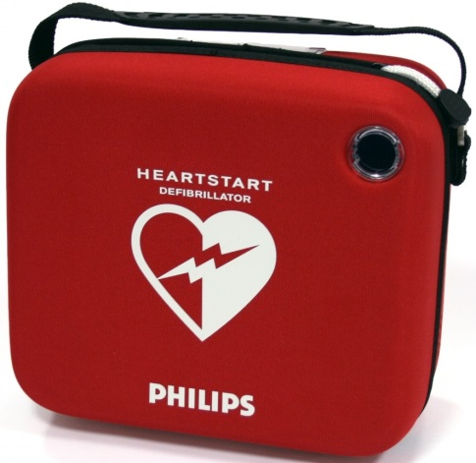
Automated
External
Defibrillators

Slide 58
Automated External Defibrillators
AED – Automated External Defibrillator
Can be used by anyone on any age
AED – Computer programed ECG
Hearts electrical system gets irritated without enough oxygen
Most common wrong rhythm 80% of SCA
AED will only allow a shock if finds VF or VT

Slide 59
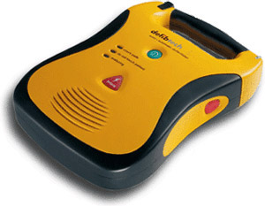
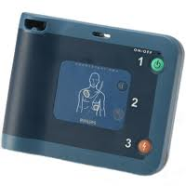
Automated External Defibrillators
Look For AEDs in public areas
All basics of AEDs the same
  Easy to turn on/off
  All talk
  All have electrodes
  Shock ability
  Data Recording
Notes:
ASK STUDENTS IF THEY HAVE SEEN AEDs IN THEIR COMMUNITY
Can be found in most public and government locations and some private locations.
Look for door sticker of a heart with a lightning bolt (many colours)
Arenas, high schools, colleges, pools, rec centres, go trains and stations, airports, libraries, fitness centres, golf courses, Onsite AEDs based on owner’s good will. Not mandatory as of 2015

Slide 60
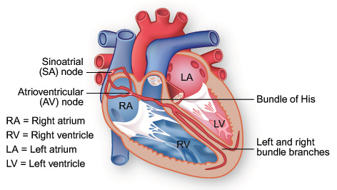
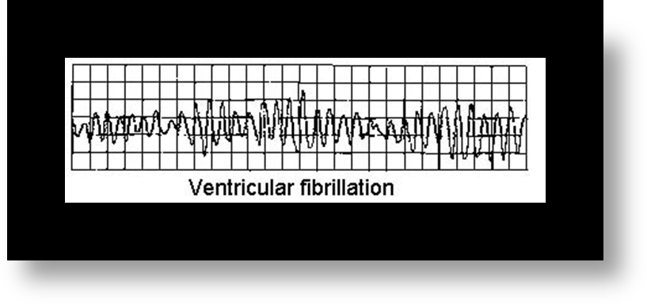
Automated External Defibrillators
Shockable Rhythm
Notes:
RESPIRATORY SYSTEM- Delivers oxygen into lungs. Circulatory system delivers oxygen rich blood to the body. Air enters through nose and mouth to trachea, bronchi, bronchioles, alveoli where gas exchange happens
CARDIOVASCULAR SYSTEM- Heart is muscle with 4 chambers. Top two are atria, bottom two are ventricles. Pumping action of heart is created by heart’s own electrical system. Normally atria fill with blood and when full, allow that blood to flow into ventricles. From there blood is pushed out to body and lungs.
IF ELECTRICAL SYSTEM DOESN’T GET ENOUGH OXYGEN…..
Can cause the ventricles to fibrillate or quiver. This causes inadequate filling of the ventricles and diminished to no blood flow to the body. The only thing that can help is a defibrillator. VF is the most common initial dysrhythmia for the first 3-10 minutes. Every minute that nothing is done, the casualty loses 7 – 10% chance of survival.

Slide 61
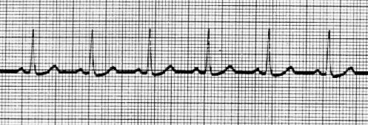
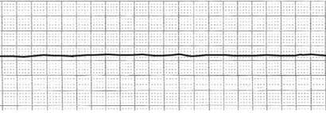
Automated External Defibrillators
No Shock
Normal Sinus Rhythm
Asystole
Notes:
INTERESTING INFO:
AED’S only recognize two ECGs. Ventricular Fibrillation and Ventricular Tachycardia :::: Shock Advised
Only 0.5% of adults are resuscitated with CPR only
When an AED is activated within the first 3-5 minutes and delivers a shock, survivability may increase to 50%. If AED does not recognize the rhythm as one of those two, it will say “No Shock Advised”, Continue CPR.

Slide 62
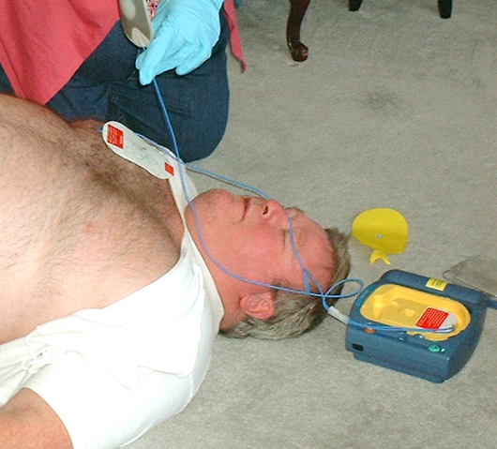
Automated External Defibrillators
Place AED by casualty’s head
  Turn AED on
  Listen to instructions
  Place pads on bare dry chest
  Clear the patient
  Push shock button if required
  Start CPR for 2 minutes
Cycle repeats every 2 minutes
Notes:
.
Remove clothing from casualty’s chest. Place pads on bare chest.
When an AED says “Do not touch casualty” Stay away and ensure all bystanders are clear for safety reasons. Repeat loudly “CLEAR”
Shock Advised, Stay Clear ! First Aider says “I’m clear, everyone stand clear!”
Push flashing shock button and then follow prompts. Leave AED on and continue CPR for 5 cycles or 2 minutes. AED will re-analyze and advise first aider to push flashing shock button if required or will say “No Shock Advised”
It re-analyzes every 2 minutes
If casualty becomes responsive or starts to breath, leave AED and pads on. Place casualty in recovery position, reassure, keep warm, monitor.

Slide 63

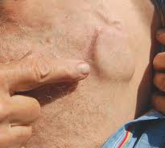


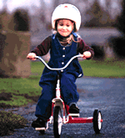

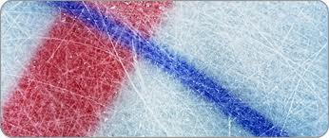
Other Considerations
Notes:
SPECIAL CIRCUMSTANCES:
DROWNING - Use AED but make sure casualty is not in pool or puddle of water ELECTROCUTION – Use AED! Watch for hazards
TRAUMA – OK to use AED PREGNANT - Yes, Save the mother, save the child. Place 1” wedge under right side hip
CHOKING – Yes, use AED. May actually help dislodge obstruction. EXCESSIVE CHEST HAIR- shave the area
MEDICATION PATCHES – remove medication patches in the way with gloved hands
IMPLANTED PACEMAKERS OR DEFIBRILLATORS - Place about 1 inch or 2.5 cm away from implanted device
PIERCINGS – If within 1 inch of pads, remove if possible.

Slide 64
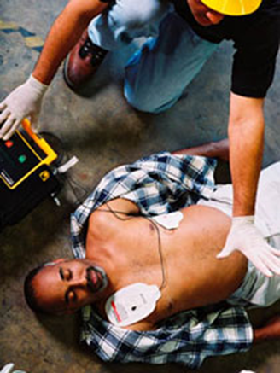
Automated External Defibrillators
Always leave pads (electrodes)on casualty
Always leave AED turned on
Even when casualty regains signs
of life
Place casualty in the recovery
position, monitor ABCs,
reassure and keep warm until EMS takes over
Notes:
CHILD AND INFANT PADS AND PLACEMENT:
Most AED manufacturers have child or pediatric electrodes but many AED sites only have adult pads.
Of course it is better to have the appropriate pads but in the absence of child pads, you are to use the adult pads.
Place the (adult upper) one in the front in the centre of the chest and place the lower left one in the centre of the back between the shoulder blades.
With each AED, there is a pouch with supplies. ie Gloves, pocket mask or barrier device, razor, scissors, paper towel.

Slide 65
Student Performance
Student is to perform look, talk, call, ABCDs. Perform CPR until the AED arrives.
Continue to follow AED instructions for 2 analyzes, ensuring at least 2 position switches between rescuers performing CPR.
Notes:
Student performs LOOK, TALK, CALL, ABCD’S and performs CPR until AED arrives.
When AED arrives, another first aider takes over CPR, while the student performing the skill moves on to use the AED.
Place AED at head of casualty beside first aider.
Turn it on. Remove clothes and ensure chest is dry.
Do not touch casualty while analyzing. Administer shock ensuring all is clear.
Continue CPR for 2 minutes until next analyze.
No Shock Advised – Continue CPR until EMS arrives

Slide 66

Choking

Slide 67
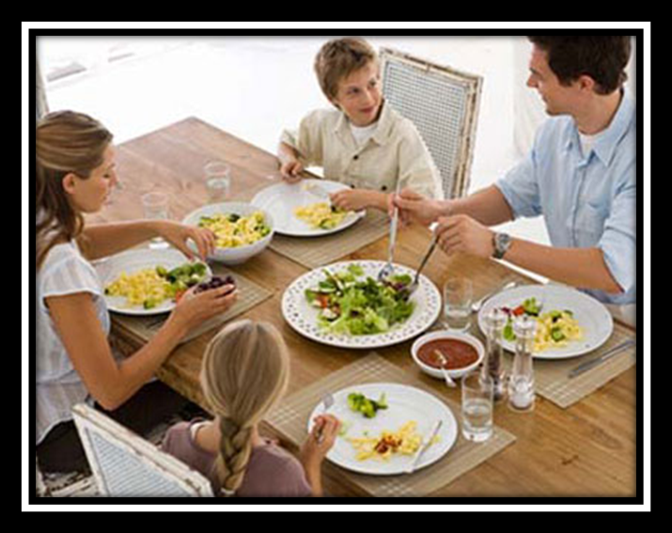
Choking
Prevention
Do not talk and eat at the same time
Small bites of food
Chew well and slowly
Sit while eating
Age appropriate toys
Notes:
Most common cause depends on age of casualty. Usually food or toys.
Don’t talk or laugh while eating.
Avoid excess alcohol

Slide 68
Choking
Adult and Child
Mild Choking
  Can still cough, talk , breath, flushed (red) skin
  Tell them to continue they are doing the right thing and stay with them
Severe Choking
  Unable to cough, talk or breath. May be grasping neck, panicked look on face and may become pale
  We must act to assist patient by:
Notes:
MILD CHOKING: LOOK, TALK, CALL, ABCD. Tell casualty you will stay with them. Remain calm. Encourage them to keep coughing and reassure them they are doing the right thing to clear the airway. Continue until airway clears or it becomes severe choking.

Slide 69




Choking
Can I help you?
Give 5 Back Blows and 5 Abdominal thrusts
Adult
Child
Notes:
SEVERE CHOKING: LOOK, TALK, CALL, ABCD. Send someone to call 911 and another to get AED. Perform up to 5 back blows and 5 abdominal thrusts.
FOR BACK BLOWS, Stand at the side of the casualty placing the arm closest to the casualty’s front across their chest and get them to bend at the waist to a 90 degree angle. With the heel of your free hand, strike the casualty between the shoulder blades until the object comes out. Up to 5 back blows
IF THERE IS STILL A SEVERE BLOCKAGE, Stand casualty up and then stand behind them and locate the casualty’s navel. Place one hand in a closed fist, thumb side to the abdomen just above the navel. Place your free hand over your fisted hand and pull slightly inward to pass the ribs and then straight up. This uses the casualty’s abdominal cavity to put pressure on their diaphragm, to in turn, apply pressure on casualty’s lungs in hopes of dislodging the object. Simulated cough. Continue this until object expelled up to max of 5 times.
FOR SAFETY, Ensure first aider’s head not directly behind casualty’s during abdo thrusts or head may collide. Maintain staggered stance to keep balance.

Slide 70

Choking
Unresponsive
Assist to the ground, ensure 911 has been called and ask for an AED
Start 30 compressions
Before giving 2 breaths check mouth every time for obstruction
Only do finger sweep if
you see something
Continue 30:2 until the patient:
  Shows signs of life
  AED arrives
  EMS takeover
Notes:
Do Not do Blind finger sweep can lead to airway damage
Only if you can see an object then sweep it out
If first breath does not go in, reposition airway and attempt 2nd breath. If that does not go in, start compressions again.
If casualty in advanced pregnancy, remember the one inch wedge under right hip to move the baby’s weight off the IVC

Slide 71
Student Performance
Student to perform treatment to a simulated mild choking patient.
Student to simulate first aid treatment on a severe choking, performing 2 sets of back blows and abdominal thrusts.
Notes:
Instructor Demonstrates and then have students pair up.
Student #1 – Casualty mildly choking, coughing effectively Student #2- Performs
LOOK, TALK, CALL, ABCDS
Encourage casualty to keep coughing and reassures them. Stays with them. Ideally, keep a hand on casualty’s shoulder for reassurance.
Switch roles.
SIMULATED CASUALTY SEVERE CHOKING: Student performs: (2 SETS)
LOOK, TALK, CALL, ABCD. and proceeds with 5 simulated back blows and 5 simulated abdominal thrusts. 2 sets
HAVE STUDENTS SWITCH ROLES

Slide 72



Infant Choking
Prevention:
Adult supervision
Age appropriate toys
Check nipples and pacifiers for wear
Safety locks on doors
Gates at stairwells
www.overstock.com

Slide 73


Infant Choking
Severe
5 back blows
5 chest thrusts
(www.ufhealth.org)

Slide 74
Infant Choking
If infant becomes unconscious ensure 911 (internal response) has been activated.
Then start CPR, after 30 compressions check the infants mouth for any obstructions. If something is found remove it. If nothing found attempt two breaths using BVM. Continue 30:2 cycles until the infant regains breathing, pulse, the AED arrives or EMS takes over.

Slide 75
Student Performance
Student to perform treatment fora simulated mild choking infant.
Student to simulate first aid treatment on a severe choking, performing 2 sets of 5 back blows and 5 chest thrusts.

Slide 76

Choking
Pregnant, large or in a wheelchair patient
After 5 back blows you may use chest thrusts
Flat fist on breastbone using armpits to locate middle of chest
Pull straight in up to 5 times
Then 5 back blows

Slide 77

Choking
Alone and choking
What do you do if you are severely choking and alone?
http://schwartznow.files.wordpress.com/2014/05/dr-oz-2-compressed.jpg
Notes:
Call 911 from a landline if possible. Use chair and drop your abdomen, just below the navel on top of chair top.
ONGOING CARE FOR CLEARED AIRWAY Place in recovery position, reassure, cover and keep warm. Monitor ABC’s often.

Slide 78

2 Person C.P.R.
CPR is very tiring
Switch with another person
after 2 mins or 5 cycles of CPR
CPR remains 30 compressions to 2
Breaths with 2 or more first aiders
performing CPR

Slide 79

CPR Review
Minimize interruptions
Push hard & fast, rate of 100/min.
Allow chest to rise fully (recoil)
Remember high quality compressions
Switch rescuers after 2 minutes (if possible)
Notes:
High quality compressions and starting CPR immediately gives the casualty the best chance of survival.

Slide 80
CPR and AED
Quiz
Evaluations
Certificates

Slide 81

Thank you for taking the time to care!

