Slide 1

Babysitter
Course

Slide 2
Agenda
Getting started
Infants
Toddlers
Preschoolers
First Aid
Quiz
Certificates
Notes:
Go over content of their manual
Remind then of the notes sections

Slide 3





House Keeping
Notes:
Review
Course times
Lunch time and where they can eat
How many breaks
washroom location
Cell phone use

Slide 4
Starting a Business
Places you can get babysitting jobs:
Family and family friends
Parents co-workers
Neighbours
Can you think of other people to ask?
Notes:
Go other and have them make a list of people to talk to
Remind them of safety and how much information they want to reveal

Slide 5
Now you have a babysitting job!
Ask some questions:
Parents full names and cell numbers
Child names or nick names
Allergies
Meal, nap and bed times
Can you think of any other question?
Notes:
Review page 3
See if students come up with other questions

Slide 6
Respect
Remember:
You need to earn the child's respect, so show them respect first
Treat boys and girls the same
Talk and treat children according to their age
Don’t power trip

Slide 7

Infants
A baby up to 1 year old.
They can:
Crawl
Rollover
Sit up
Try to walk
Notes:
Page 5
Review all items babies may be able to do

Slide 8
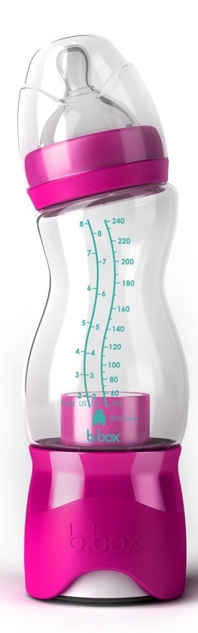
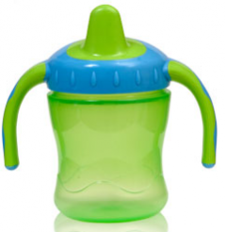

Feeding Time
Infants may:
Only use a bottle
Bottle and food
Sippy cup and food
Notes:
Page 6
Show at least 2 different bottle types
After discussion time to help check temperatures of bottles using water
Show a couple of different spoon types
and the proper amount of for on the spoon oatmeal is a good product

Slide 9

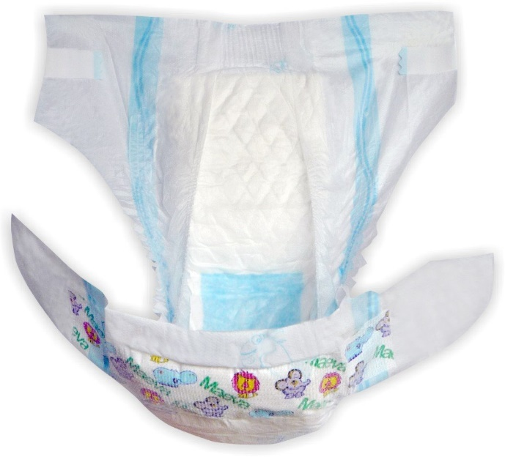
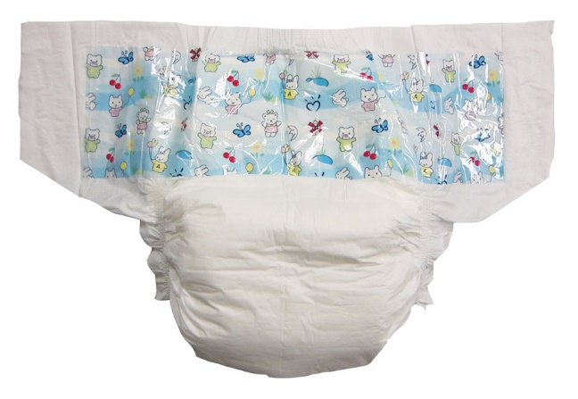
Diaper Changes
Diapers come in different styles
Disposable
Cloth
Notes:
Good time to show the diapers front from back
How the tabs work etc.
Put students into pairs
Hands on diapering a manikin

Slide 10
When caring for an Infant
Always be prepared
Have all you supplies with in your reach
All food ready
All diaper supplies
Other children taken care of

Slide 11
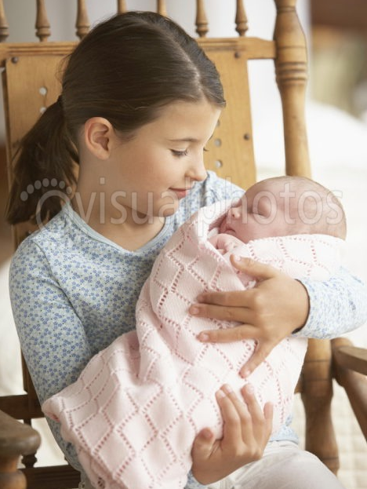

Hold me Close
Most common ways to hold a baby safely:
Shoulder Hold
Cradle Hold
Notes:
Page 9
After discussion
put students in pairs
have a 5 lbs bag of flour or sugar and have them practice the holds
as well as with the manikins

Slide 12
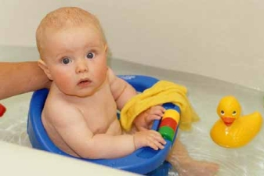
Bath Time
Bathing an infant is difficult
Never leave baby alone for
any reason
Keep bath area warm
Make sure water is the
right temperature
Watch bath water doesn’t
cool too much
Notes:
Page 10
Should be experience in bathing an infant or child
Review safety steps
Door bell
Phone
Other children
Hot water
Water faucet

Slide 13
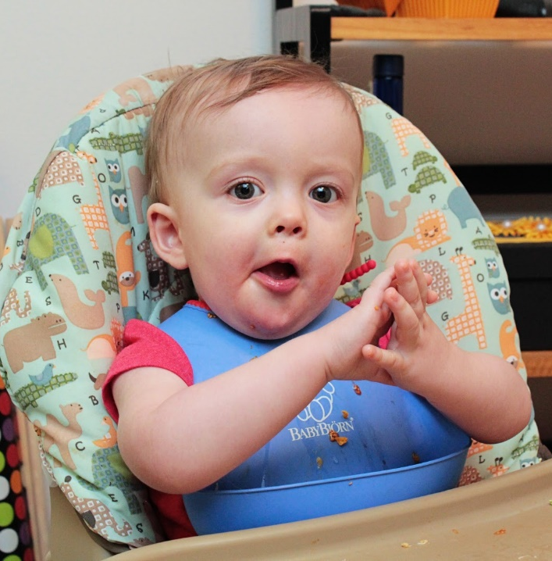

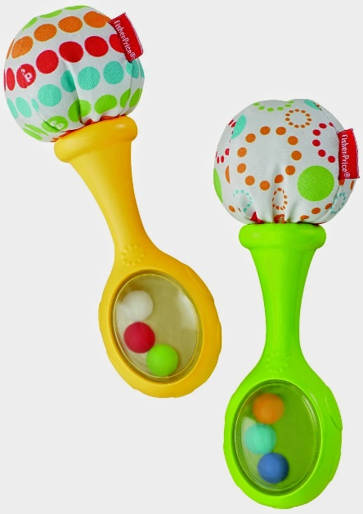
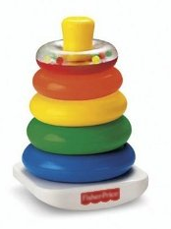
Baby Play
Infants like to play
Play games gently with stuffed toys or building blocks
Sing or read to them: this is playing to an infant

Slide 14

Safety
Keep your cool
Never shake a baby
Always use all safety straps
provided
Never leave the infant alone
unless in their crib
Notes:
Page 12
Discuss keeping your cool techniques put infant in crib
Call for help to parents
Talk about shaken baby syndrome
How pillows and blankets wont keep baby safe

Slide 15

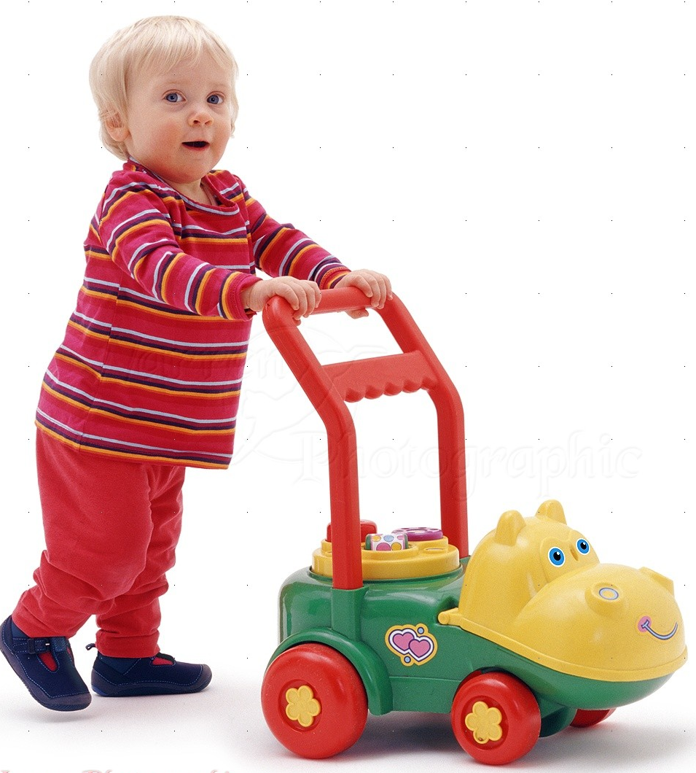
Toddlers
This is from ages 1-3 years old
They now can:
Walk
Run
Talk
Be very strong willed
Notes:
Page 17

Slide 16
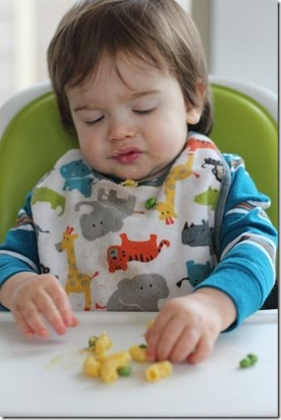

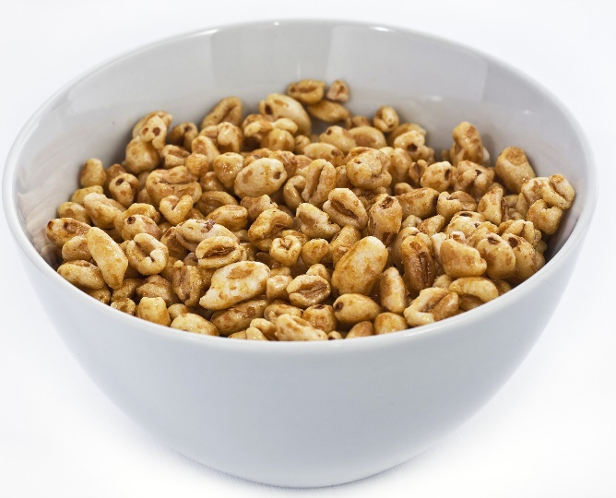
Different Challenges
Eating – They usually want to feed themselves,
so use finger foods
Notes:
Page 18
Talk about the proper size so toddlers don’t choke
Watching how much food is in their mouth
Making sure they are seated at all times eating

Slide 17
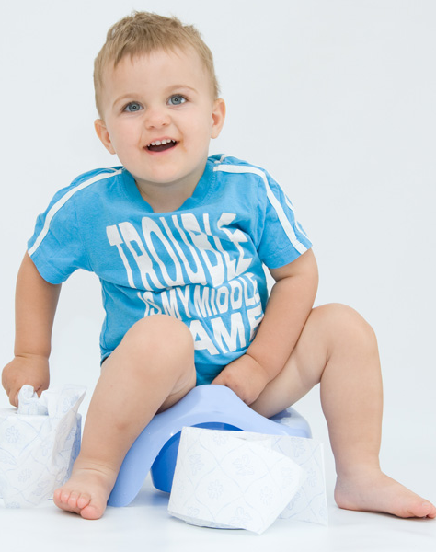

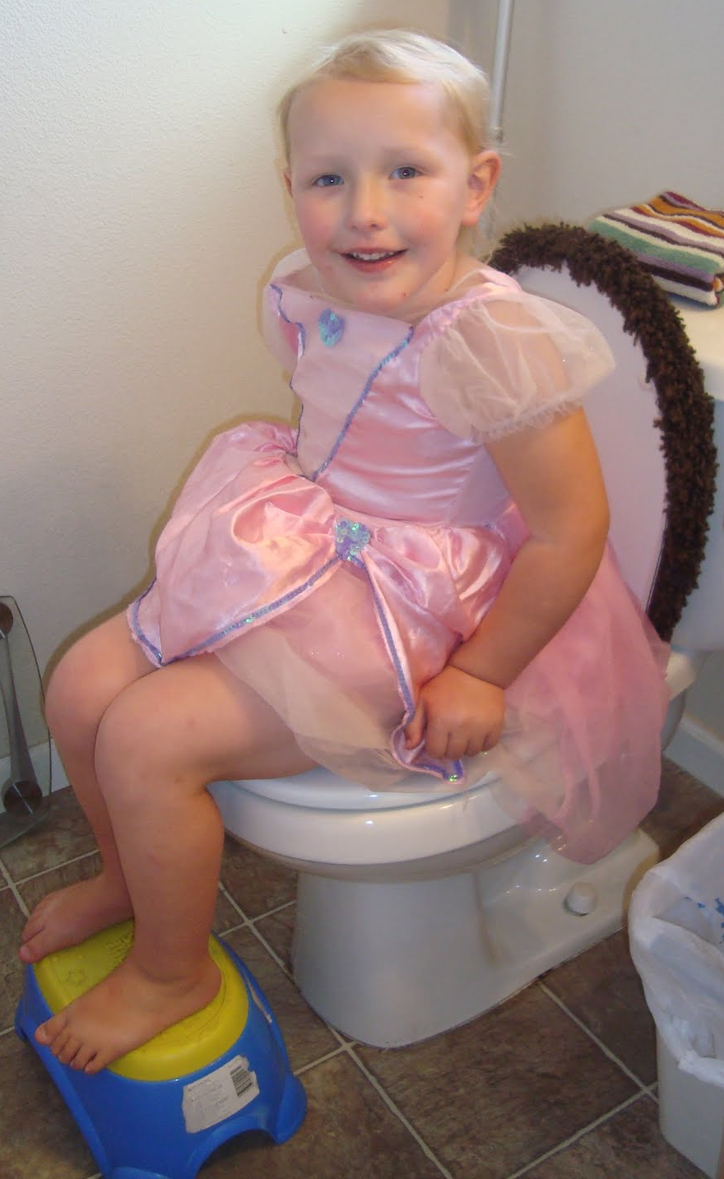
Changing diapers or washroom routines
Notes:
Page 18
Toddlers are very strong and difficult if they don’t want to be changed, turning and grabbing at things
Discuss impatient and stubborn toddlers and to use the parents method to be successful
Babysitter need patience for both

Slide 18


Clothes – They usually want to dress
themselves in what they want
to wear
Notes:
Page 19
Don’t worry what child is wearing as long as it is appropriate for the weather

Slide 19
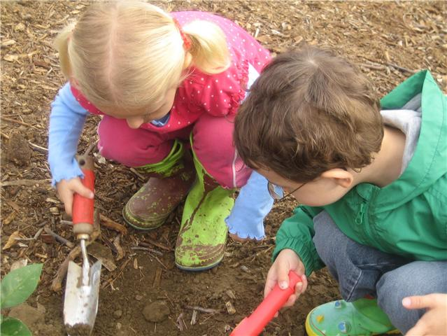
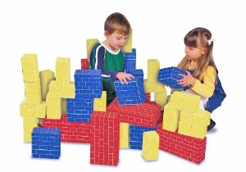
Play Time
At this age they may still play with baby items but there are lots of new adventures waiting for them

Slide 20

Behaviour Issues
Be patient
Don’t let them hurt themselves
When they let, you console them
What else can you do to help the toddler?
Notes:
Page 19
Discuss different methods of distracting them
Make sure they don’t hold the child down
Move anything the child may kick or hit
Always talk in soft voice
Never shake a child

Slide 21

Preschoolers
Ages of 4-6 years old
They can:
Dress themselves
Feed themselves
Read themselves (may require some help)
Notes:
Chapter 4 page 20

Slide 22
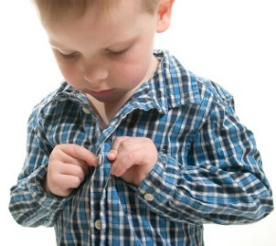
Expectations
Toddler will feed themselves
You still have to prepare food
Toddler will dress themselves
You may have to help with buttons
Can you think of any other things you may have to help with?
Notes:
Page 20
Giving toddler lots of time to eat
Ask parents what the child is to eat in front of parents
Must be seated and supervised at all times
Giving toddler lots of time to dress
Winter clothing challenges
Sunscreen they can do their legs or arms sitter must redo and do the toddlers face
insect repellant must be done by babysitter
Talk about stubbornness

Slide 23

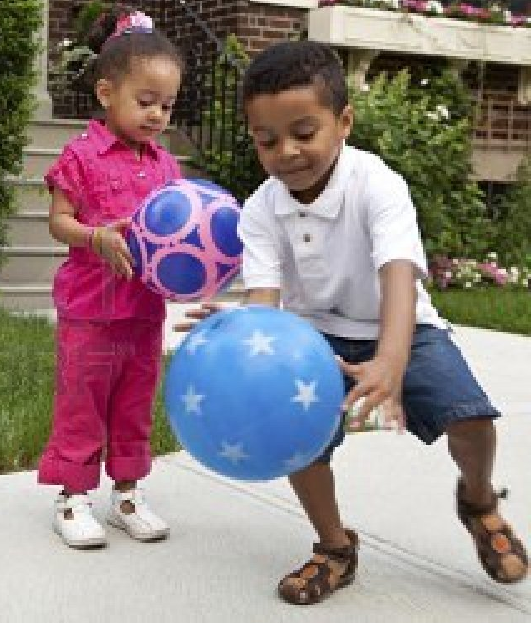

Play Time
Preschoolers are social
Like to be in charge
Often don’t think of
the safety of activities
Notes:
Socializing with preschoolers friends not sitters friends
Preschoolers can run fast so always watch and stay close by them
Let them make the rules up and be in charge of the game if you can

Slide 24
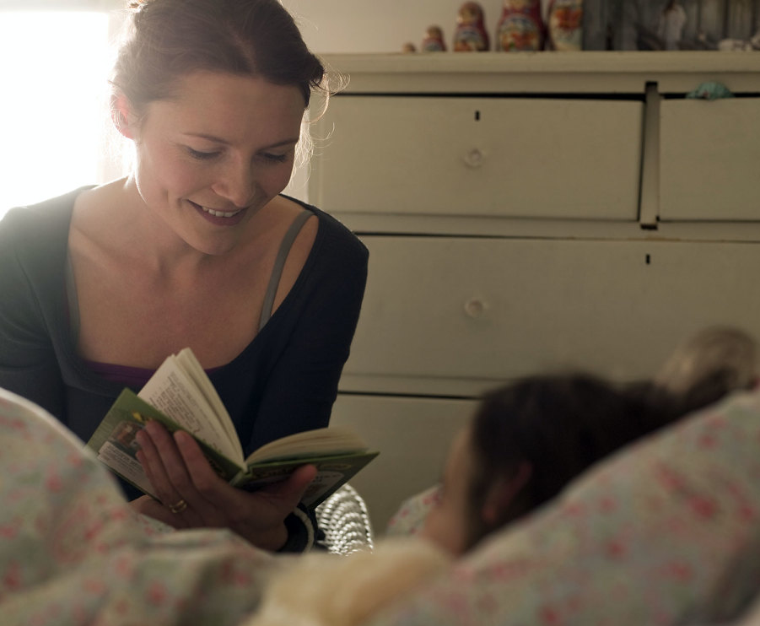
Independent State
May be strong willed
Using washroom with no help
Never let child lock the door
May not want to take naps
Will become over tired
May not want to go to bed
Needs plenty of sleep to grow and stay healthy
Notes:
Page 23
Use same methods as parents… count to 3…magic 123 etc.
Respect child's privacy in bathroom
If having a bowel movement may be a long time and need help cleaning up
Never allow child to lock you out of bathroom
Before naps and bedtime quiet activities like reading singing calm the child down

Slide 25

First Aid
Always play safe
If an accident happens:
Provide first aid?
Call parents?
Call 911?
Notes:
Chapter 5 Page 25
Talk about when to call parents or 911
Always call 911 first
What happens when you call 911

Slide 26

Emergency
Look, Talk, Call, ABC
Look to see what happen or any hazards
Talk to the child and tap their shoulders if they don’t wake up
Call 911
Notes:
Page 29 do a quick
Look Talk Call

Slide 27
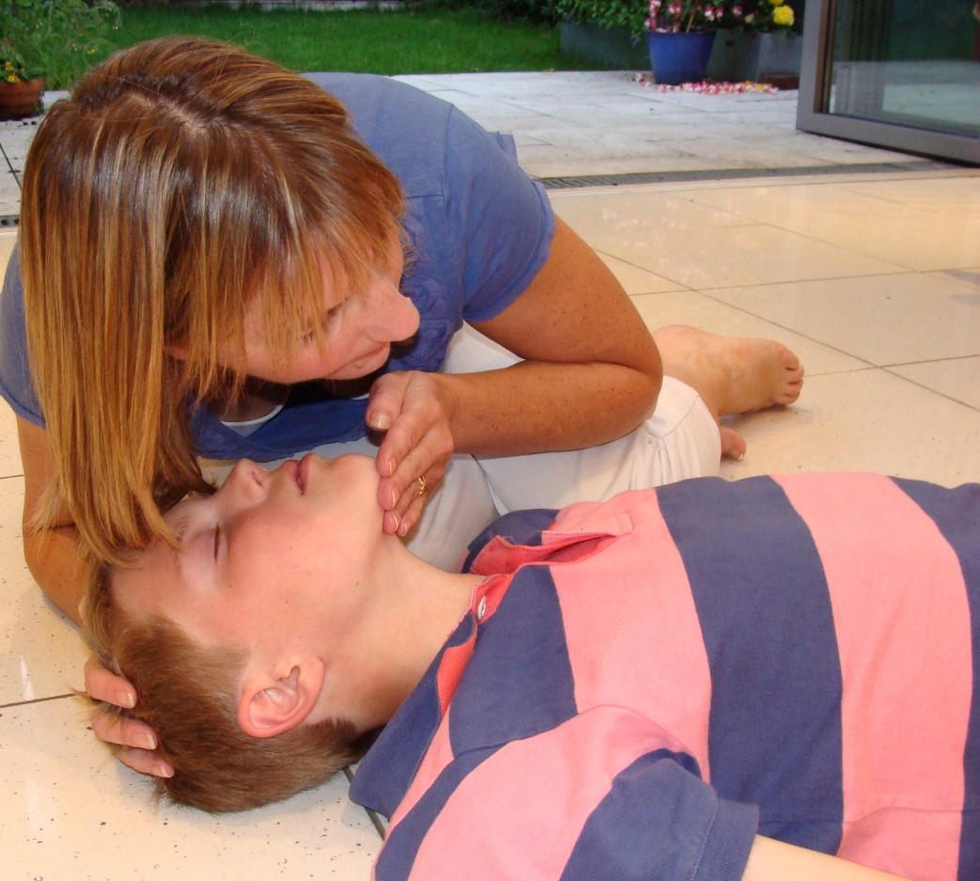
Emergency
If not awake:
Airway Open their airway
Head tilt chin lift
Breathing check for
5-10 sec
Bleeds check for big bleeds
Put onto their side (recovery)
The 911 dispatcher will help you with each step
Notes:
Page 29
Now do the ABC
Put the sequence together Look talk call ABC
Remind them of pay phones and no $ needed to call 911

Slide 28
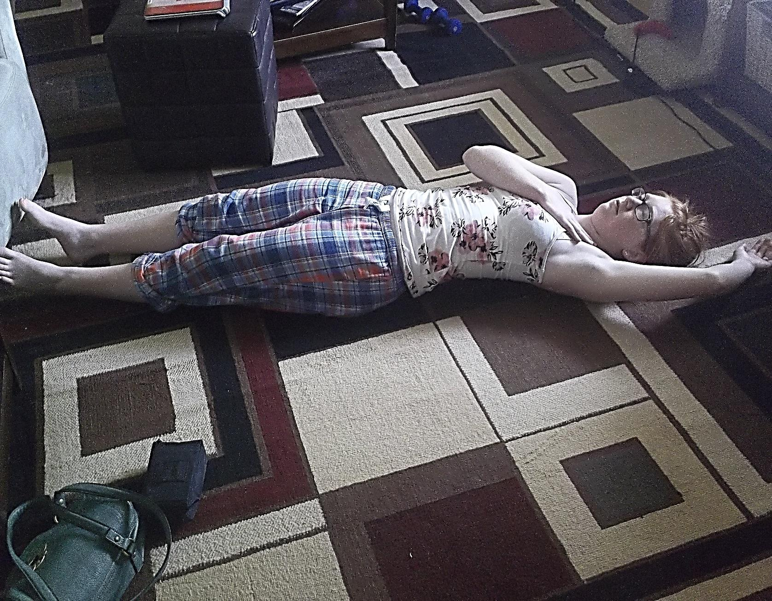

Recovery position

Slide 29
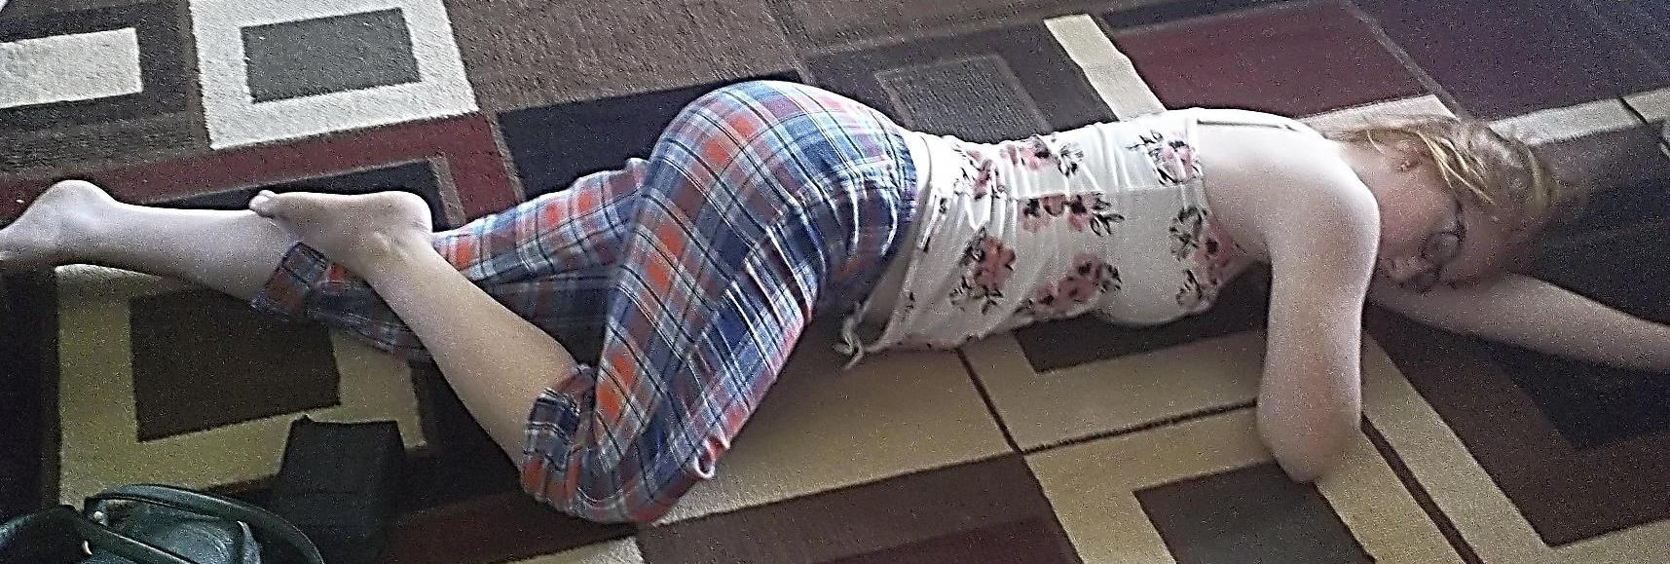
Recovery Position
Always roll towards you

Slide 30

Choking
Prevent chokings by:
Cutting food into small bites
Sit while eating
Eat slowly
Mild Choking: Child can cough, talk or breath
Encourage the child to cough and stay calm
Notes:
Page 28
Talk about foods that need more chewing
No playing at table that may encourage laughing
Hands on
Pair students and have one encourage the other to keep caughing

Slide 31
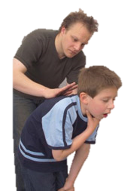
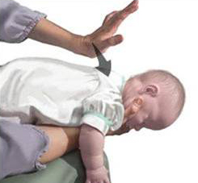
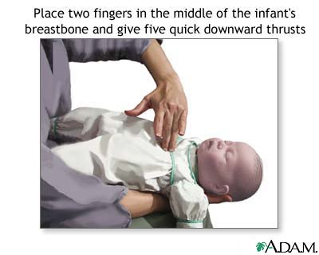
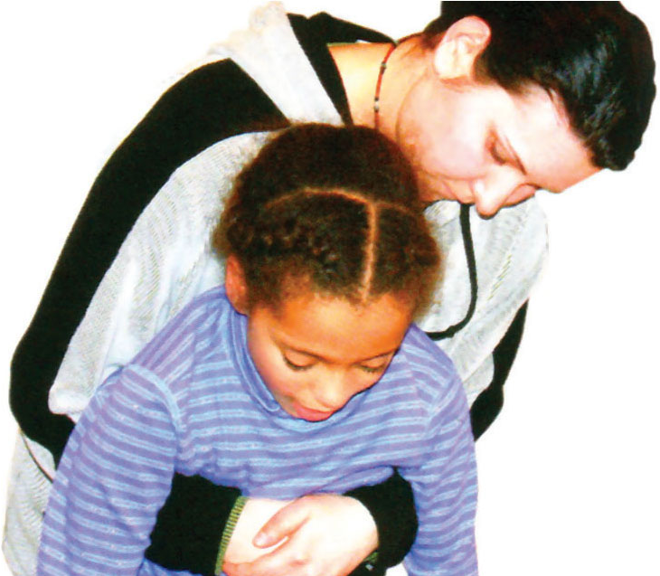
Choking
Severe Choking: Unable to cough, talk or cry, whizzes or blue lips
Notes:
Discuss and then do
Hands on
Students pair using infant manikin
And then simulate on each other

Slide 32

Bleeds
Direct Pressure
Use a clean cloth or rag
Rest
Have the child sit down or lay down
Notes:
Page 30
Talk about things you can grab at the house to stop bleed

Slide 33
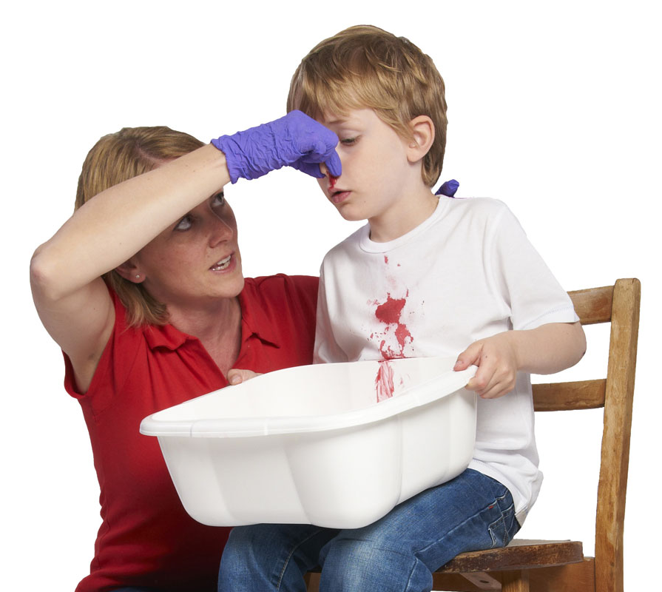
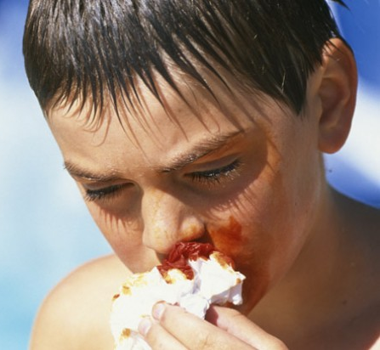
Bleeding
Notes:
Page 30
Discuss
Nose bleed when to call parent
Knocked out tooth (not already loss) call parents

Slide 34

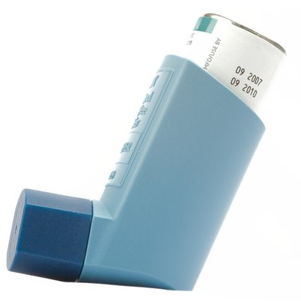

Illnesses
Asthma
Keep medications close
Seizures
Call 911, keep safe and watch
Poisoning
Call 911, follow their directions
Notes:
Page 30
Discuss Asthma
Triggers
Signs and symptoms
How to help with puffers
When to call 911 or parents
Seizures
Signs and symptoms and that its scary to see
Don’t hold them down nothing in mouth
Call 911 and follow instructions
Poisons
Call 911 keep substance off to the side
No vomiting or milk

Slide 35
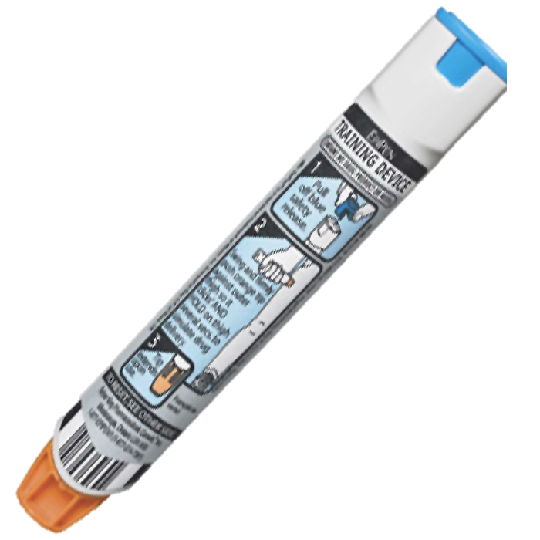
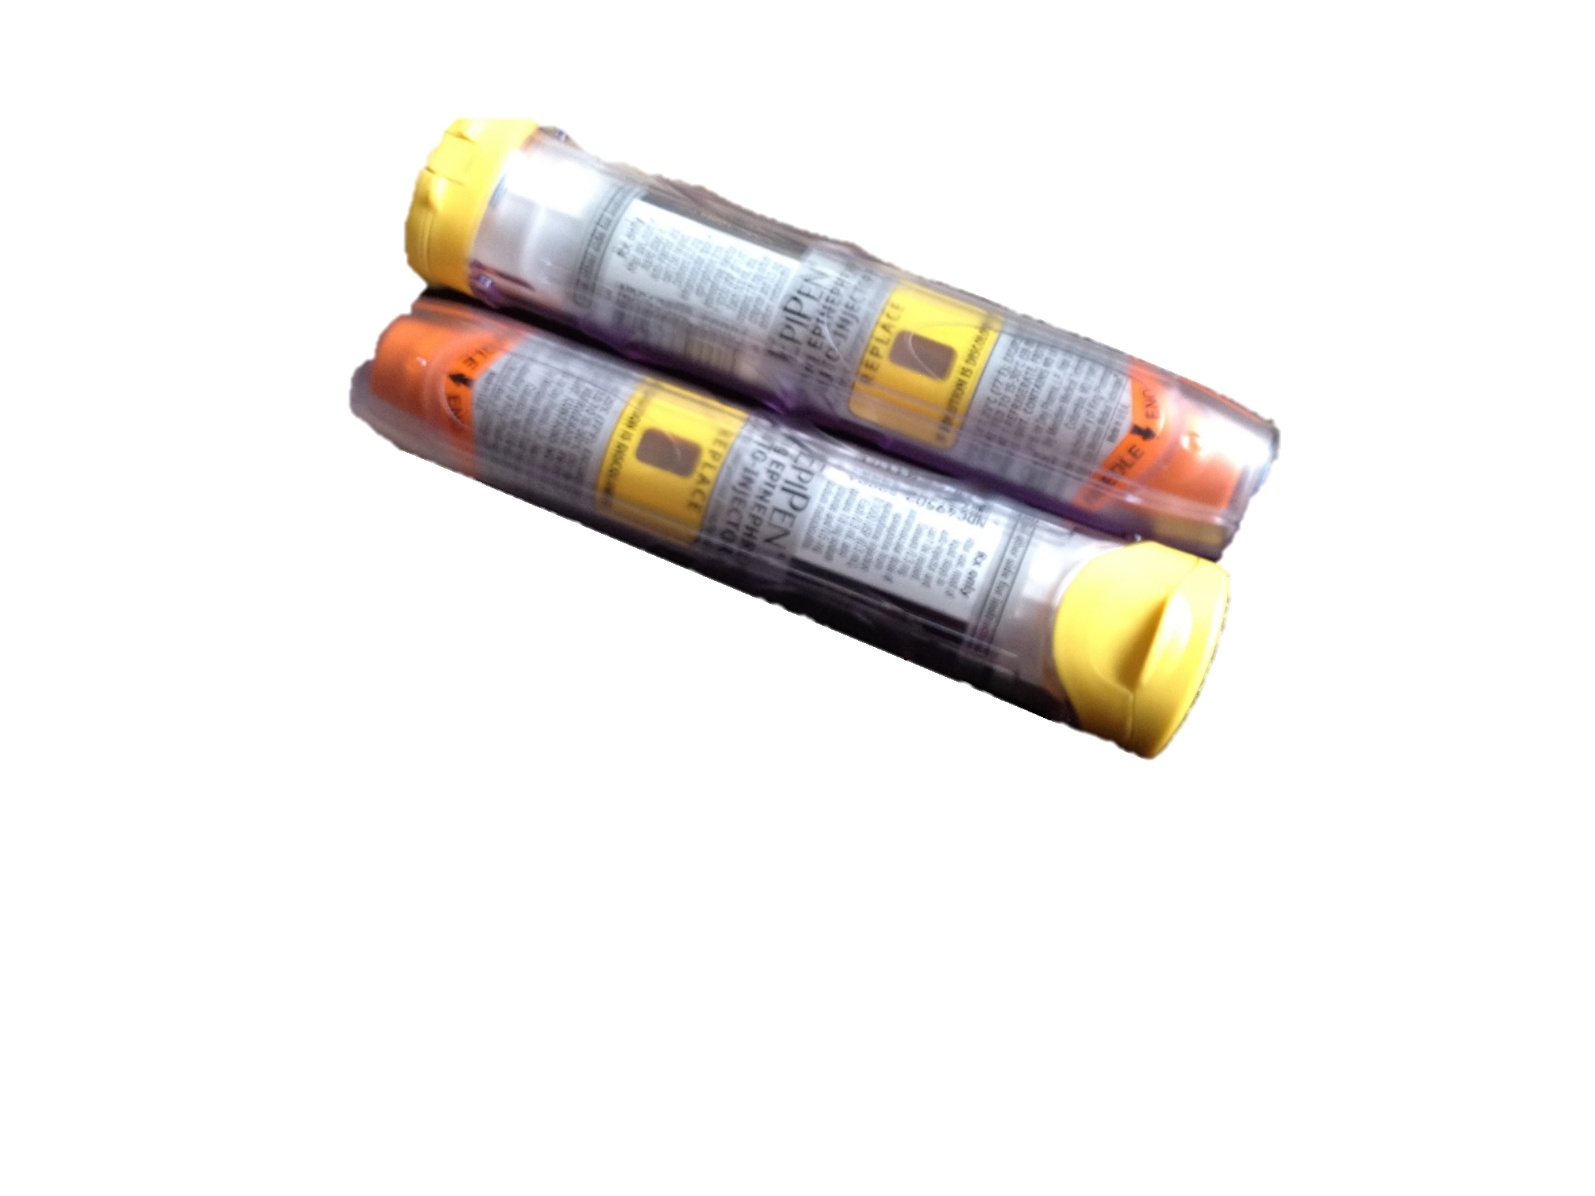
Severe Allergic Reaction
Be aware of all allergies
Always keep EpiPen close
If pen used always call 911
Notes:
Page 31
Discuss common allergies
Nuts dairies shellfish
Signs and symptoms
Use of EpiPen
If you have a trainer pass it around

Slide 36

Burns
Prevent burns by:
Never cooking with loose cloths
Stay away from open flames
If the child gets burned:
Cool under cool water until burning stops
If blisters appear do not break them
Notes:
Page 32
Discuss things that might burn sun, hot food or drinks
Not to remove clothing if stuck
No creams
Call 911 If:
Fire
Burns to face hands feet genital areas

Slide 37
Safety Always
Never let friends or strangers in the house
If you answer their phone or on the internet, never tell anyone the parents are out of the house
Know the fire escape route
Always use safety equipment provided (straps, helmets)
Have Fun!
Notes:
Page 32
Discuss other things that may come up
Swimming
Walking dogs
Bike riding

Slide 38




Questions?
Quiz
Answers
Certificates
Home time

