Slide 1

Home Alone Program
Life’s Emergency Training 2016

Slide 2

Agenda
Am I ready?
Top 10 Rules
Stranger Danger
Safety on computer and phone
Kitchen Safety
First Aid Basics
Quiz
Certificates

Slide 3





House Keeping
Notes:
Review
Course times
Lunch time and where they can eat
How many breaks
washroom location
Cell phone use

Slide 4


Am I Ready to stay home alone?
Here are some questions to think about:
Do I want to stay home alone? For how long?
Do I have younger brothers or sisters to watch?
What do I do if I get hurt or sick?
Can I use the computer?
Can I go to my friends house or have them over?

Slide 5


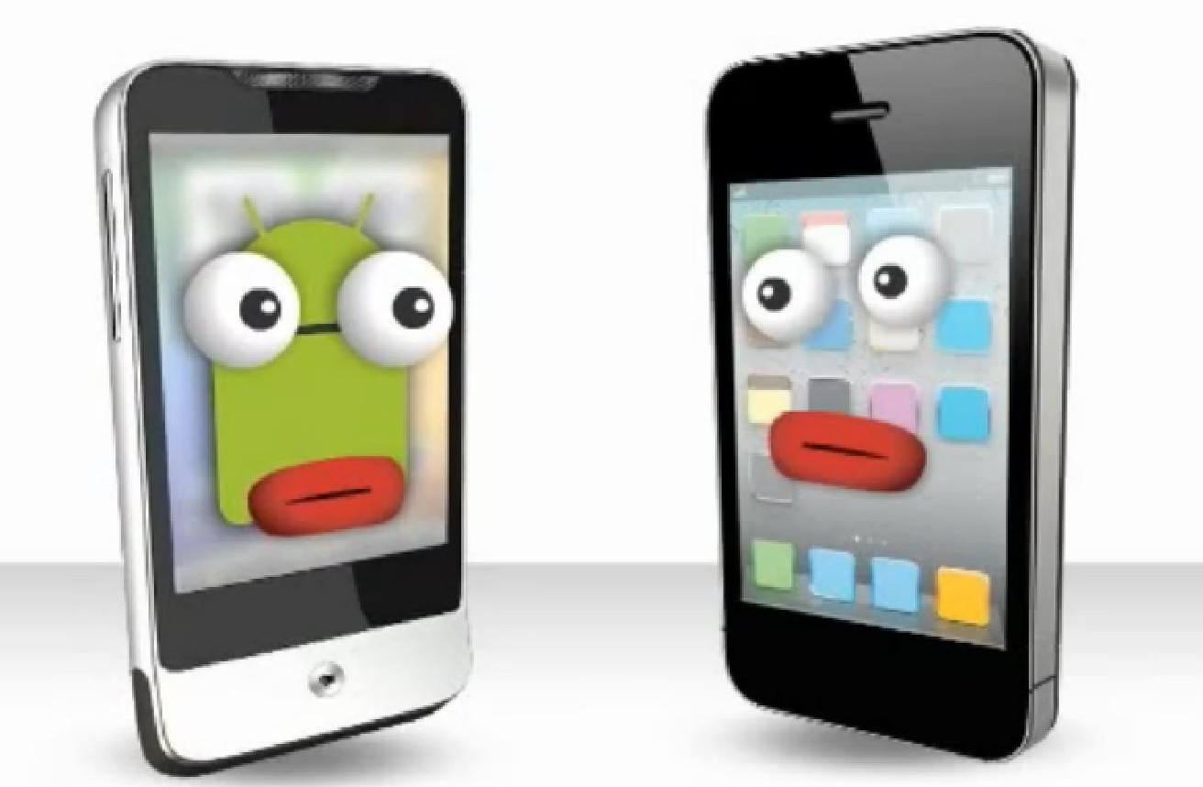

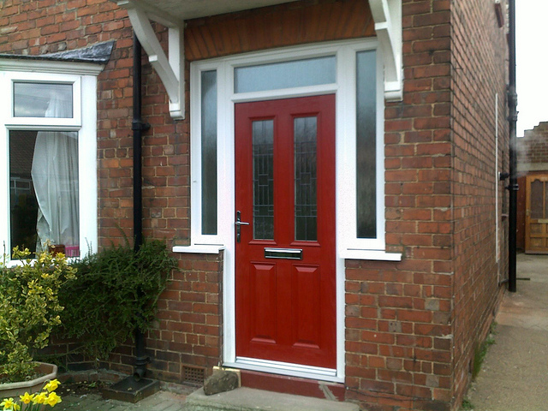
Top 10 Safety Rules
What’s the 10th safety rule?
Notes:
Page 5
Review rules

Slide 6
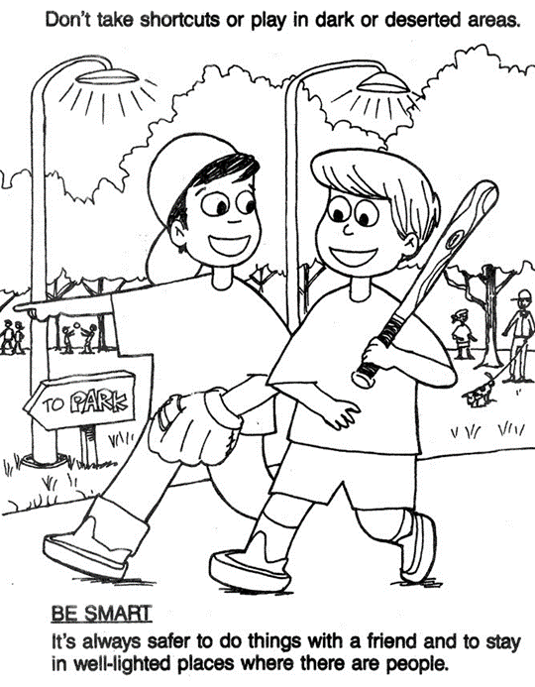
Be Smart Don’t take shortcuts or play in dark or deserted areas

Slide 7

Break

Slide 8
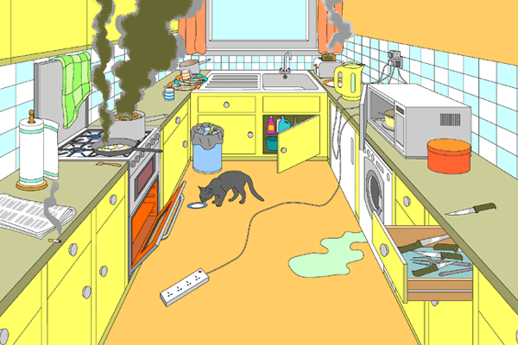
Kitchen Safety
How many safety issues can you find?
Notes:
Do as a group
Then have the students do their own on page 9

Slide 9
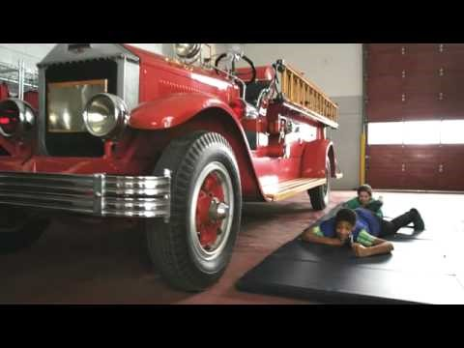
Video
Notes:
11 minute video from Brampton fire

Slide 10
Snacking
Notes:
Review recipes
Ants on a log
Fruit kabobs
Strawberry Tea Sandwiches
Discuss one that students have
Add any you may use

Slide 11


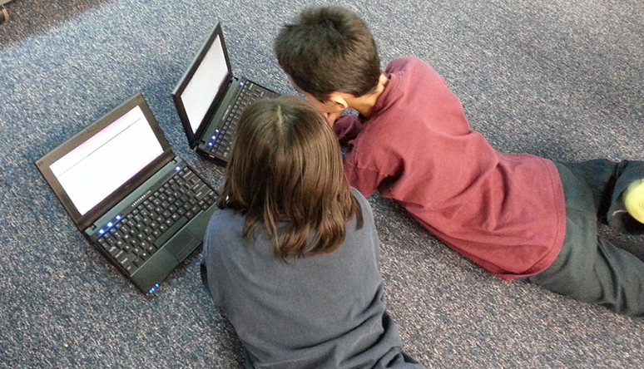
Computer Safety
Notes:
Safety Rules
Discuss rules that students have written down
Bullying is not okay
Posting pictures of other people is not okay if they don’t give you permission
Always talk to an adult if you are having problems online

Slide 12
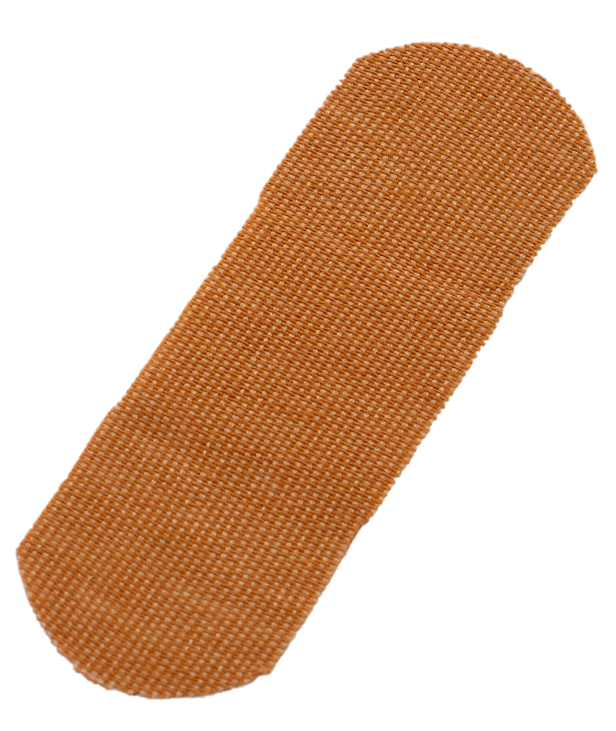
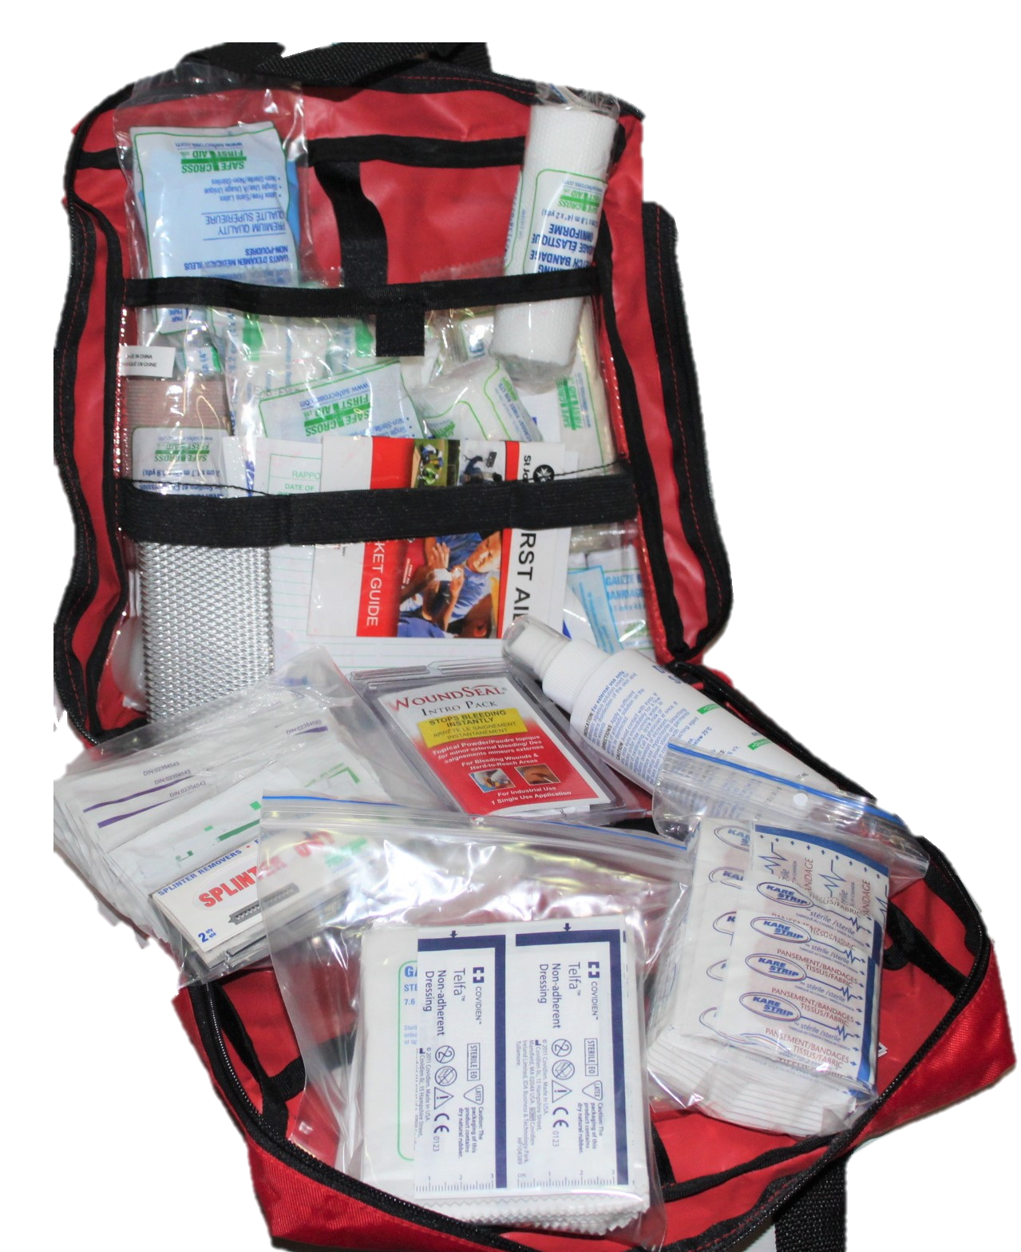
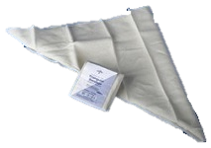
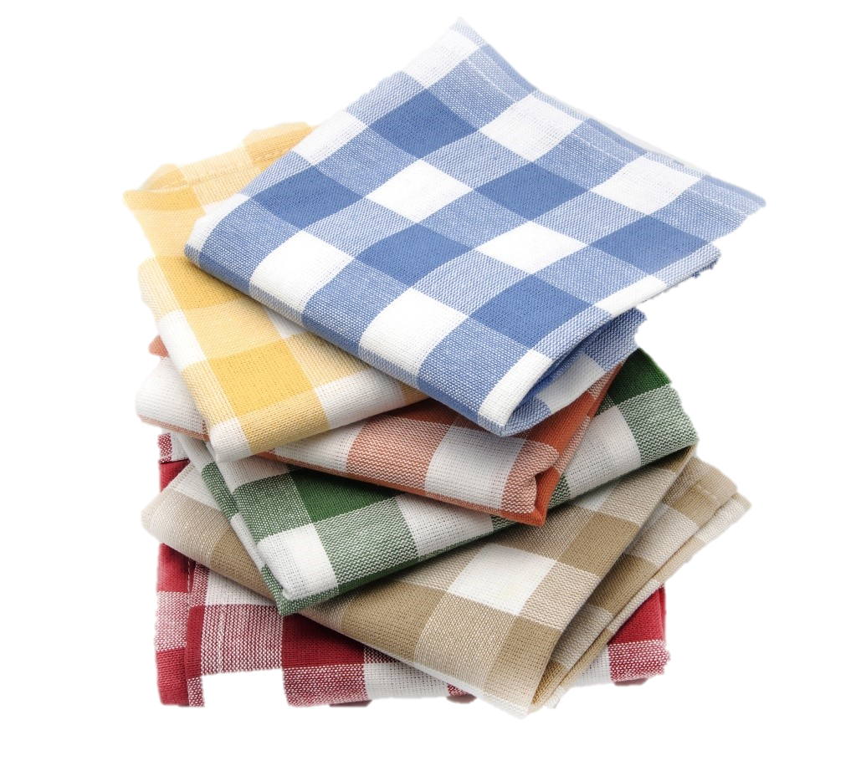
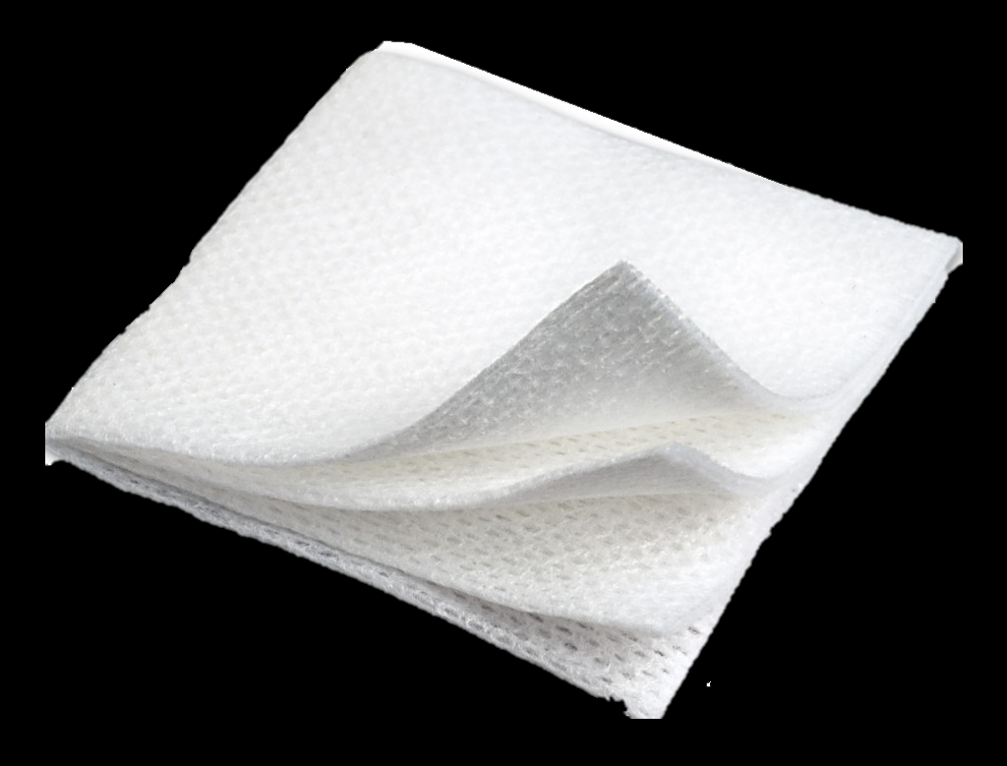
First Aid
Notes:
Ask what other items can be used from your home?
Face cloth
Scarfs
Cloths

Slide 13
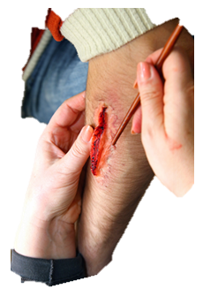
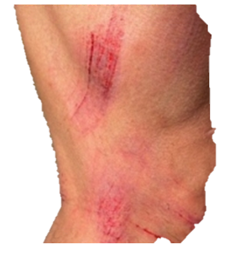
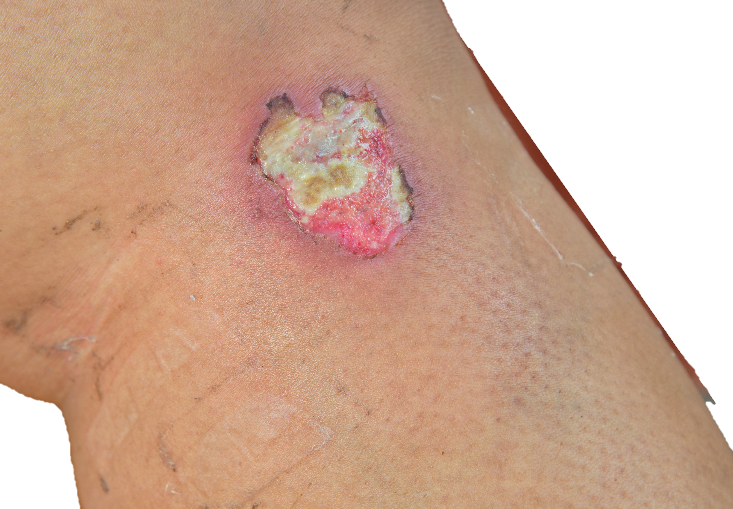
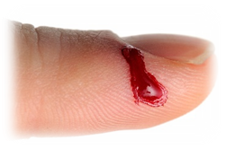
Minor Wounds
Brush any dirt away
Gently wash with soap and water
Antibiotic creme if available
Watch for signs of infection like:
Pus or discharge
Heat
Sore
Notes:
Have water rinse down or away from your body
Water temperature warm or cool
If allowed to use antibiotic crème never put crème on wound only on dressing

Slide 14
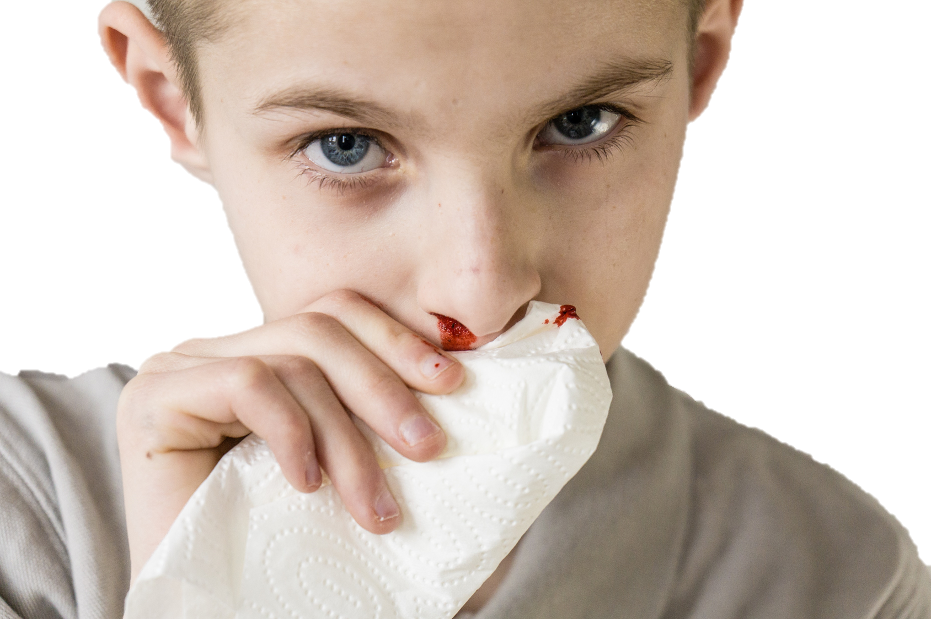
Nose Bleeds
Sit down
Lean forward
Pinch nose
Spit out blood in mouth
Notes:
Do Not out anything up you nose
Pinch for 5 – 10 mins
Don’t peak to see if its stopped yet
When stopped don't pick blow or inhale hard
If you cant stop the bleed call your parents

Slide 15
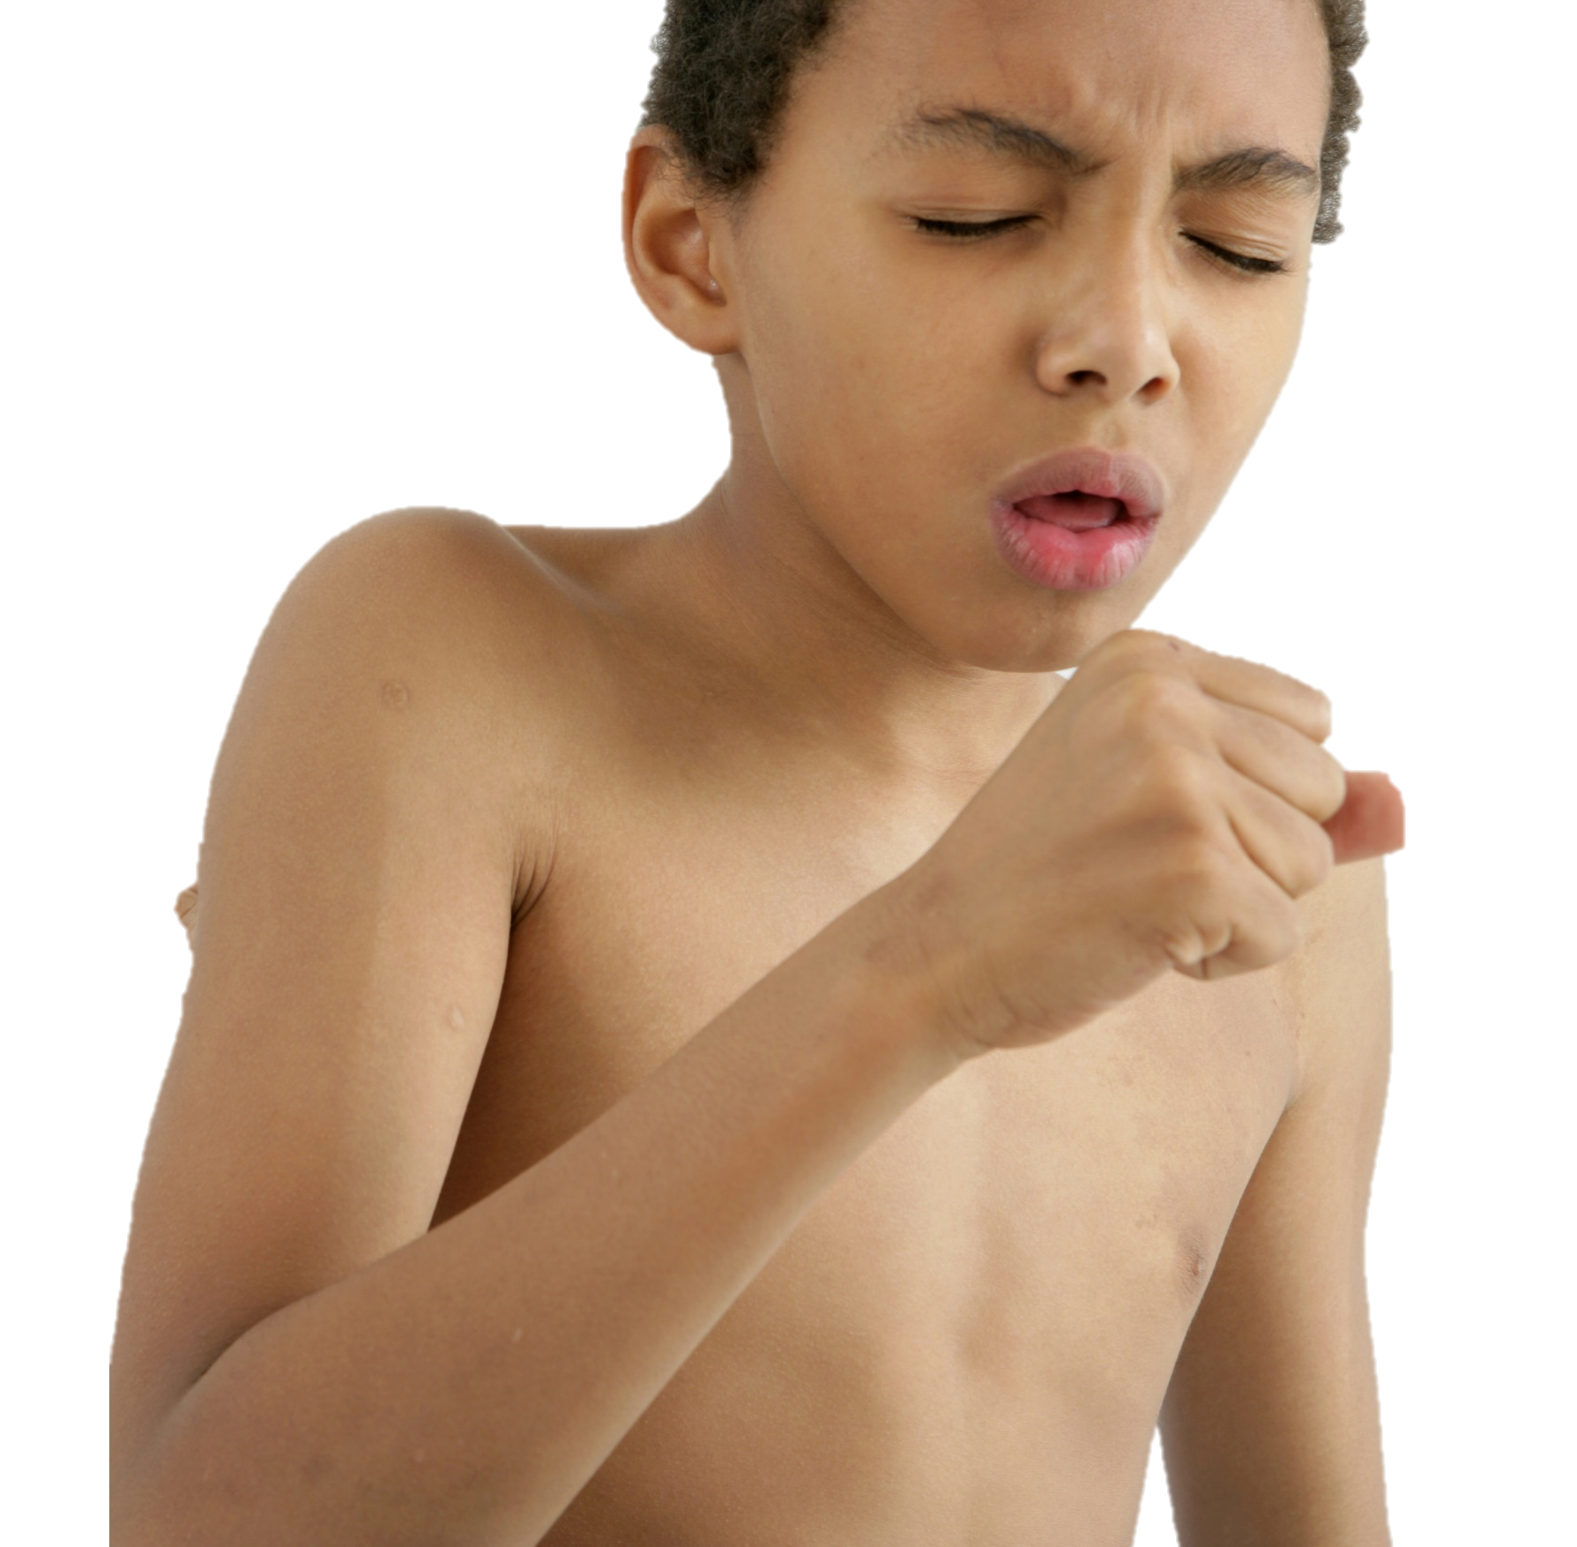
Choking - Mild
Mild Choking - You can cough and talk
Keep coughing until the item comes up
Do NOT try to drink or eat anything
Notes:
Prevention is important

Slide 16


Choking - Severe
Severe Choking
You CAN NOT cough or breath
When you are Alone
Notes:
You can also use the edge of a
Table
Counter

Slide 17
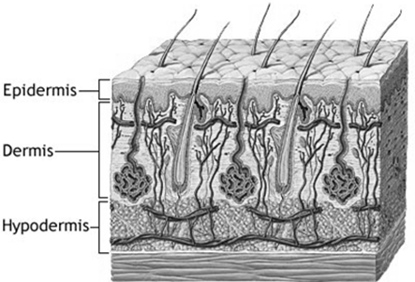
Burns
1st Degree - Superficial | 2nd Degree - Partial Thickness | 3rd Degree - Full Thickness
Epidermis | Epidermis & Dermis | Epidermis, Dermis, muscle, fat & nerves
Red, painful, hot, | Red, painful, hot & blisters | Black & charred Or gray & waxy not painful
Notes:
1ST DEGREE: Top layer of skin injured. Red painful, hot, skin may feel tight
2ND DEGREE: Top 2 layers of skin injured (epidermis and dermis) Red, painful, hot, blisters
3RD DEGREE: Top two layers of skin and underlying muscle, fat and nerve endings. Black and charred or gray and waxy. May not be painful as nerve endings destroyed
Get the students to fill out their chart on page 17

Slide 18
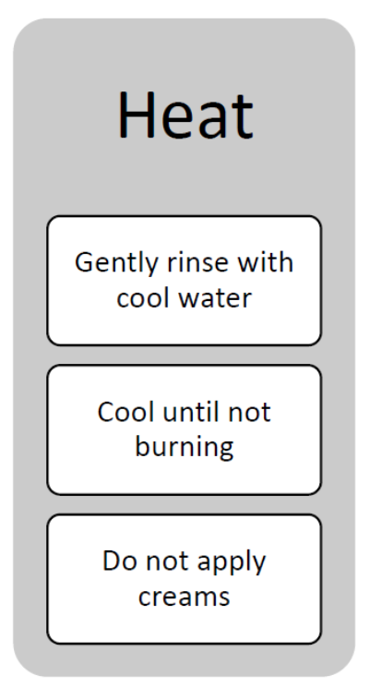
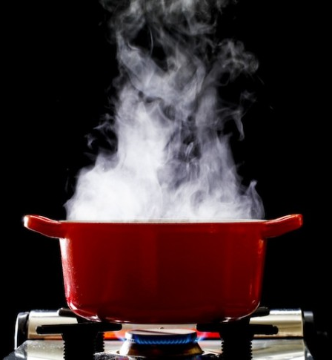
First Aid Treatment
Heat and Radiation Burns
1st and small 2nd degree burns use cool water
Large 2nd and 3rd light covering seek medical attention

Slide 19
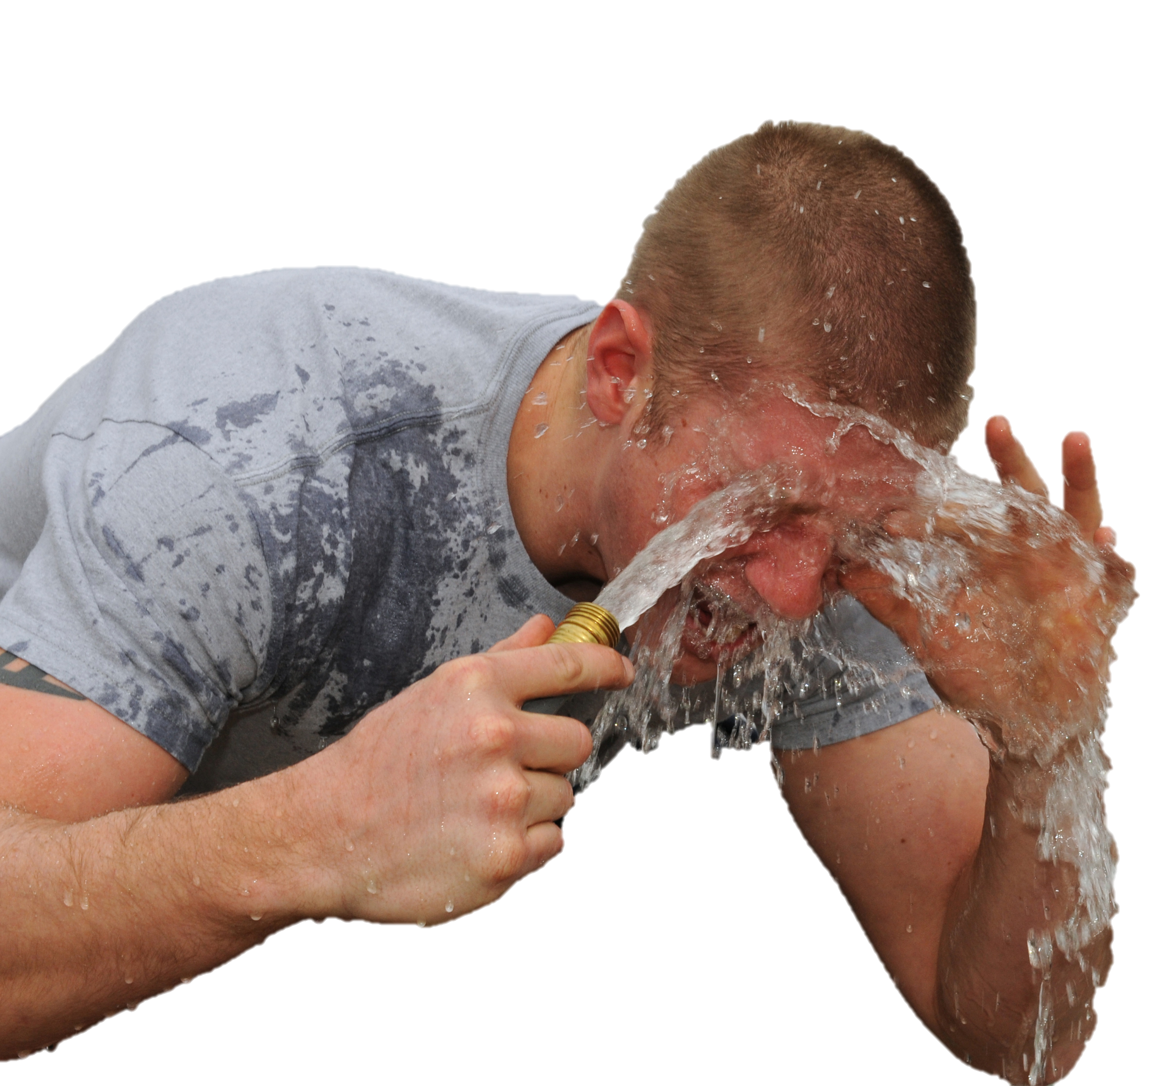
Burns
Chemical Burns
Remove excess (dry) chemicals and flush for 20 minutes with water
Wash away from your body
Go to the hospital with chemical bottle
Call 911 if any breathing problems
Notes:
Explain washing away from body to students

Slide 20
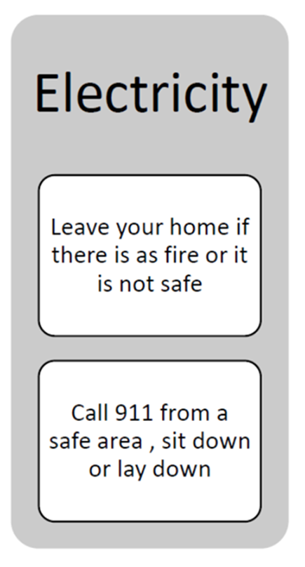
Burns
Electrical Burns
Ensure area is safe!
Cover entry and exit wounds
Look for secondary injuries
All electrical burns need to seek medical attention
Notes:
If the child can open their eyes call parents right away . I child cannot open their eyes call 911
Remind the child that 911 or the police will contact their parents

Slide 21
Word Search
Notes:
Have students complete search on page 19

Slide 22
When You Get Home
Remember when you get home
Do your Home Alone Test 2 with your parent
Sign your Real World Safety agreement with your parent

Slide 23

Home Time!
Please wait here for someone
to get you and sign out.

